Slide 1
Multilingual Storytimes: Partnerships with Community Organizations
Rick Medrano : Outreach Librarian
Christina Hernandez : Outreach Librarian

Slide 2
Background
Christina Hernandez
Outreach Librarian
Immigrant, Refugee, and International Communities
chernandez@highplains.us
Developed this partnership and coordinates the Multilingual Sorytimes offsite in community education centers, libraries, and schools.
Facilitates, preps, and delivers storytimes
Trains and builds relationships with library staff to host their own

Slide 3
Overview
Context
Multilingual Storytimes
HPLD
Structure
HIPPY
Organization
Partnership
Outreach
History
What next?
Who does what?
How we got here
What works?

Slide 4
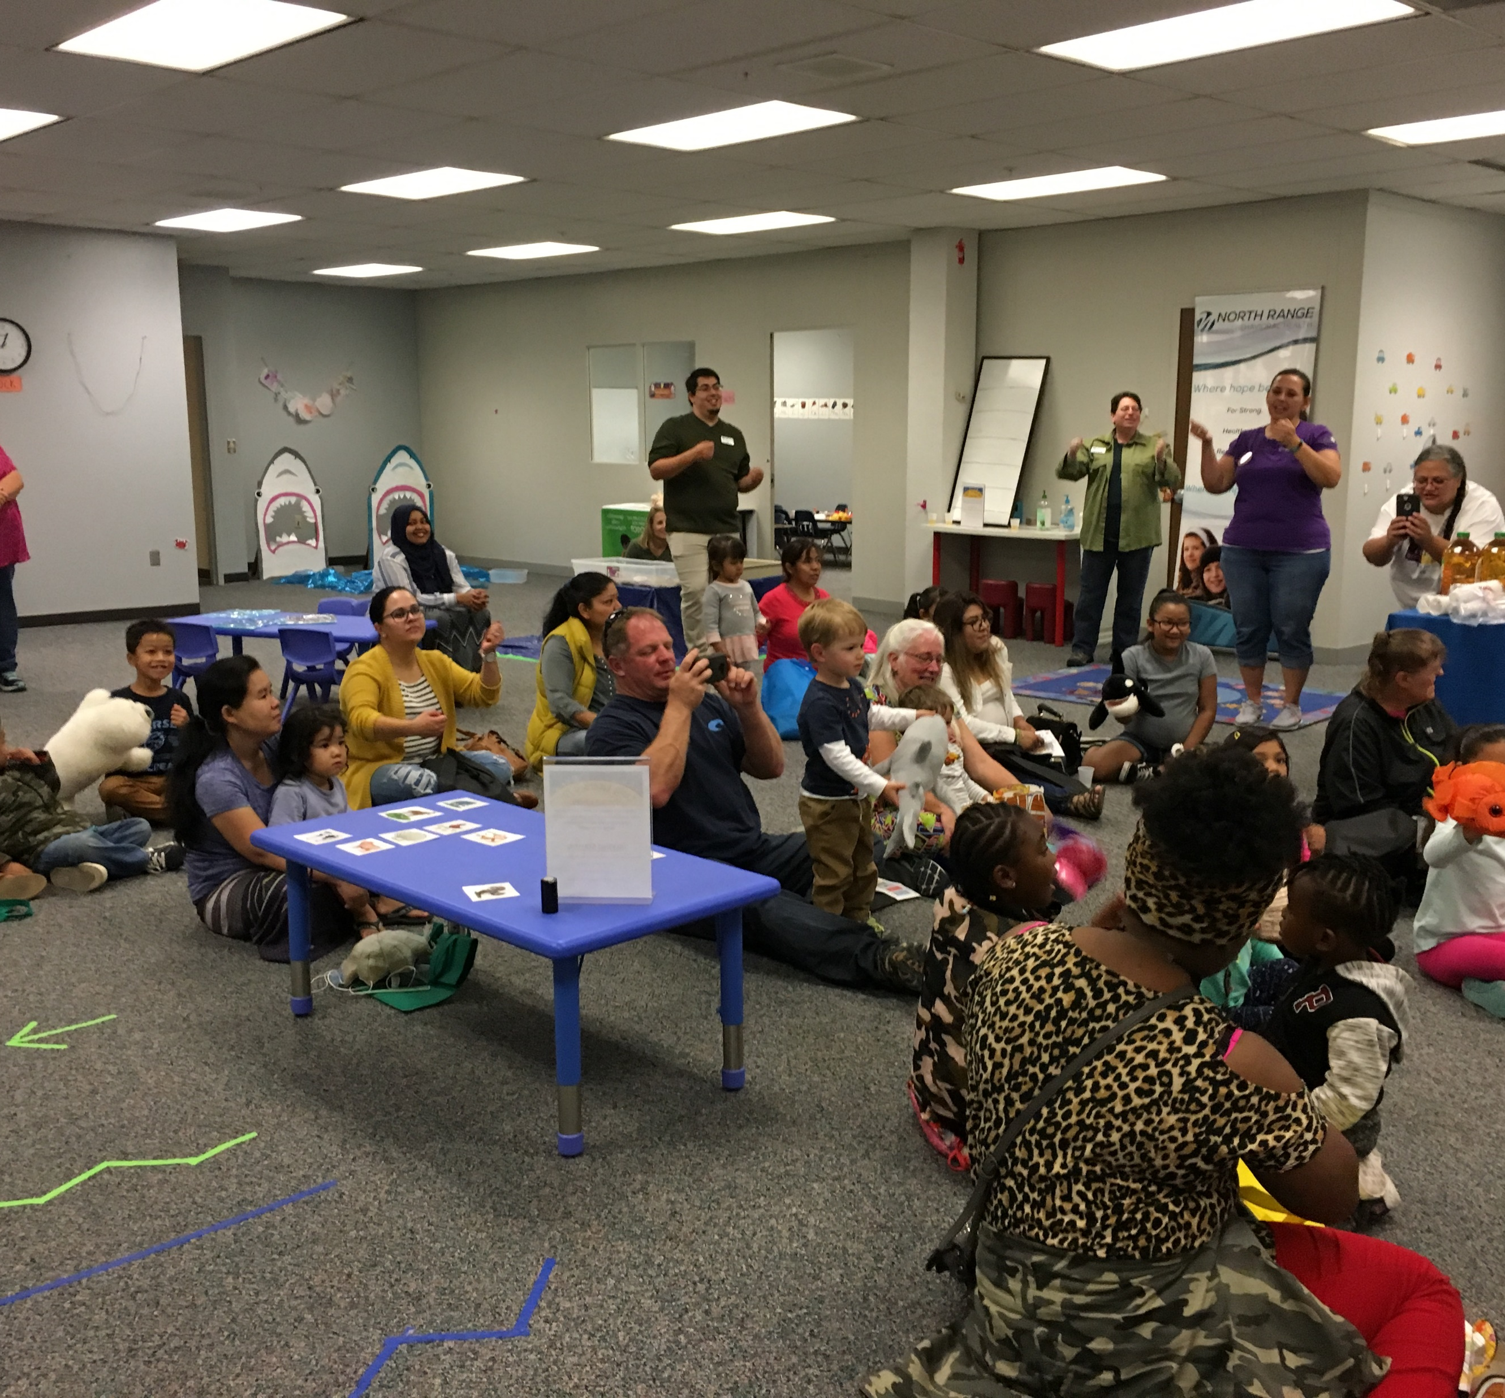
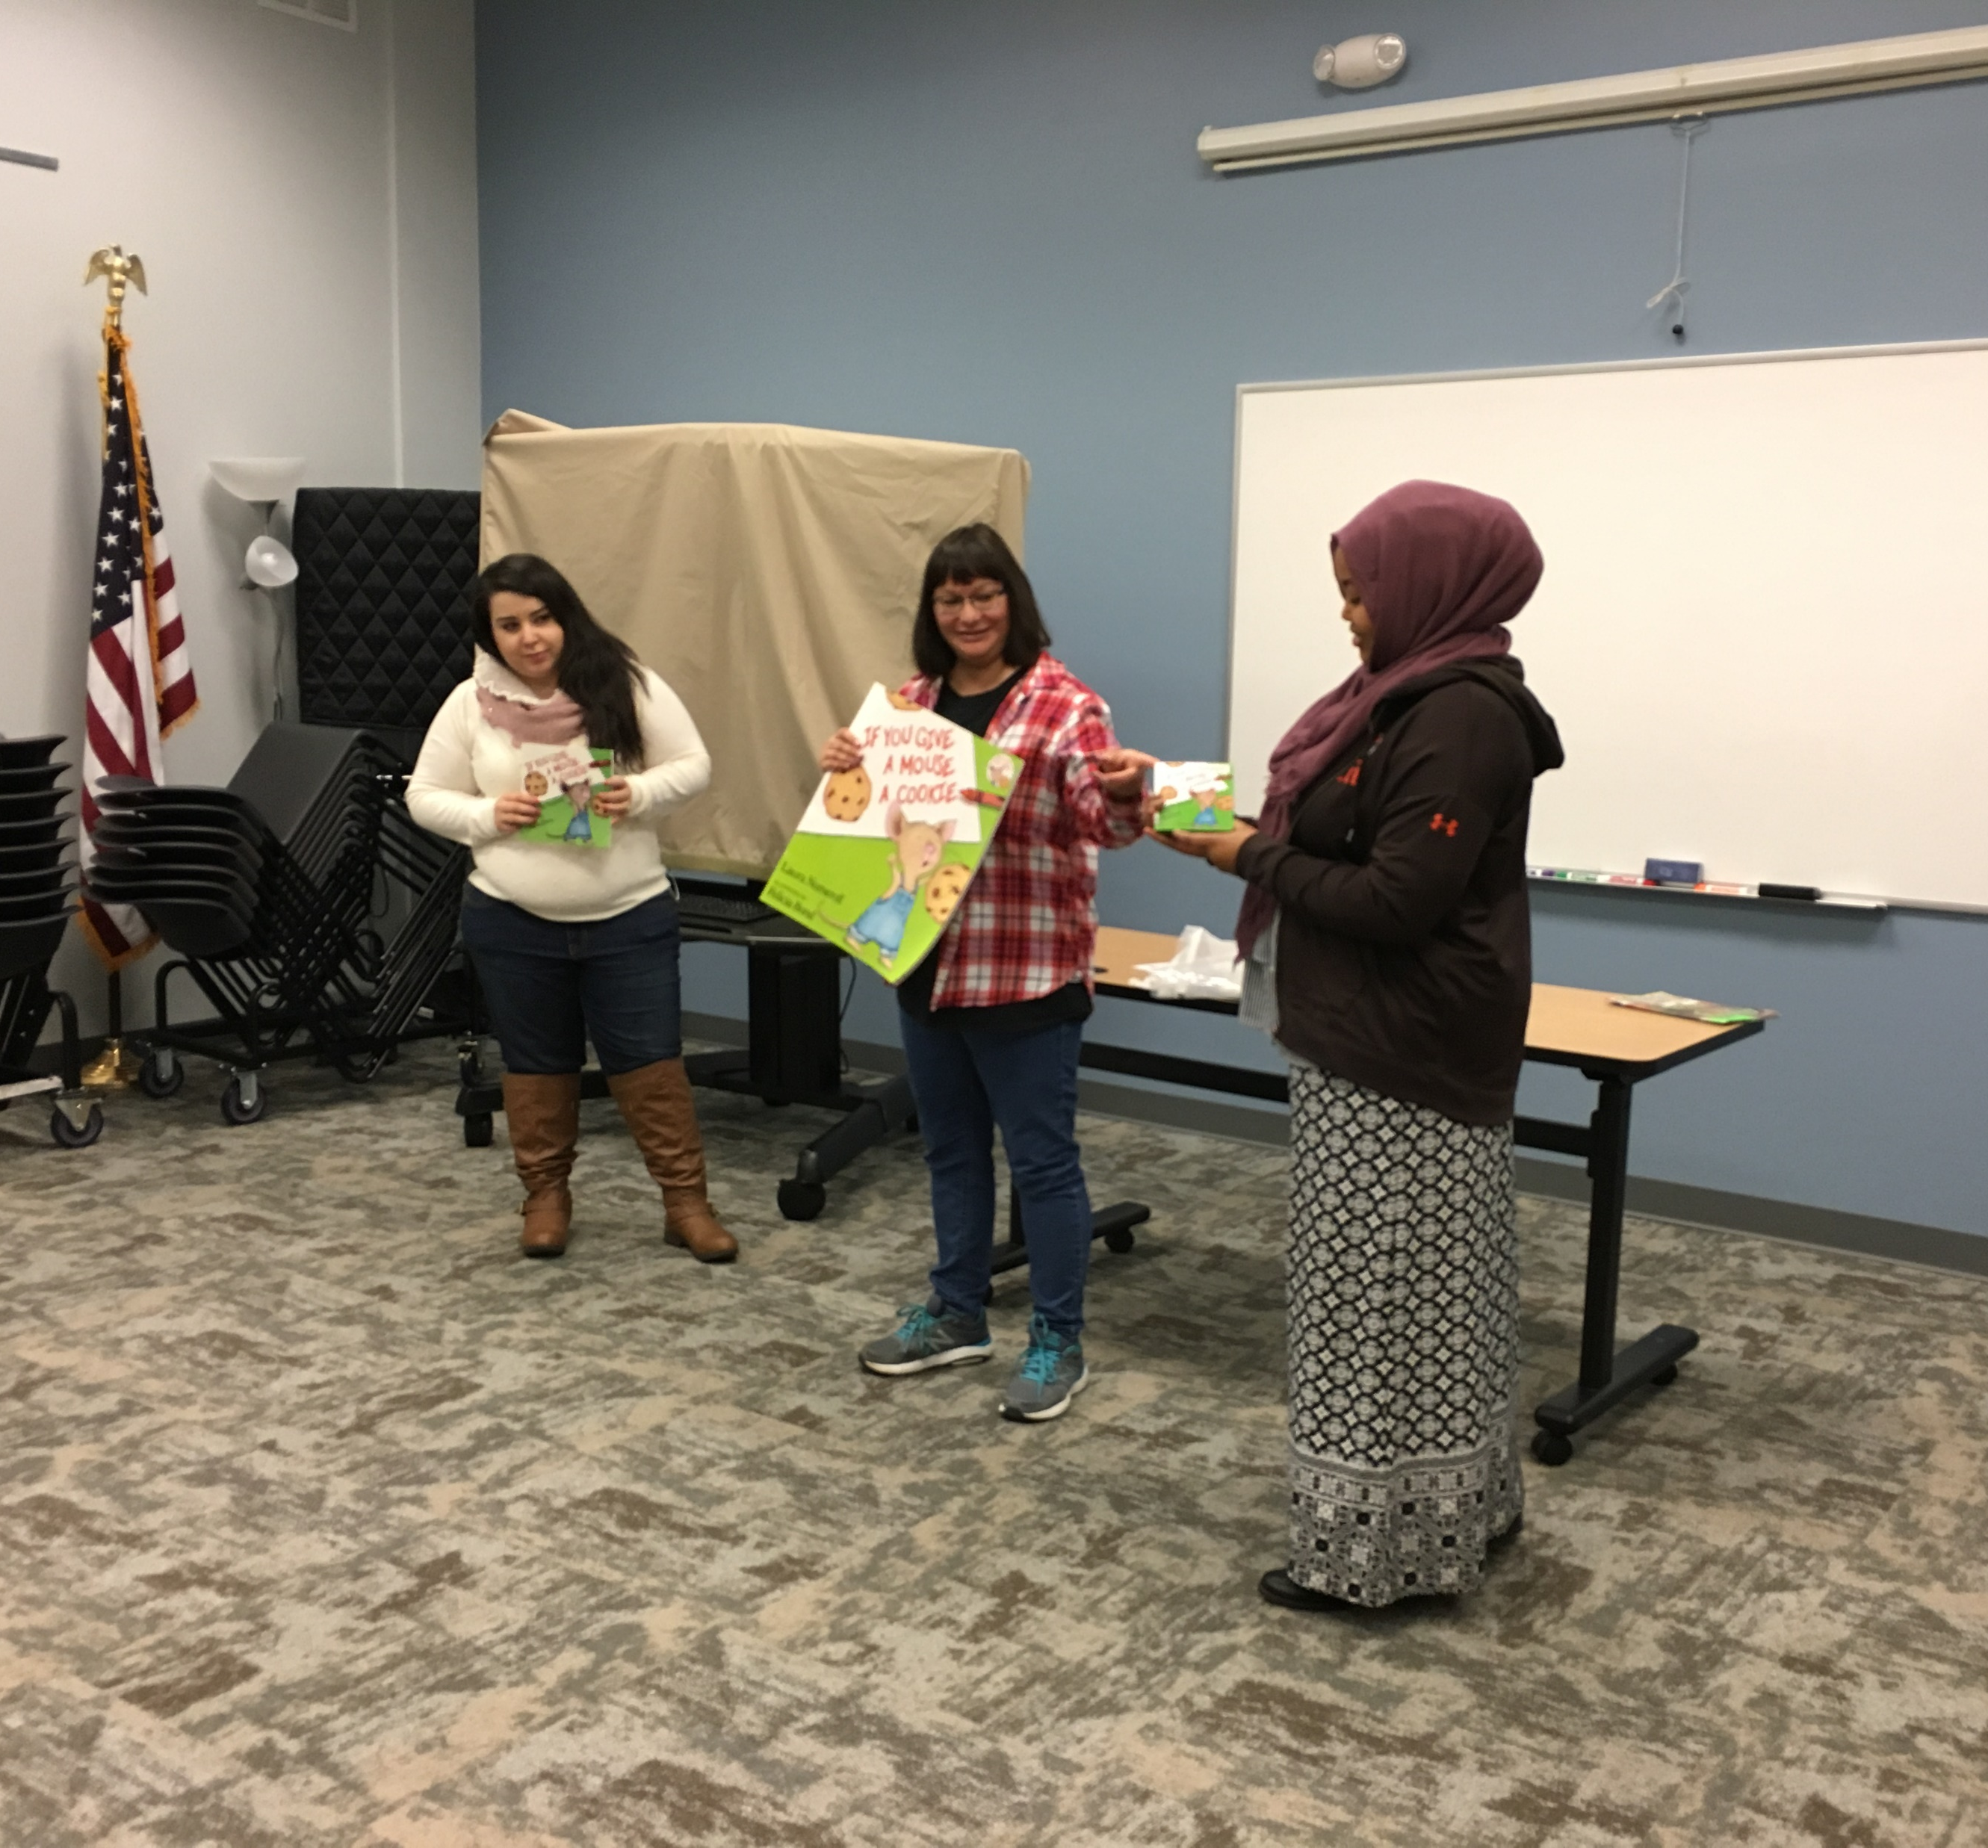
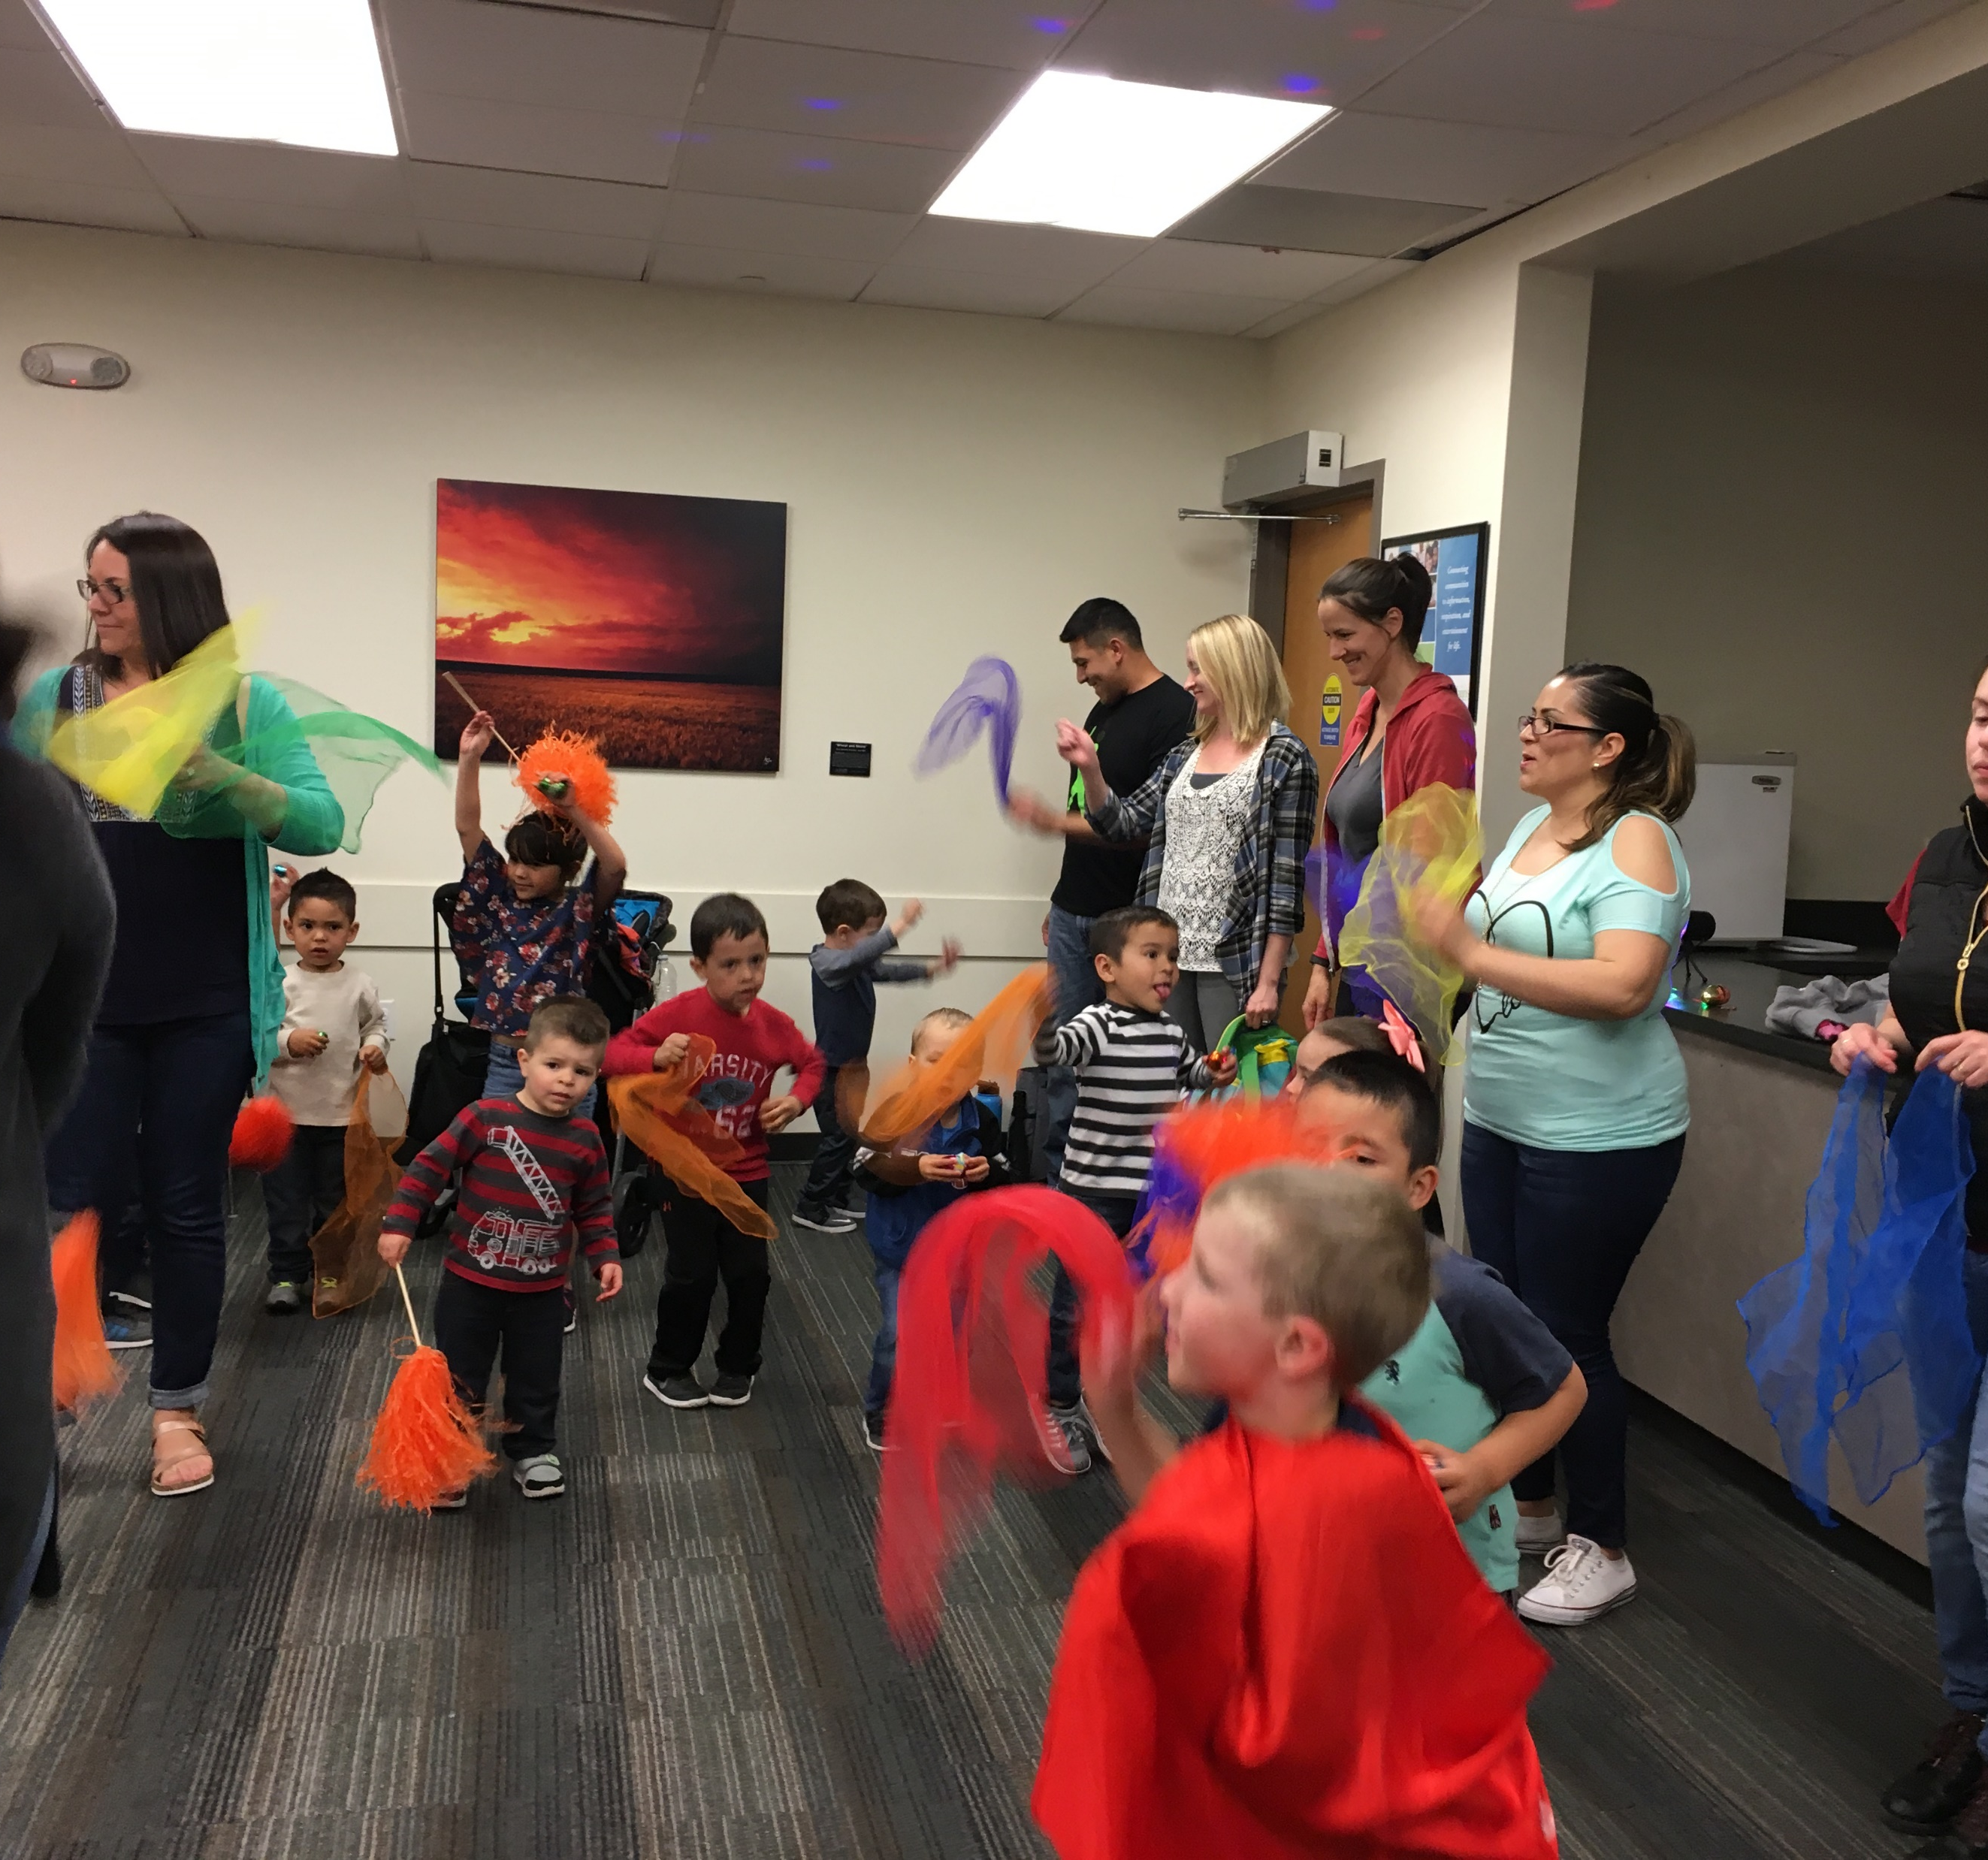
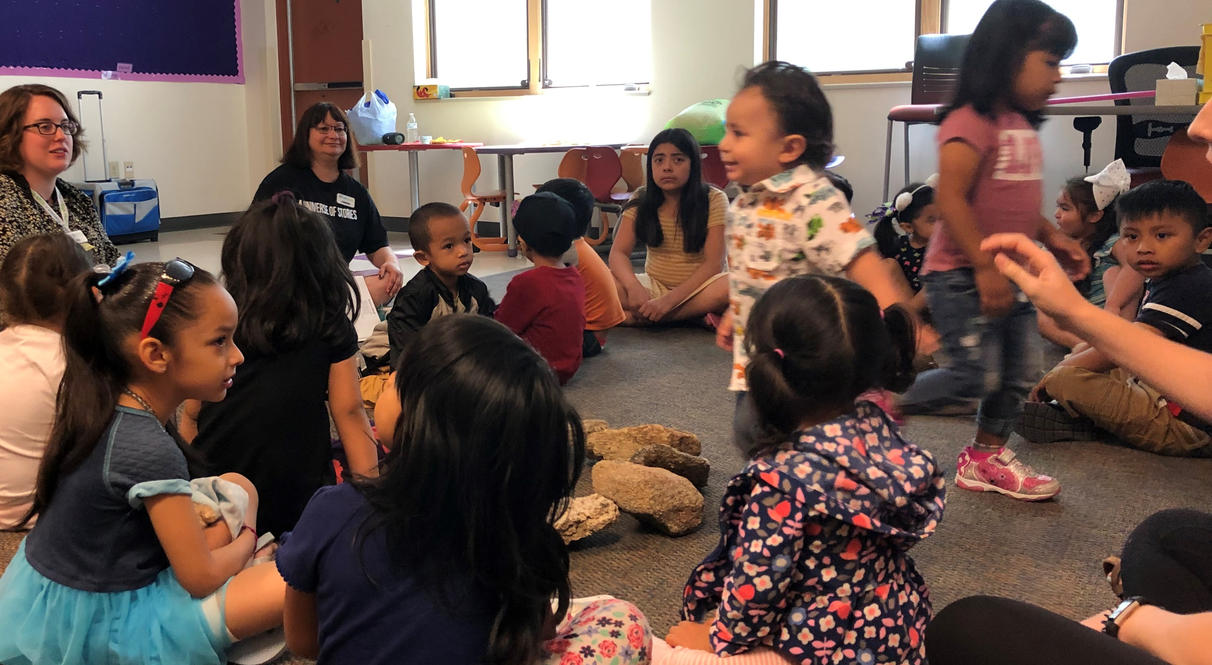
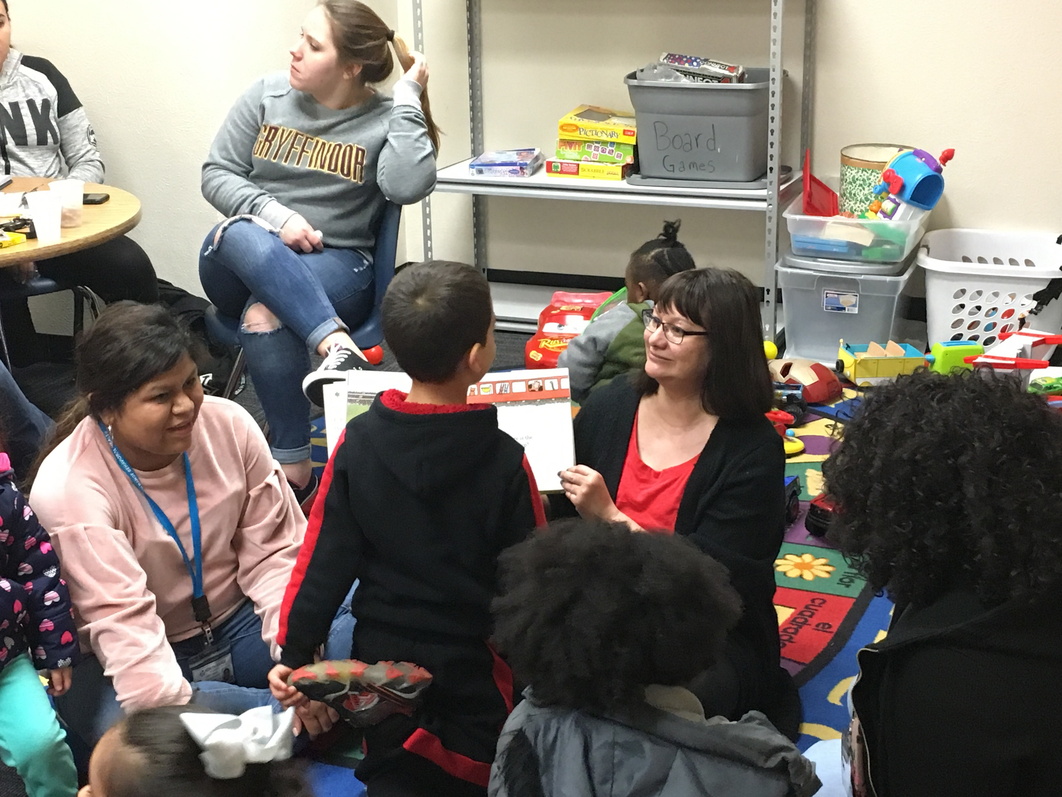
Multilingual Storytimes

Slide 5
What does it look like?

Slide 6
What does it look like?

Slide 7
What does it look like?

Slide 8
What does it look like?

Slide 9
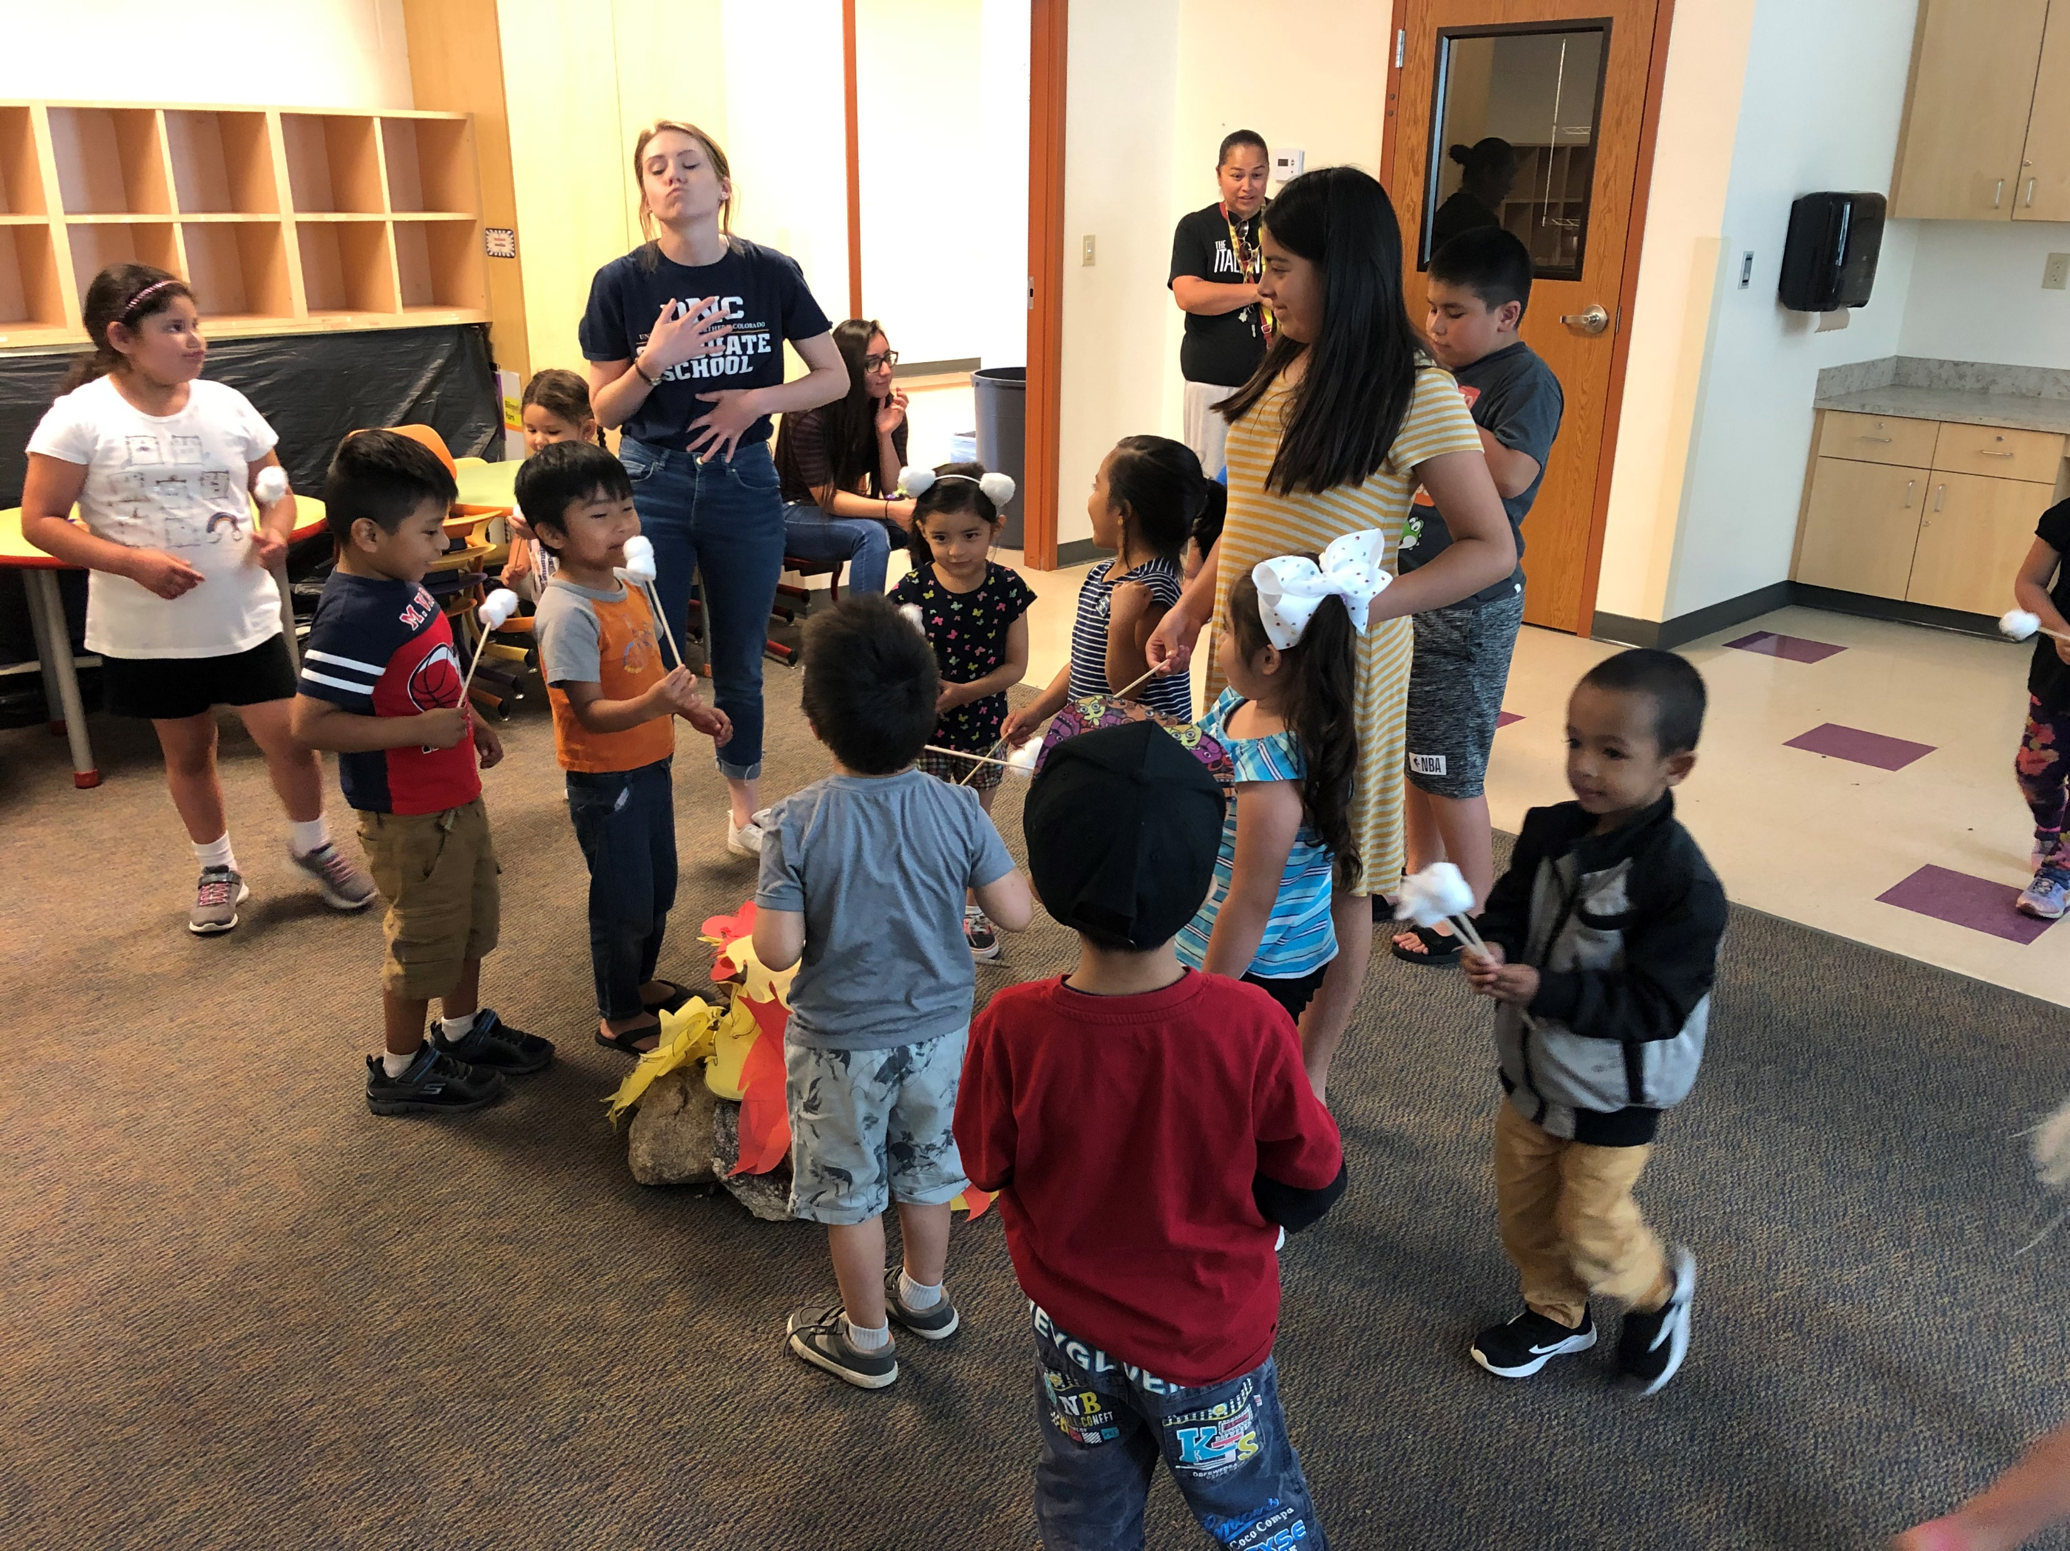
What does it look like?

Slide 10
How did we get here?

Slide 11
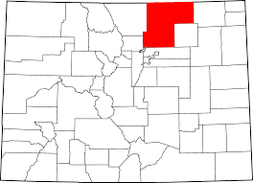
High Plains Library District
Serves 4000 sq/miles of Weld County, Colorado.
304,633 Residents
13 Locations
7 Members
6 Branches
Outreach Department
Notes:
The High Plains Library District Serves 4000 square miles of Weld County Colorado with 14 locations. These locations include both branch libraries as well as member libraries who are part of our organization, but have their own administration and board structures.
We also have an outreach department that is tasked with serving the whole district outside of the library locations, and the individual member service areas.

Slide 12
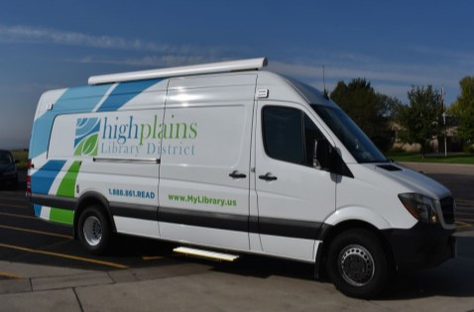
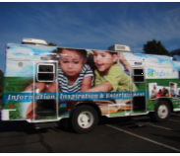
HPLD Outreach
Under Community Engagement
Virtual and Mobile Services
11 Librarians with different “target” populations
Early Literacy, Immigrant and Refugee, Mobile Services, Virtual Services, Rural Communities, Housing Facilities, Transitional and Reentry Populations
8 Library Associates
3 Vehicles
Bookmobile
Lobby Stop Sprinter
Early Literacy Transit
Notes:
The Outreach Department serves as an extension of the High Plains Library District by providing equitable service delivery to communities, neighborhoods, and individuals outside of a library location. This department operates in cooperation with other branches in the High Plains Library District service areas and spans the entire county—apart from several unincorporated lands and independent library systems. Due to the scale of the district and the services offered within, I will focus my analysis and strategies to better understand and market to the population the Outreach Services department works to engage.

Slide 13
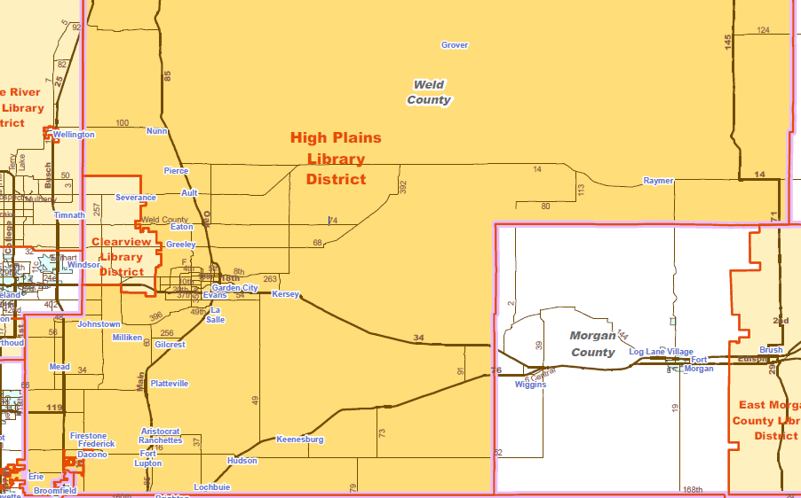
Notes:
The High Plains Library District Serves 4000 square miles of Weld County Colorado with 14 locations. These locations include both branch libraries as well as member libraries who are part of our organization, but have their own administration and board structures.
We also have an outreach department that is tasked with serving the whole district outside of the library locations, and the individual member service areas.

Slide 14
HIPPY What is HIPPY?
Home Instruction for Parents of Preschool Youngsters
Originated in Israel 1965
Moved to the US in 1985
Now has 155 sites across the country and is in 8 countries.
Colorado has 8 sites and a regional “state” site
Weld County
2012 started with a demographic survey of county
Based on data, multilingual and multicultural team was a must
Notes:
What is HIPPY?
Home visitation evidence-based program, originated out of Israel in 1965. Began in Arkansas in 1985, where Hillary Clinton brought it to support low performing children. Donated land to be sustained here.
-Adopted first by Reservations. 155 sites across the country in 11 countries. There are 8 sites in Colorado with a state office. Not all states have State office, some states use other states offices.
-2012
August 2012 started with 4 visitors and now they are at 12.
Did a demographic check to identify needs.
Knew they wanted a mulitilingual team from the start. So they sought these applicants.

Slide 15
HIPPY What do they do?
Deliver home instruction to parents in underserved communities.
Build own case load via recruitment
Do not work directly with children
Teach literacy skills and provide resources
Bring families into the community when possible
Serves as career training for the Visitors
Partner with organizations to offer volunteer service hours
Notes:
How many volunteers in HIPPY?
12 currently, and probably 20-30 overall.
Over 180 families served and 200+ children served.
50% are Spanish Speaking
20% English
30% other languages
5000 home vists
6000 hours in parent child together time.

Slide 16
HIPPY Who are they?
AmeriCorps Volunteers
Hired through North Range Behavioral Health
Many Visitors are previous service recipients
Must have multilingual or cultural competence skill
Often move into education fields after service
Members of these underrepresented communities!
Notes:
4 year max term
Many

Slide 17
Partnership
Is a unique partnership in Colorado
Libraries are often on the radar for recommendations
HIPPY Visitors offer families information, resources, and publicity about the library
HIPPY Visitors have trust with their communities
Library has free resources for parents and families
Storytimes, cultural exchanges, and volunteer opportunities
Language skills

Slide 18
Partnership History
Began as a grant to get 1000BBK information and resources into the hands of hard to reach communities in 2017
In 2018 Multilingual Storytime began via Buell Foundation Grant
Offer 12-16 storytimes and had to be in 3 or 4 languages
We did 14 in 2018
Rohingya, Burmese, Somali, Spanish, and ASL.
HIPPY packets and resources about the library
More Multilingual Storytimes in more languages
Brought in HIPPY for 2018 and 2019 volunteer projects
Seeking to expand collaboration efforts

Slide 19
Feedback from HIPPY Visitors
Offering “behind the scenes” tours for underserved community members into libraries, admin facilities, or circulation centers
Collaboration for offsite program and service sites
Only give publicity they know about
Host HIPPY Graduations for families
Offer several storytimes in a week for families with time constraints
Supply visitors with questionnaire
“What would you like to see at your library”
Songs or rhymes in addition to stories
Notes:
Collaboration offers library better access to community and HIPPY access to new families

Slide 20
Benefits to the library
More language skill without staff time requirements
Community dialogue and connections
Volunteer assistance with more difficult projects
Trust building with communities — wide reach
International and world language collection visibility
More patronage and use
Staff and community learn about new cultures, languages, and nursery rhymes
Getting publicity in the hands of community members
Strengthened community partners and literacy networks

Slide 21
Questions?
Christina Hernandez
chernandez@highplains.us
Rick Medrano
rmedrano@highplains.us

