Slide 1
How We Measure the Impact of Outreach Services
Michelle Lynn Gordon –
Supervising Librarian of the WithOut Walls Outreach Department,
Fresno County Public Library

Slide 2
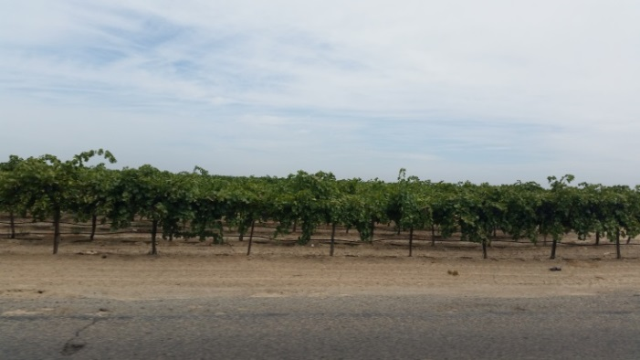
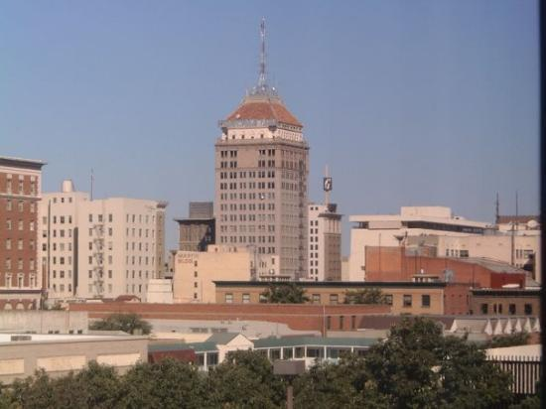
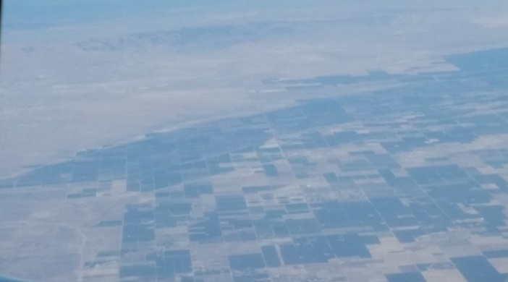
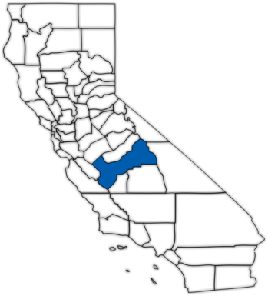
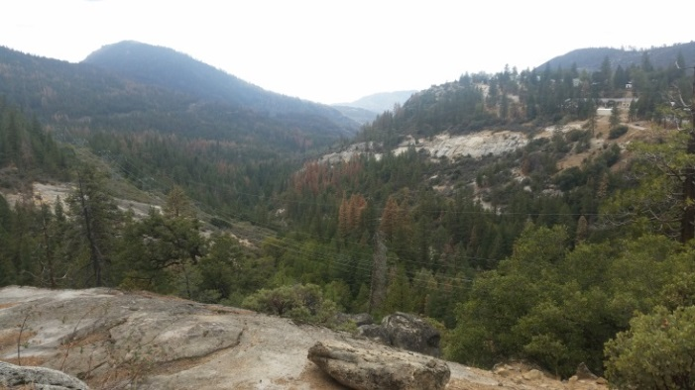
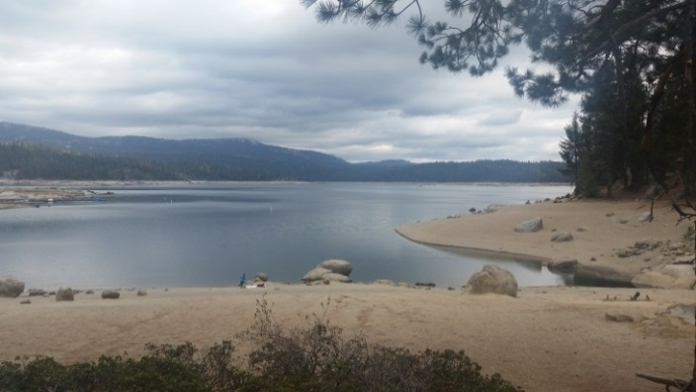
So…where is Fresno County?
Just over 6,000 Square Miles.
Has ~ 980,000 residents.
13.3% of the population is 62 years or older.
~200,000 immigrants (22% of population)
44.6% speak a non-English Language at home

Slide 3
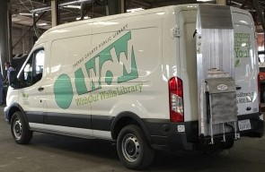
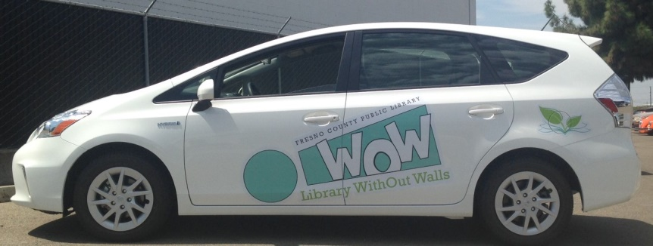
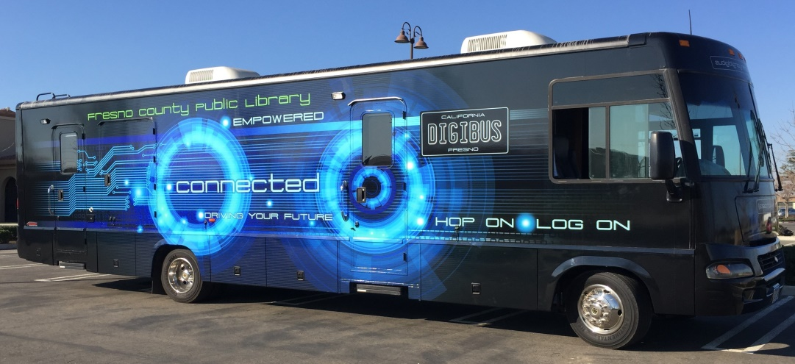
And what exactly is WoW!?
WoW! is the Outreach arm of the Fresno County Public Library.
The department has:
5 FTE subject focused Librarians and 1 FTE Library Assistant
3 Toyota Prius Wagons (a 4th is used by our Literacy Department)
1 Ford Transit Cargo Van – with hydraulic lift for book carts
1 Ford Winnebago, retrofitted as a mobile computer classroom

Slide 4
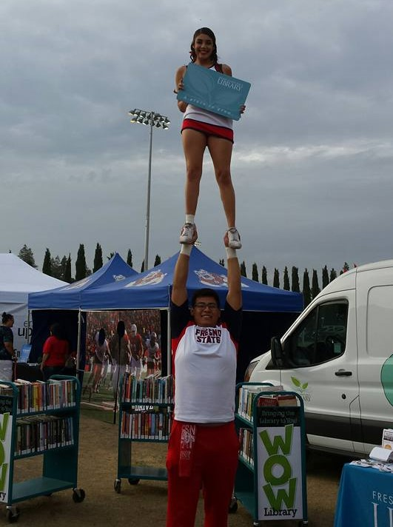
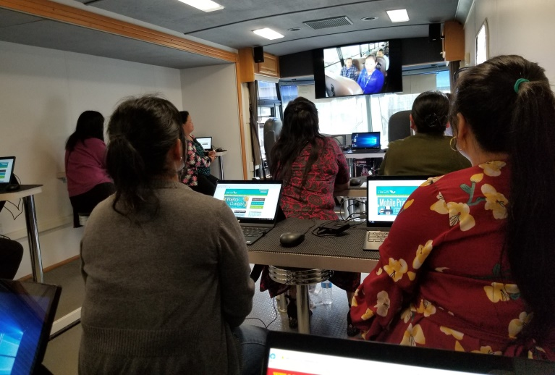
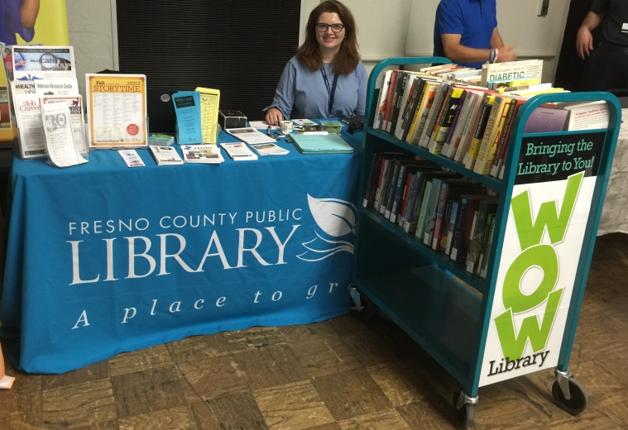
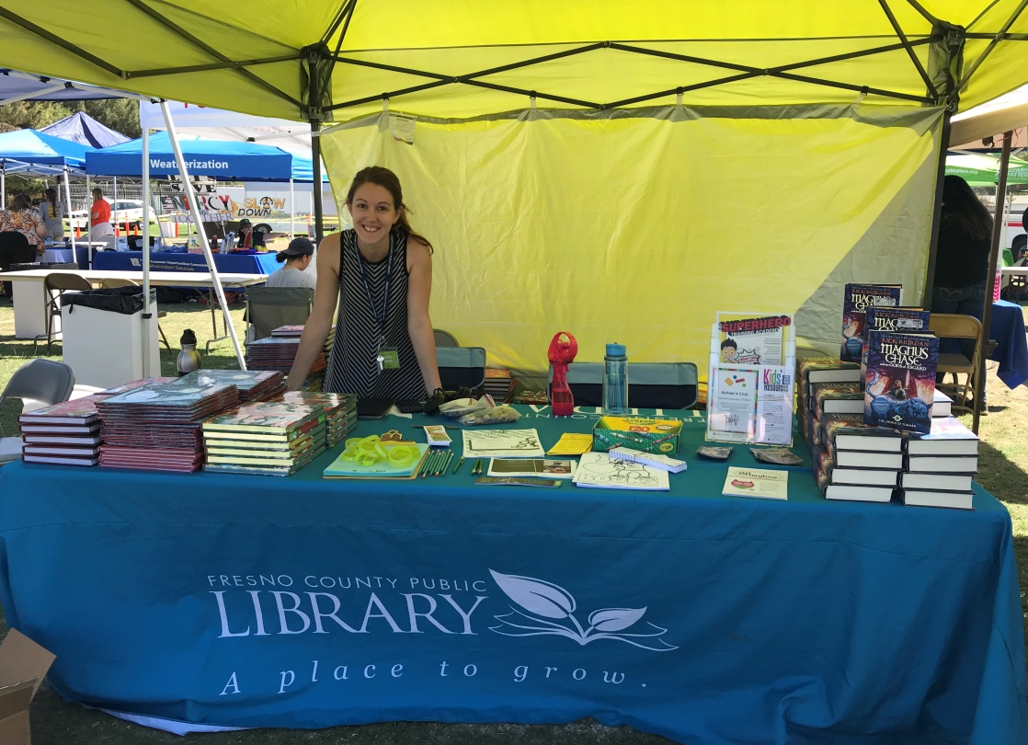
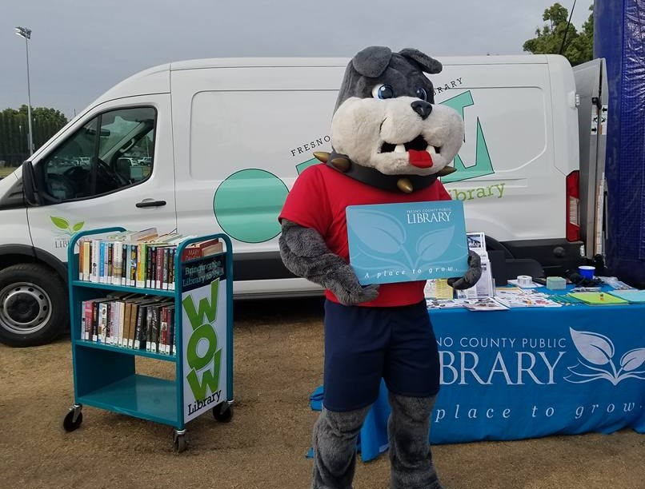
Outreach

Slide 5
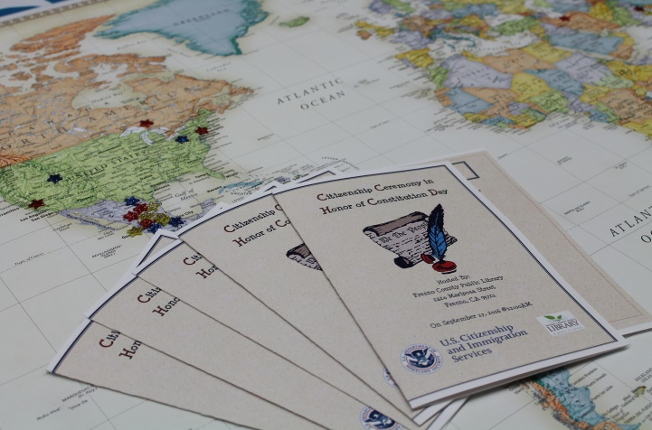
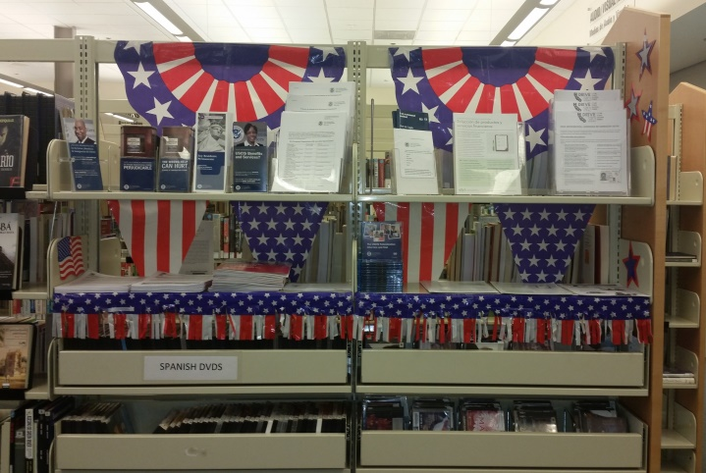
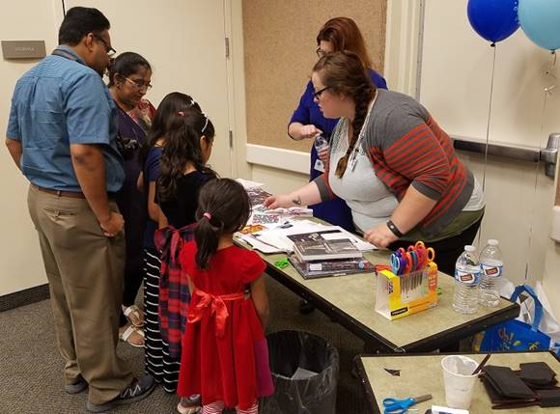
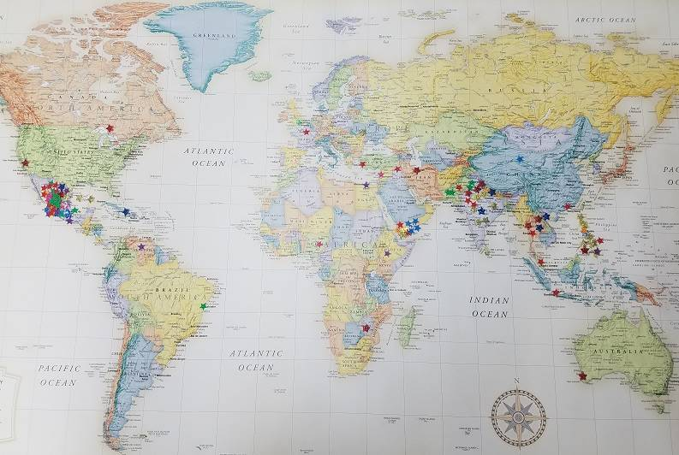
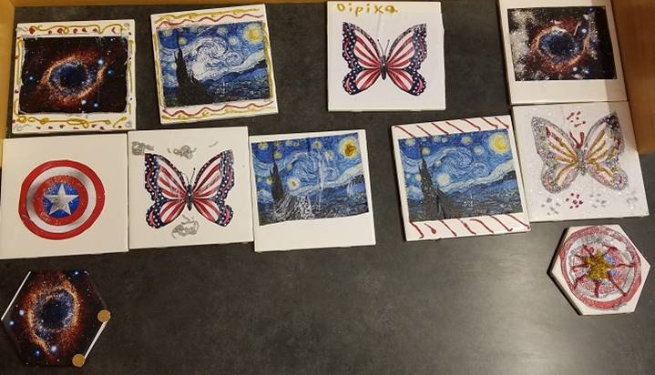
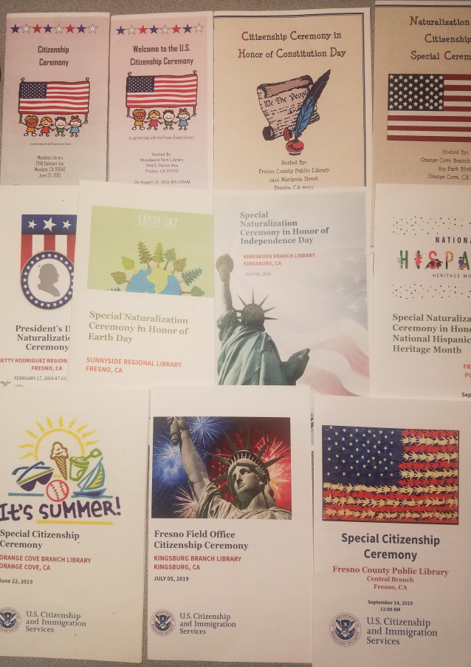
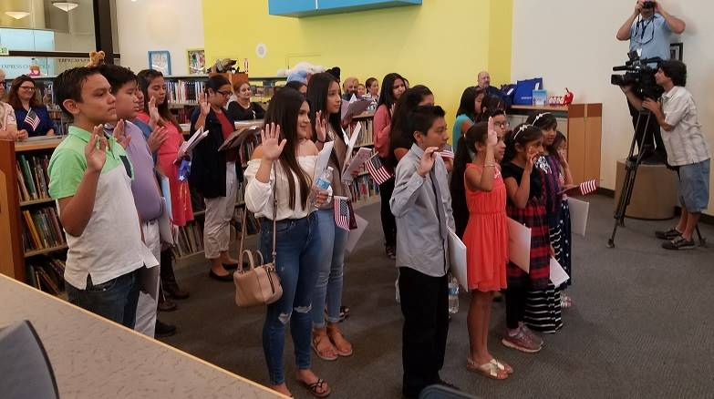
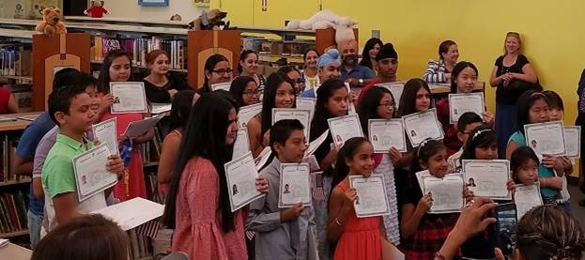
Programs and Resources

Slide 6
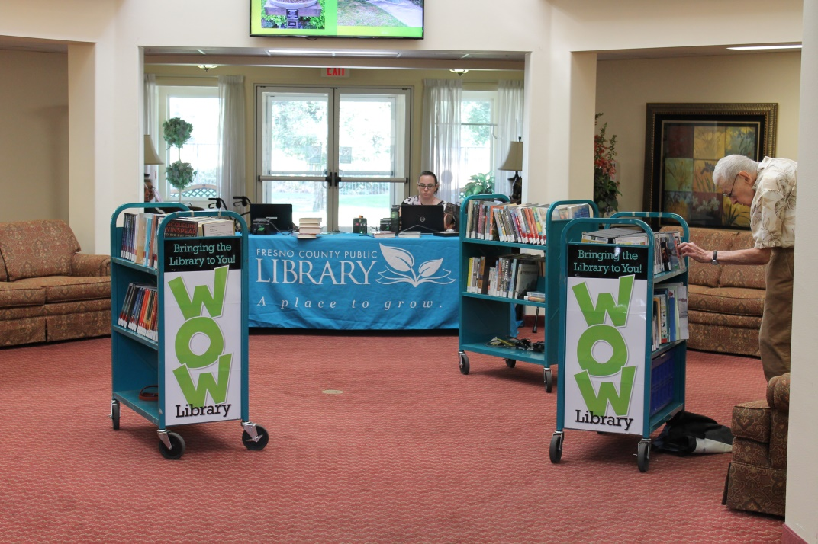
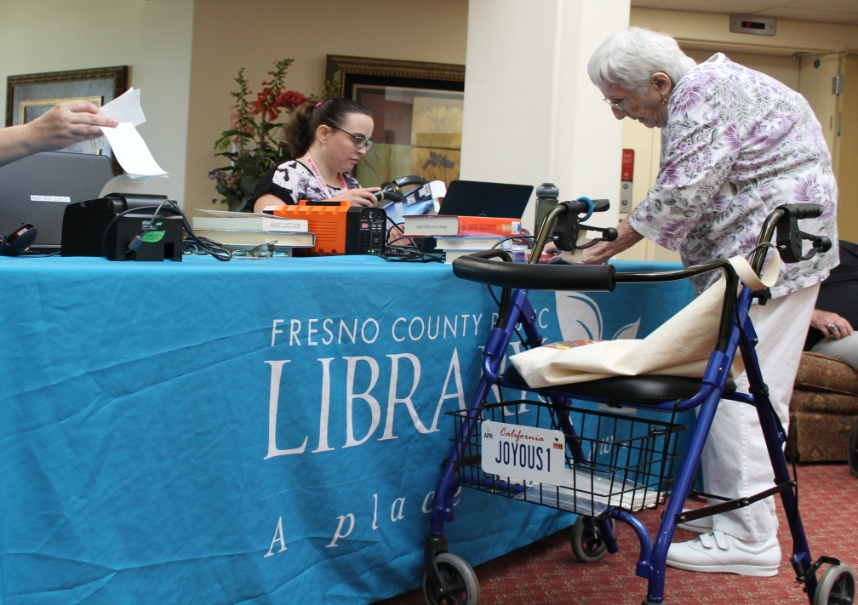
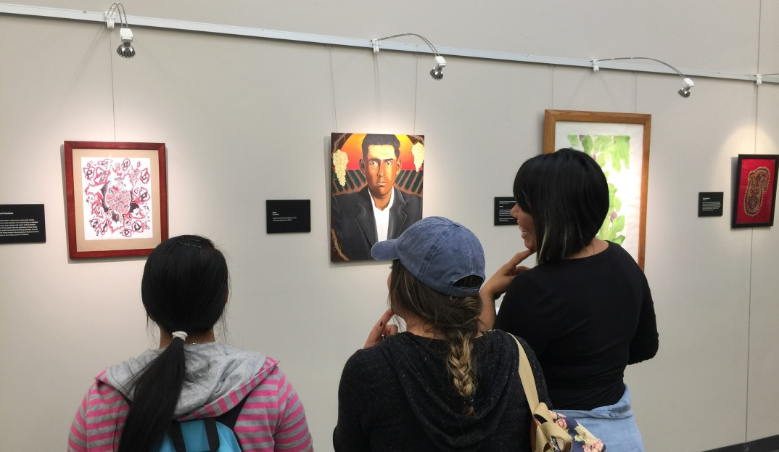
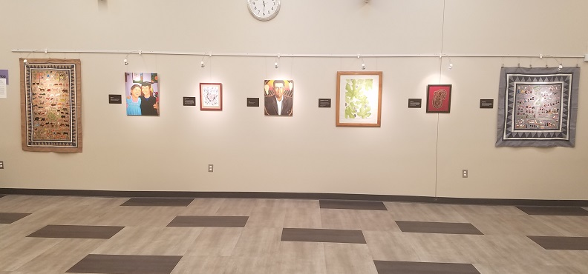

Slide 7
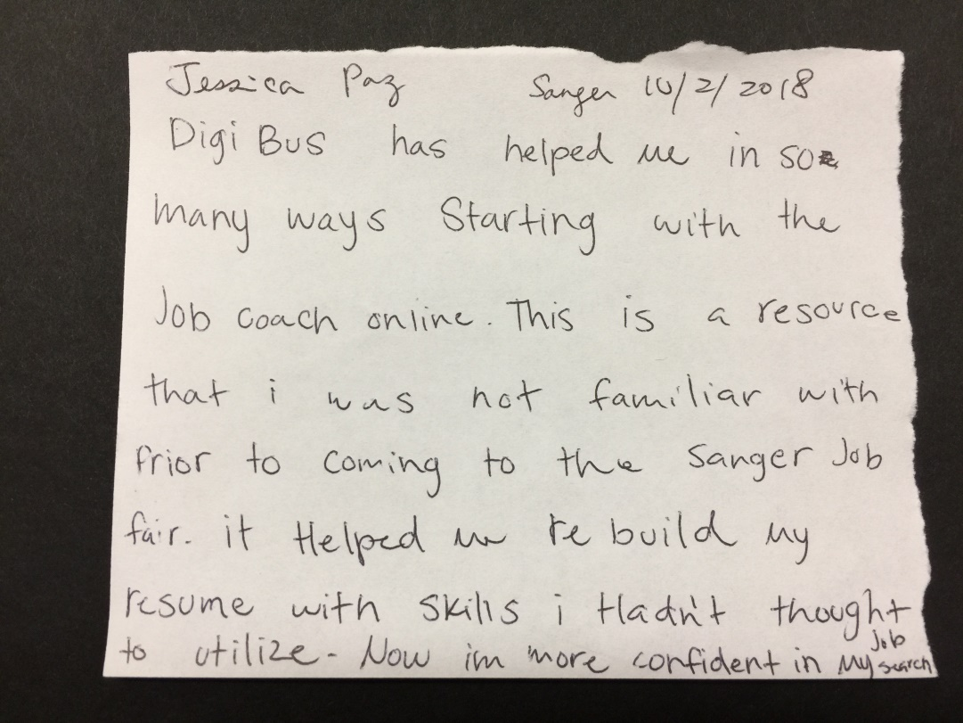
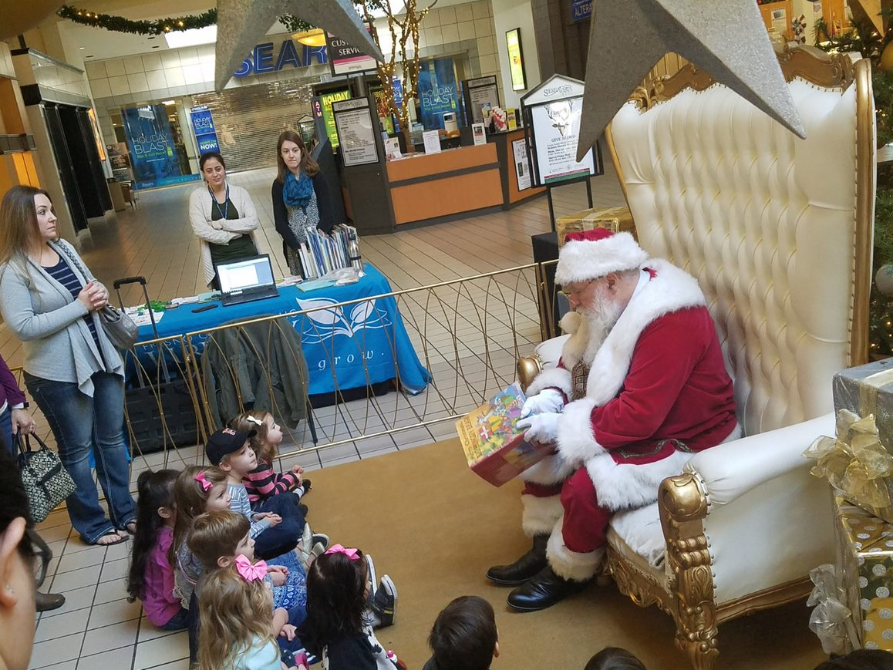
The Soft Data:
Stories…the warm and fuzzies
The personal impact stories are important.
The personal impact we have on our communities and community members is why we do what we do.
But it won’t always buy us a new vehicle.

Slide 8
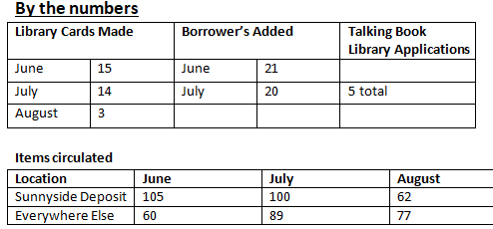
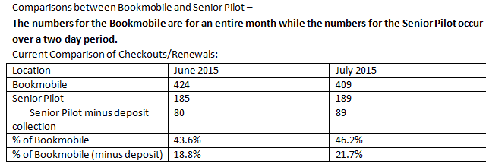
System Reports and data collection
Notes:
These statistics were presented to the FCPL Administration team after the first three months of our Senior Pop-Up Library pilot program. The program was a success and I was asking our administration team to buy the department a van to expand the program. Our County Librarian had heard the Talking Book Library story. But it wasn’t until I presented these numbers that she pulled the trigger on purchasing our van. These numbers led to a $50,000 purchase for my department.

Slide 9
Collecting Data
What WoW! collects:
Lead source – where did the outreach opportunity come from?
Organization type – Nonprofit, gov’t, education, community organization, ect.
Project type – outreach table, pop-up library, presentation, Digibus event, etc.
Language skills used – what languages were used by library personnel?
Support staff – who all went?
Notes – are there things we need to note so we can look back next time we work with this partner?
# of Library Cards made at event
Attendance – broken down by age group

Slide 10
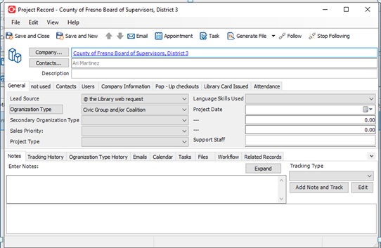
Prophet – a customer relationship management database

Slide 11
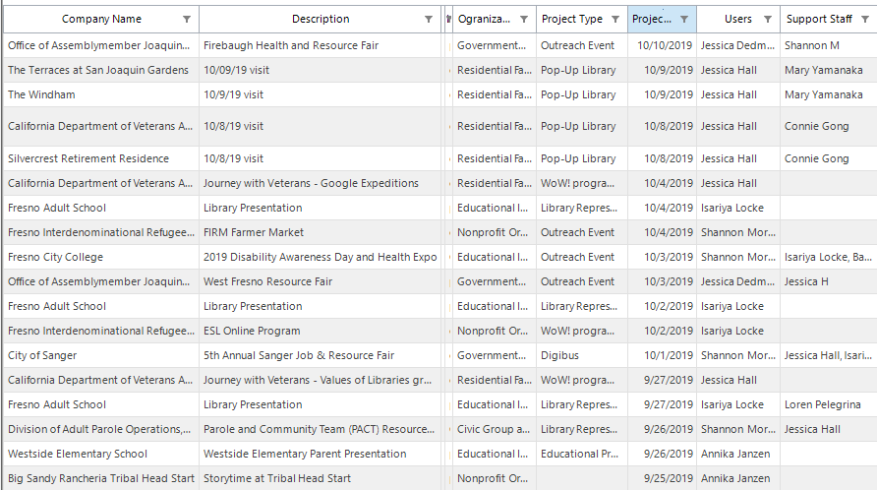

Slide 12
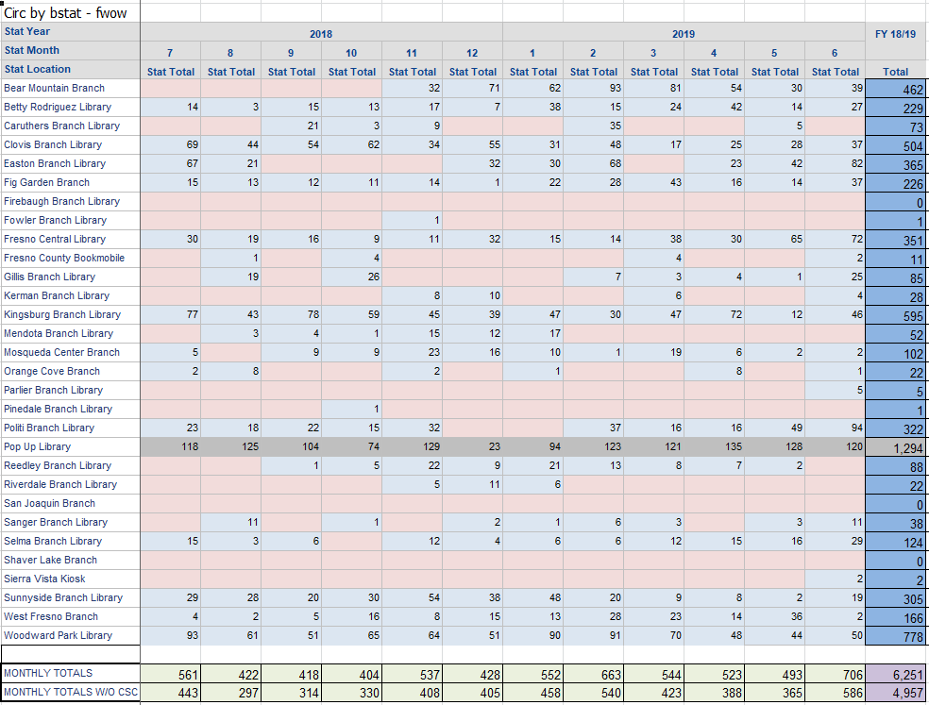
Blue Cloud Analytics

Slide 13
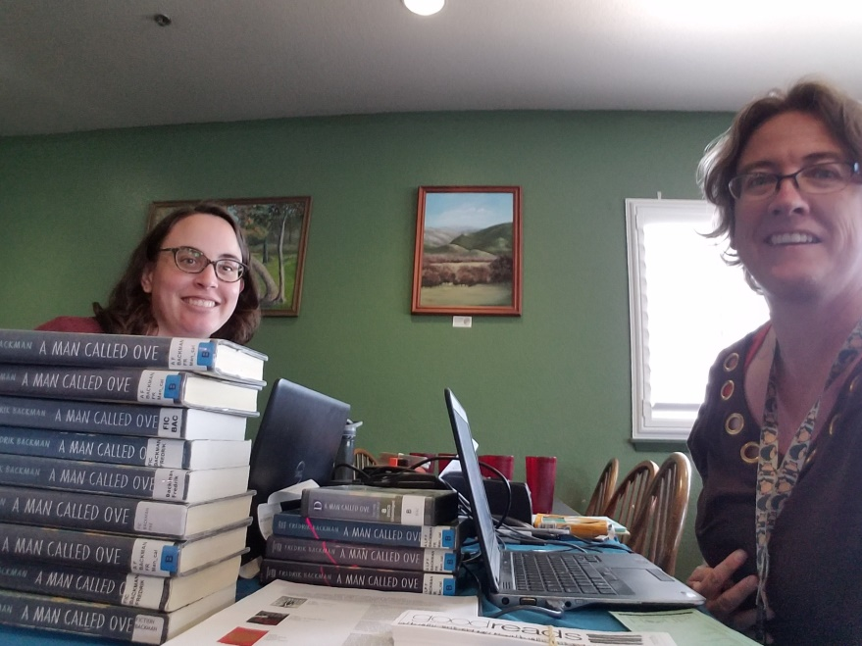
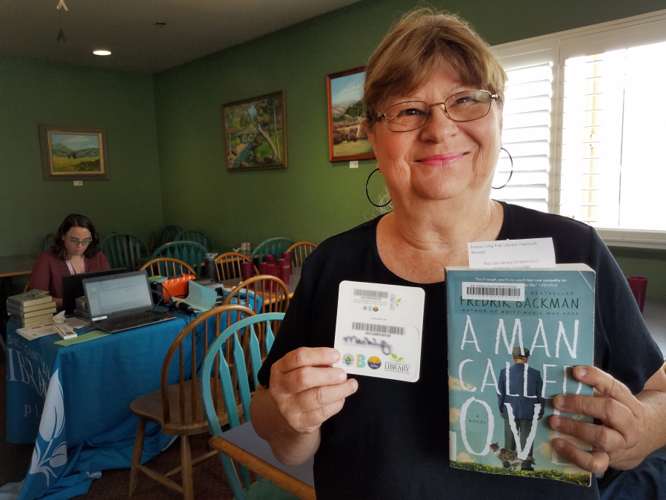
Intentional Outreach = results

Slide 14
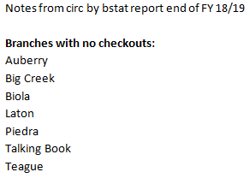
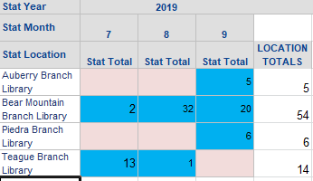
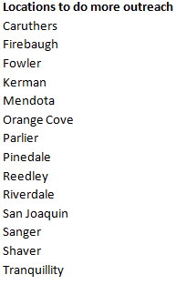
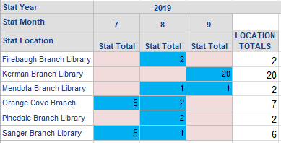

Slide 15
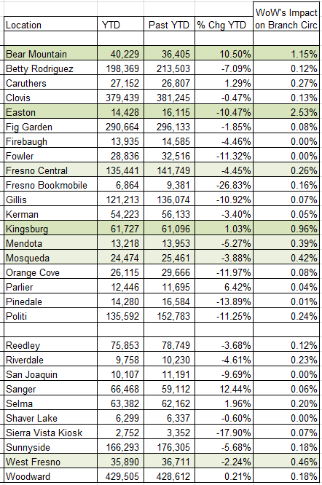
From the reports, I was able to calculate the impact WoW!’s outreach has on branch circulation of physical materials.

Slide 16
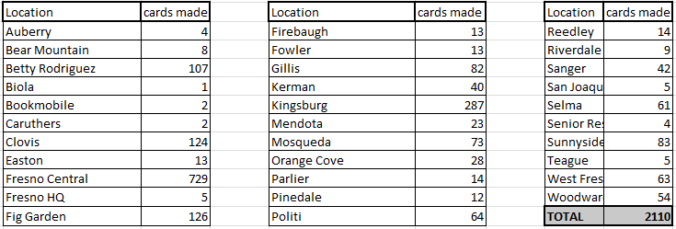

Slide 17
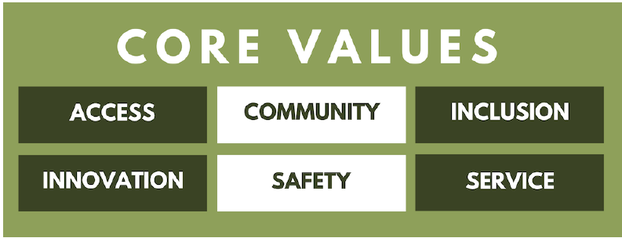
Going Forward

Slide 18
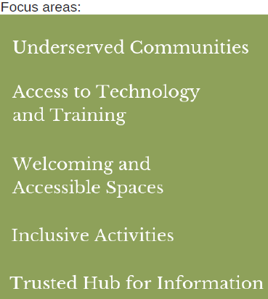
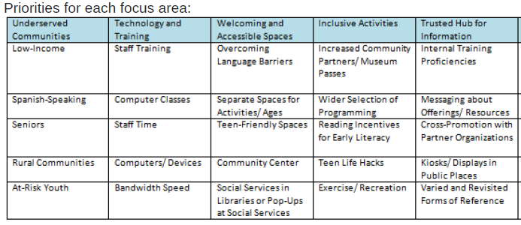
Service with intent
Increase events in non-metro areas, targeting low-income and/or Spanish speaking communities
Provide resources for Census 2020 for Hard-to-Count populations
Attend Back-to-School events in targeted communities

Slide 19
It’s all a balancing act

Slide 20
Questions? Comments?
Contact info:
Michelle.Gordon@fresnolibrary.org

