Slide 1
How to specify the right outreach vehicle
Barbara Battles, SBPL and Michael Swendrowski, SVS
Notes:
Introduce self and Michael – working together on new vehicle

Slide 2
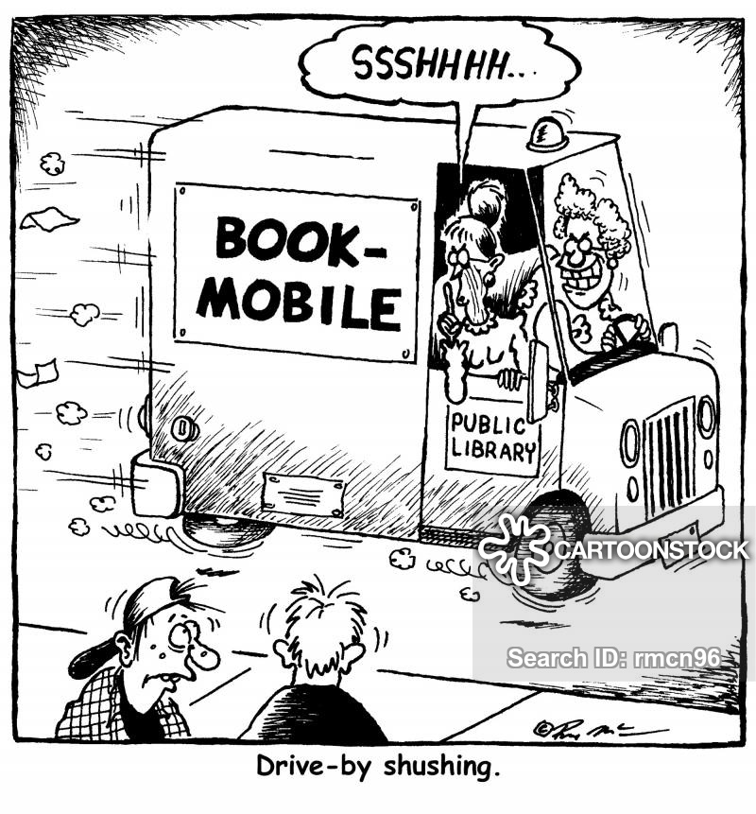
Why put your library through this process?
First things first – get your ducks in a row.
Who are the decision makers?
Who are your customers?
Who are your partners?
Who will provide the funding
What are your goals for the service?
Notes:
Things you need to determine first that will affect every decision you make. Keep in mind throughout.

Slide 3
Identify your decision Makers
The Team
Administration
Outreach Staff
Library Trustees or other governing body
Township Council or Local Government
Other Library Staff Members
Friends, Foundation or other library groups
“The Public”

Slide 4

Priorities
This is somewhat of a “What came first, the chicken or the egg?” kind of dilemma.

Slide 5
When to seek help?
Preliminary Planning
Design Development and Documentation
Implementation and Vendor/Client Liaison
Needs assessment
Planning and Conceptual Design
Budgeting and Estimating
Technical Specification writing
Scheduling and task management
Bid solicitation, analysis and recommendation
Contract negotiation
Overall Supervision and Administration
Construction Management
Inspection and Testing
Operator Training

Slide 6

How will it be purchased and who will own it?
Considerations:
Public Money or Private Money – Individual and/or Corporate
Lease or Own
New or Used
Foundations and grants
Environmental and Fuel Incentives
Grassroots and Crowdsourcing

Slide 7
Service history and Goals
New Start-up Service
Continued Service
Expanded or Additional Services
Who suggested this service?
Who will benefit from this service?
How much do you need to do and for how long?
Will you be able to grow or expand once you get started?
Do you want to continue in the same direction?
What has worked and what can be improved, changed or eliminated?
Has the scale of the operation changed over time and will that continue?
Where is the current service falling short or is it?
What more could you do?
What do you need to accomplish new goals?

Slide 8
Information Gathering

Slide 9
Demographics
What are the characteristics of your target audience?
  Ages
  Education
  Ethnicities and languages spoken
  Location - present and future customers
  Needed and Beneficial Services and materials
  Disabilities and special needs accommodation

Slide 10

Partnerships

Slide 11
Community Needs
Basic Library services and materials
Literacy Support
Home Delivery
Institutional Delivery
Accessibility

Slide 12
Library needs
Outreach
Expansion – Branch vs. Bookmobile
Marketing – more visibility and good will
Educational Support
Additional Service Opportunities

Slide 13
Scope
Single vehicle
Multiple vehicles (at outset or over time)
Single-use vs Multipurpose Vehicles
Convertible Vehicles

Slide 14
Staffing and operations
Full-time or part time staff – in house or new-hire
Job Titles and Descriptions
Hours and Days of Operation
Experience and Training
Garaging or staging of vehicle
Maintenance of vehicle
Fuel decisions

Slide 15
Collection Management
Requirements
Flexibility
Size and Scope
Home location, shifting and loading
Budget and Processing

Slide 16
Design Considerations
Number of staff and number of seats and workstations
Comfort needs
Layout and Configuration for function
Shelving
Materials
Graphics
Electronics
Display and Storage

Slide 17
Vehicle Types
Book-bikes, book-boats and other specialty vehicles
Small electronic three-wheeled vehicles
Sprinter vans and smaller delivery vehicles
Trailers
Small RVs
Step Vans
Busses
Trucks
Other

Slide 18
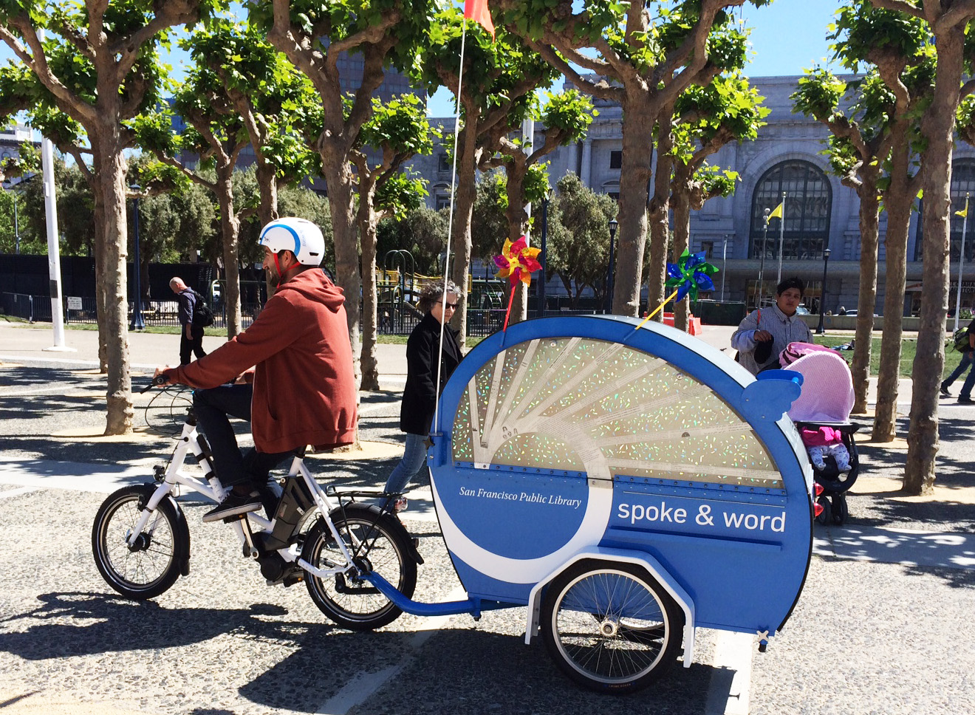
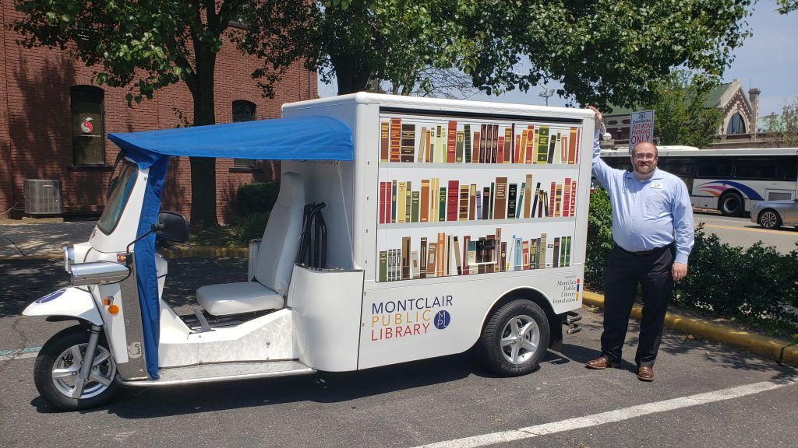
Small human and electric Powered fair-weather vehicles

Slide 19
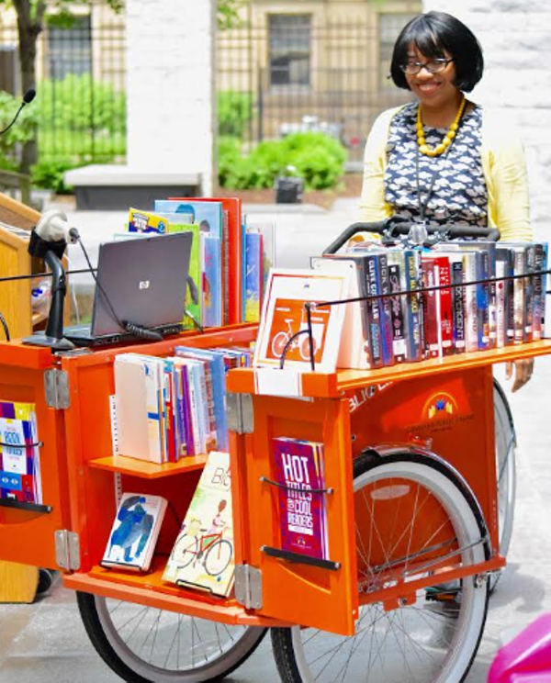
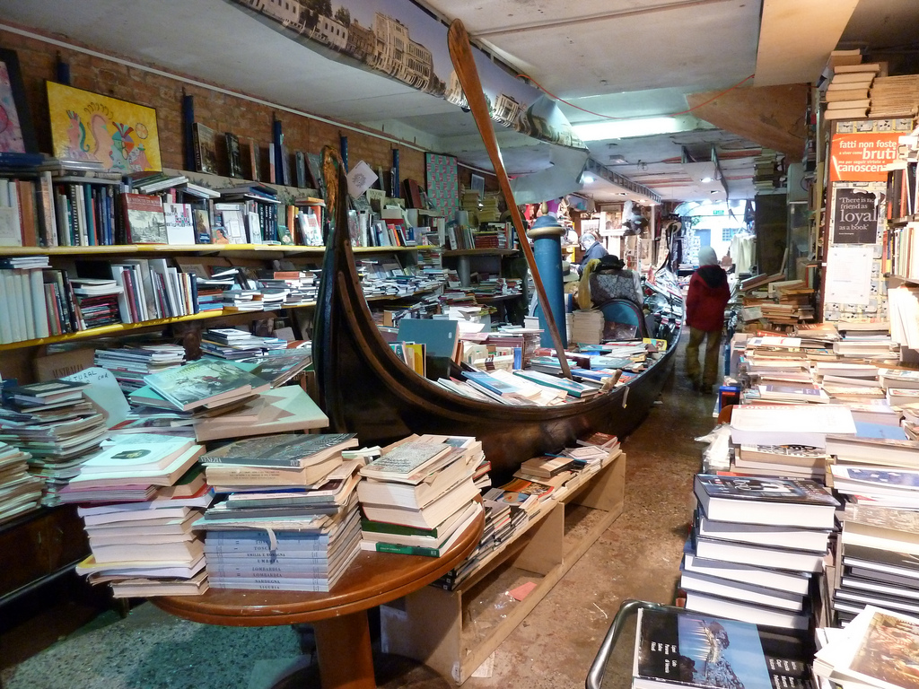
Bikes and Boats

Slide 20
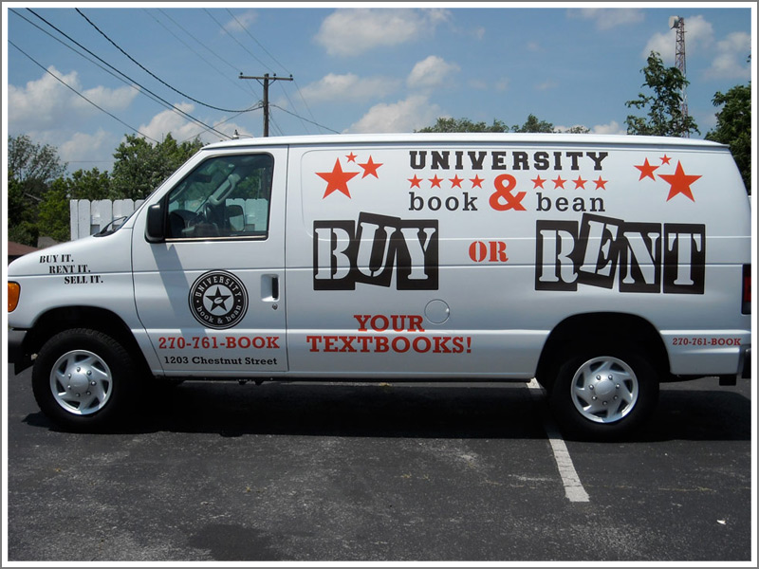

Vans, Small and mid-sized Delivery Vehicles

Slide 21
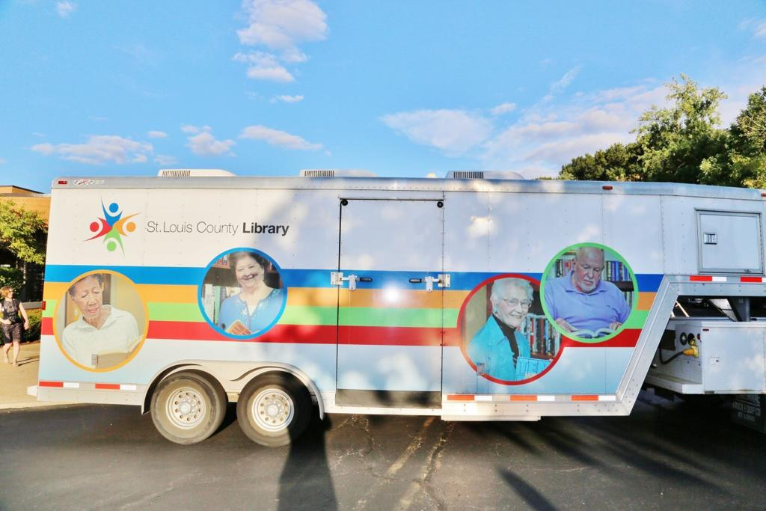
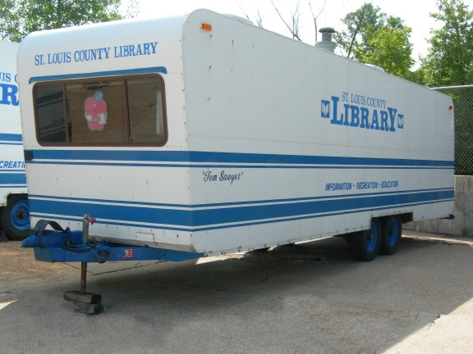
Truck pulled trailers

Slide 22
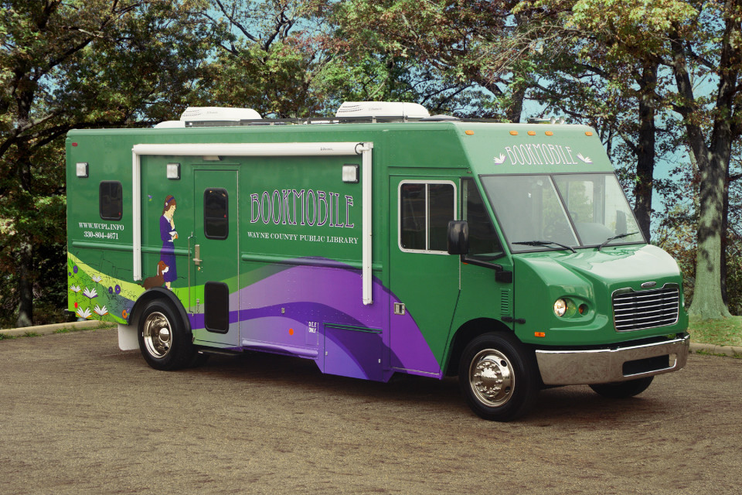
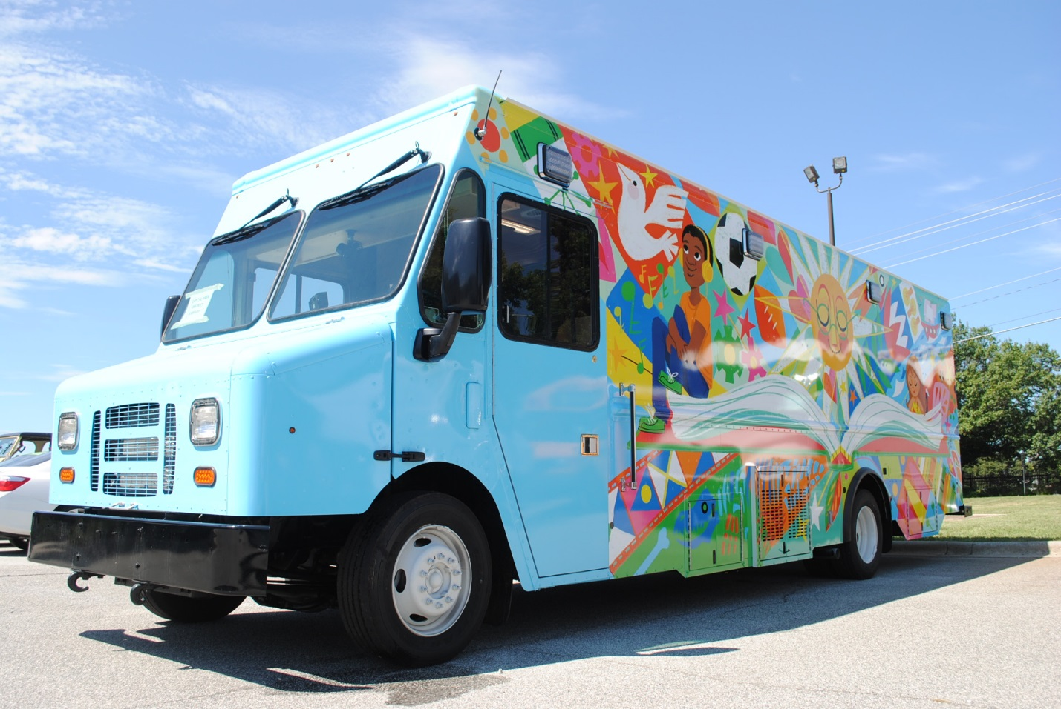
Step Vans

Slide 23
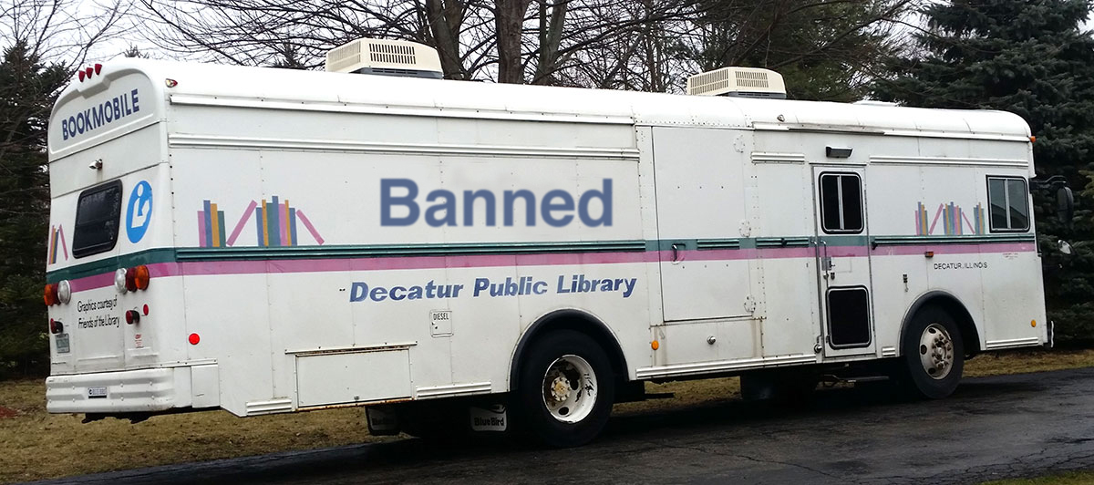
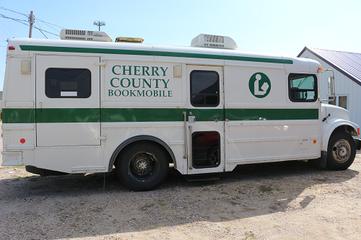
Busses

Slide 24
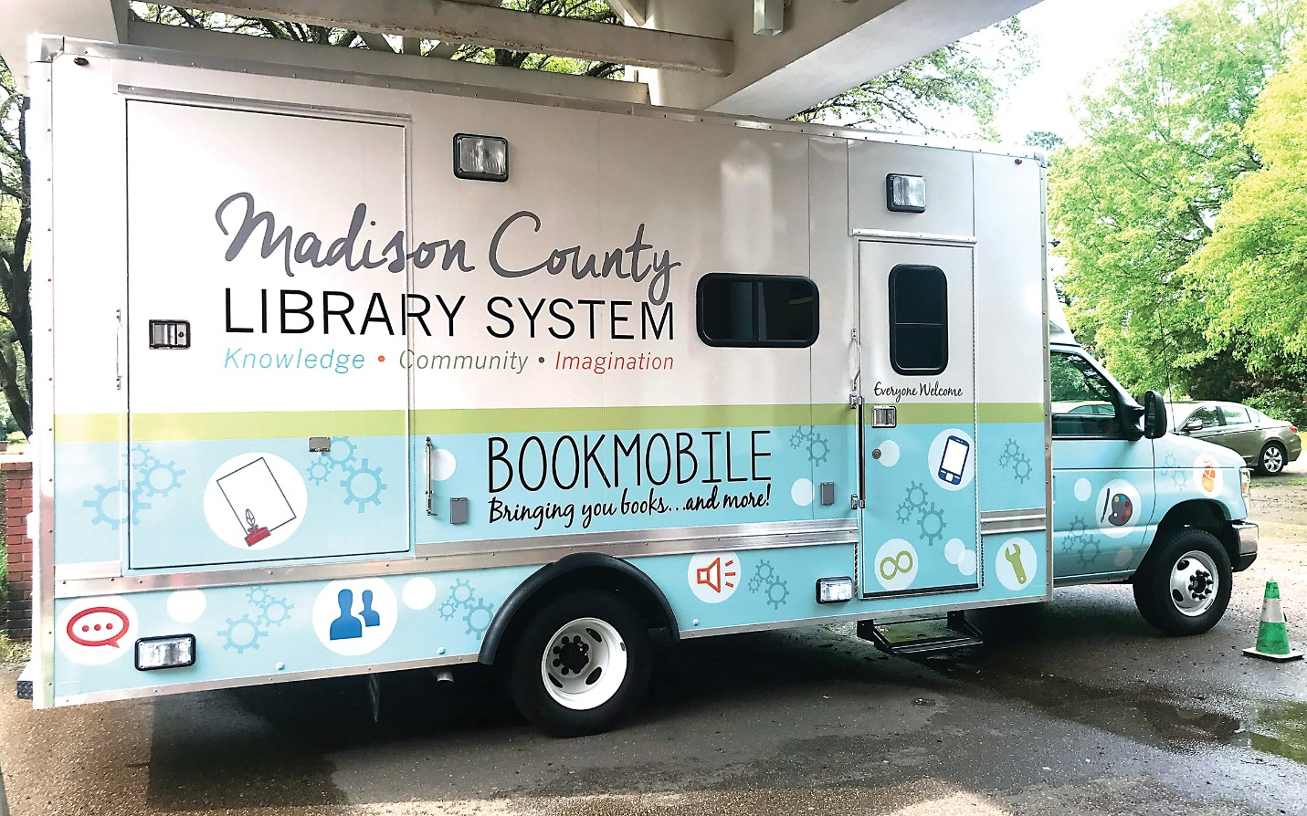
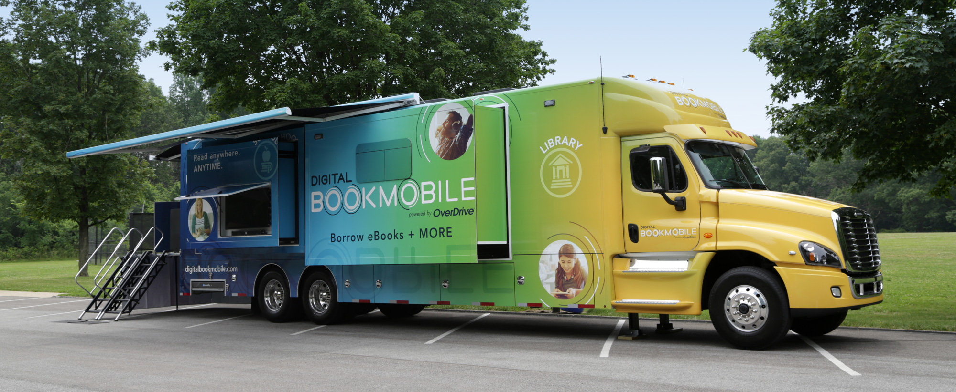
Trucks

Slide 25
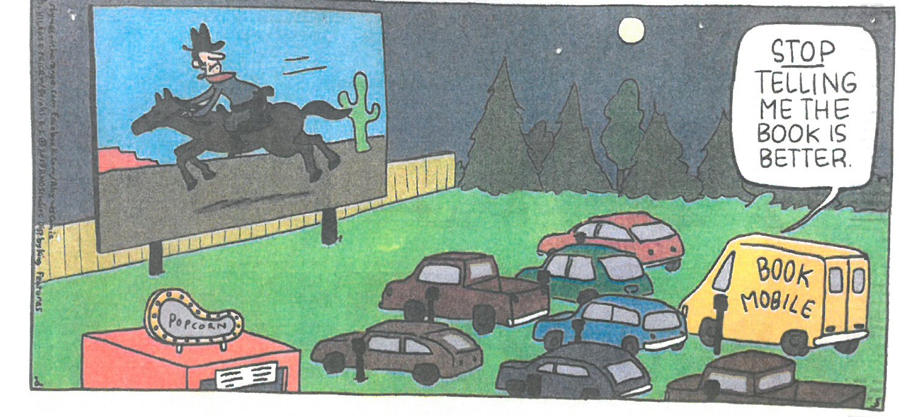
Enjoy your vehicle however you use it!

Slide 26


FURTHER DOWN THE ROAD WITH VEHICLES. ☺

Slide 27


Michael swendrowski
33-year veteran of specialty vehicle industry (1986)
Over 1000 vehicles to date
President Specialty Vehicle Services, LLC. (2002)
Chairman ALA Subcommittee on Bookmobiles (2006)
ABOS Board of Directors (2010)
Chair of BOIR Subcommittee
Co-author of On the Road with Outreach (Libraries Unlimited, 2009)
Assisted over 100 libraries with outreach vehicle projects worldwide
Notes:
33-year veteran of specialty vehicle industry (1986)
Over 1000 vehicles to date
Planters Nut Mobile
Starbucks Venti Vans
Lockhead Magic Schoolbus
OverDrive Digital Bookmobile 1.0 and 2.0
President Specialty Vehicle Services, LLC. (2002)
Chairman ALA Subcommittee on Bookmobiles (2006)
ABOS Board of Directors (2010)
Co-author of On the Road with Outreach (Libraries Unlimited, 2009)
Assisted over 100 libraries with bookmobile projects worldwide

Slide 28
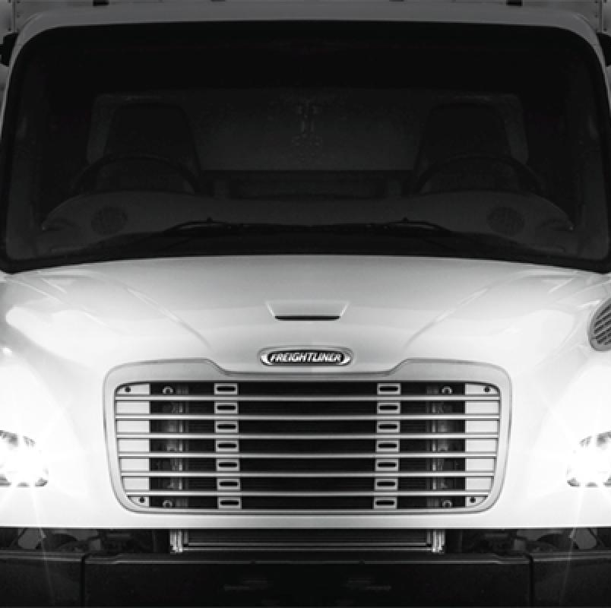
Base vehicles
Notes:
Barbara went over a host of different base vehicle types. I would like to speak a bit further about the most popular choices used for outreach services. ☺

Slide 29
Overview
 |  | Overall Length | Overall Width | Floor Height | Interior Height | Collection Capacity | Service Duty | Service Life | Service Types | Base Cost (2018) | Maint. Costs
Truck |  | 28' - 40' | 102" | 32" - 44" | 84" & 91" | 2500 - 6000 | Medium - Heavy | 14-20 years | C, D, E, I, L, LV, P, R, S, U | $225K | Low
Bus |  | 28' - 40' | 96" | 38" - 44" | 77" - 87" | 3500 - 5000 | Heavy | 15-21 years | C, LV, P, R, S, U | $250K | Low
Van |  | 20' - 25' | 78" | 29" - 32" | 66" - 78" | 1000 - 2500 | Light | 7-10 years | C, D, E, H, L, LV, P, S, U | $150K | Low
Cutaway |  | 20' - 26' | 96" | 30" - 36" | 69" - 84" | 1000 - 2000 | Light | 7-10 years | C, D, E, H, I, L, LV, P, S, U | $150K | Medium
Step Van |  | 20' - 40' | 96" | 36" - 42" | 72" - 84" | 1000 - 6000 | Light - Medium | 12-16 years | C, D, I, L, LV, P, S, U | $190K | Medium
Low Floor |  | 28' - 32' | 96" | 12" - 16" | 77" - 84" | 2000 - 3000 | Medium | 9-15 years | C, D, E, H, L, S, U | $250K | High
Service Type Key:
C = Children Bookmobile |  | H = Homebound Delivery |  |  | LV = Learning Vehicle |  | S = Suburban Bookmobile
D = Deposit Collections |  | I - Interlibrary Delivery |  |  | P = Programming |  | U = Urban Bookmobile
E = Elderly Bookmobile |  | L = Lobby Stops |  |  | R = Rural Bookmobile
Notes:
Refer to chart. General guidelines and data to help.
Length equates to capacity and maneuverability -
REGARDLESS OF WHAT YOU’VE SAID OR HEARD… SIZE DOES MATTER! (share size stories – not enough based on licensing constraints – too much for garage)

Slide 30
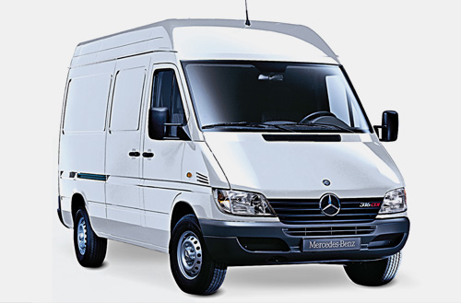
Vans
Pros
Cons
Low cost
Easy to drive
Highly maneuverable
Limited space
Light service duty
Small collection
Notes:
Start at about $150K
Very “car like” with AC, power windows & locks, cruise, etc. Even air bags!
Short wheelbase gets in and out of tight spaces.
Limited width (78”) and interior height (78”)
7-10 year life span
Maximum 2,500 volume capacity

Slide 31
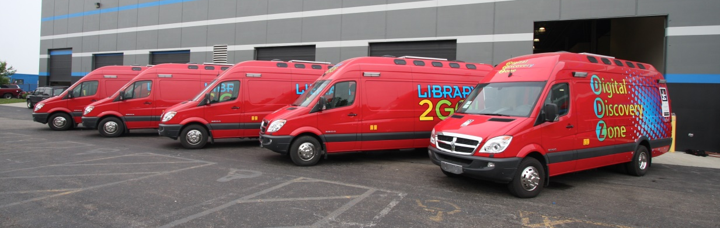
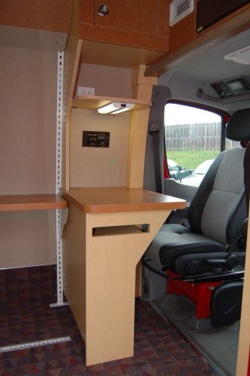
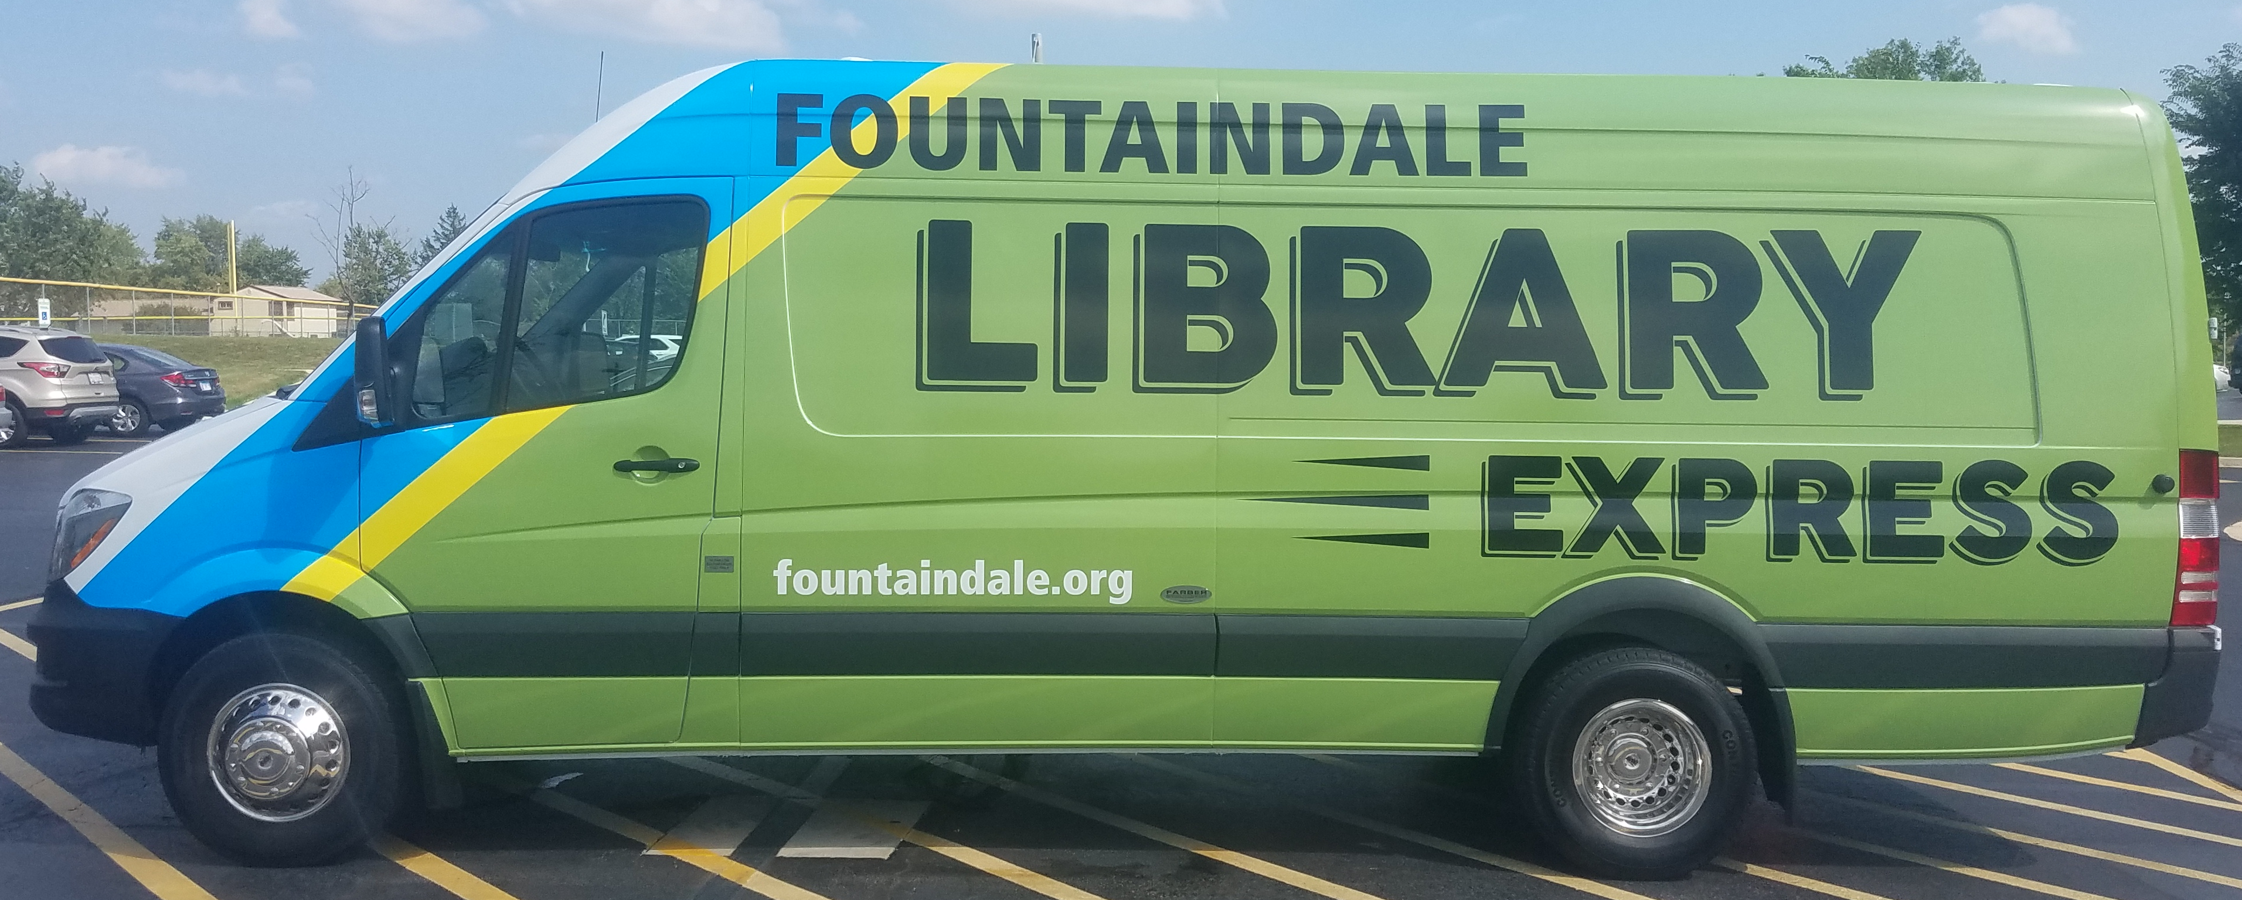
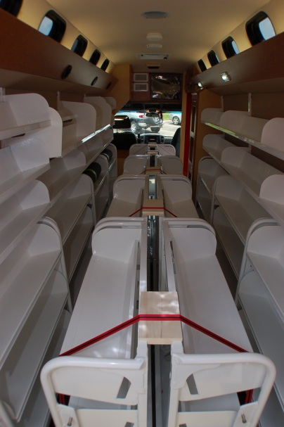
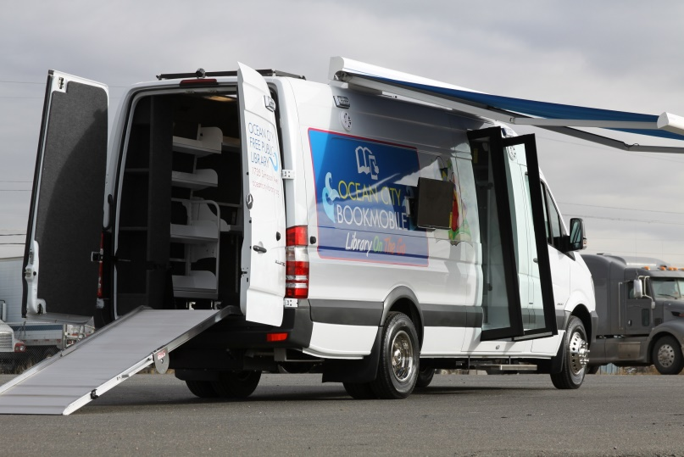
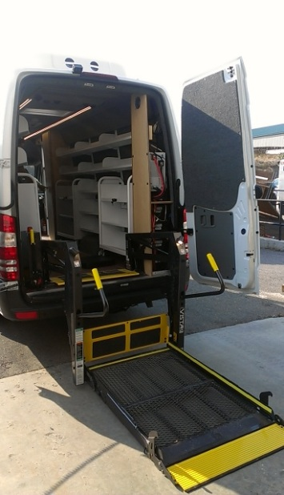
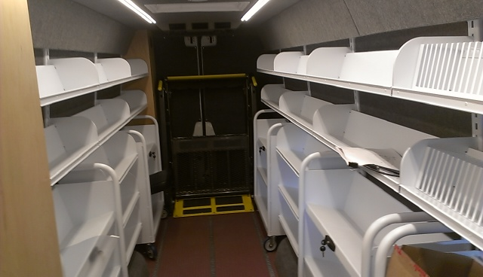
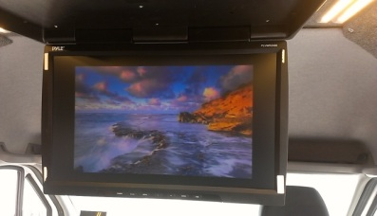
Vans

Slide 32
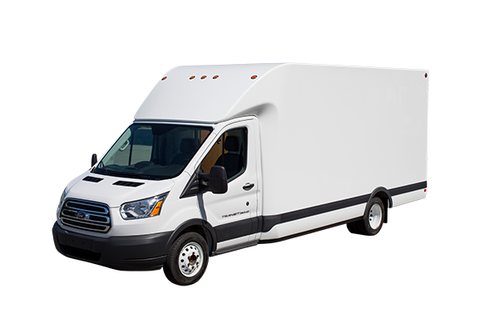
cutaways
Pros
Cons
Cost effective
Rectangular body
High headroom
Light service duty
Minimal weight capacity
Limited length
Notes:
Not much more than the van
Body is rectangular (more efficient)
More width and height in body
Still have light service duty (more so than van)
Less payload due to heavier body
Only 2 or 3 length options

Slide 33
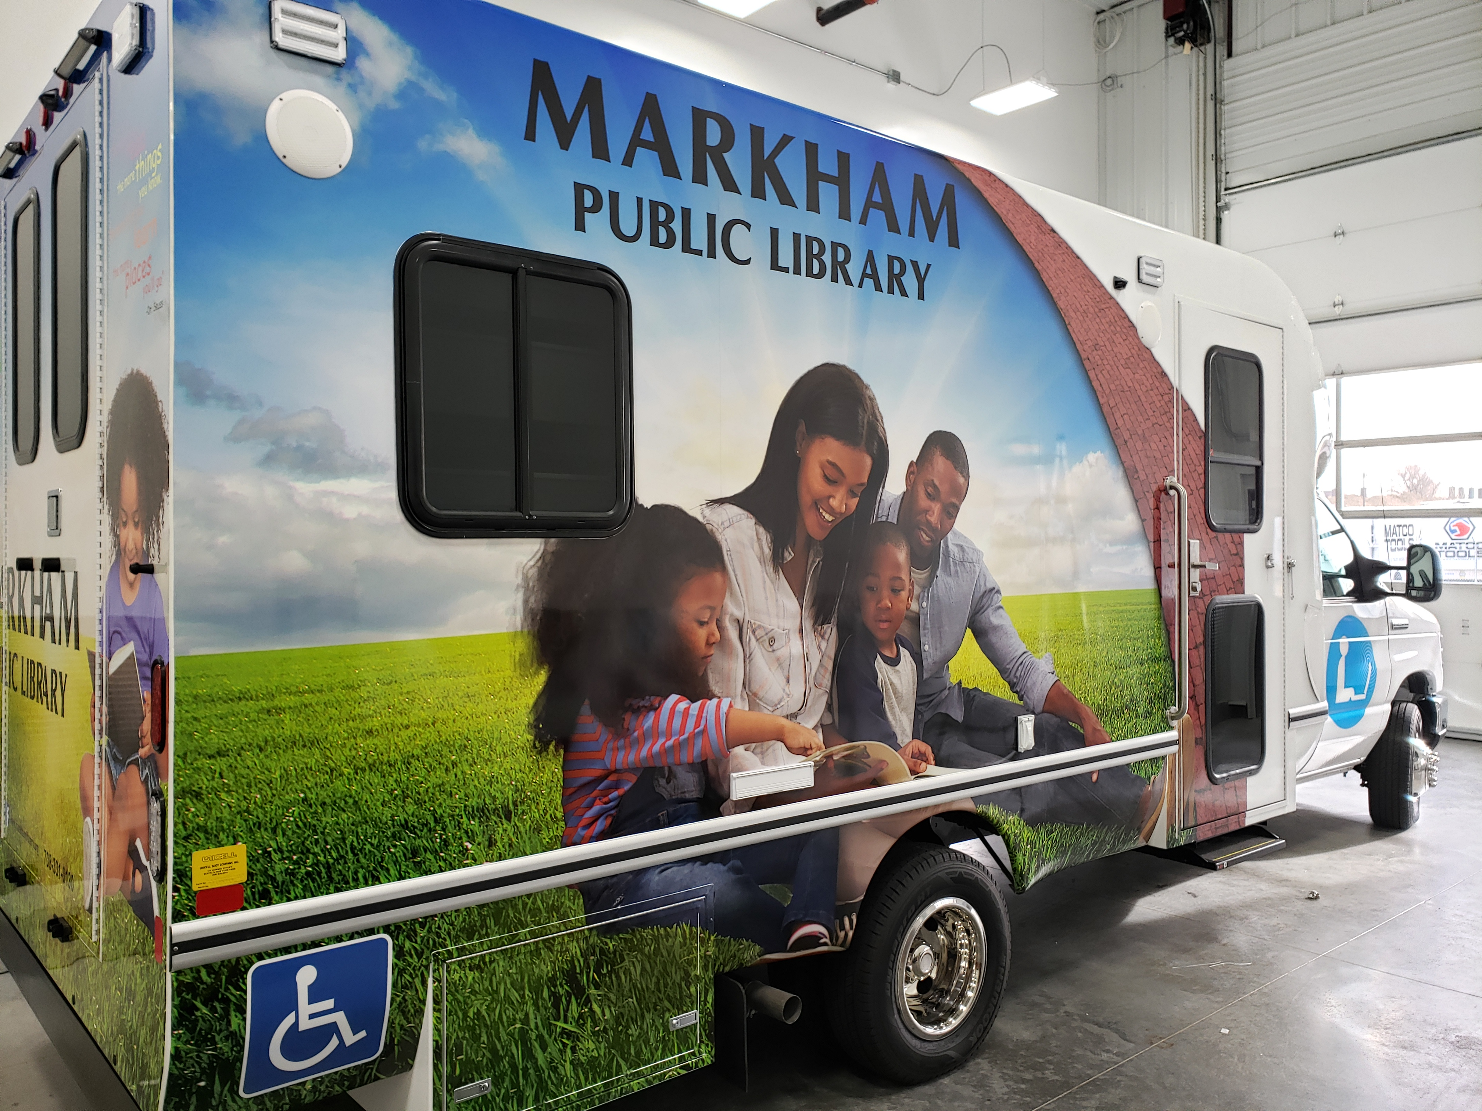
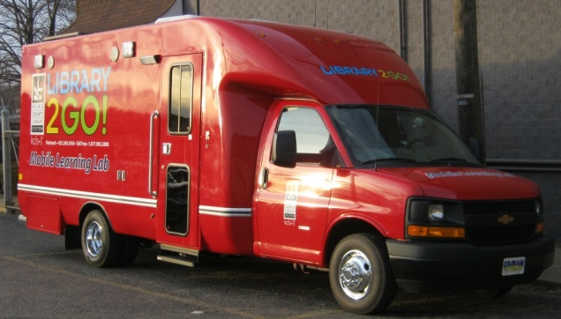
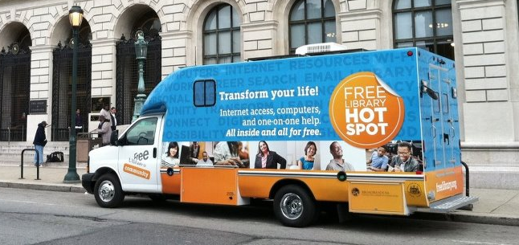
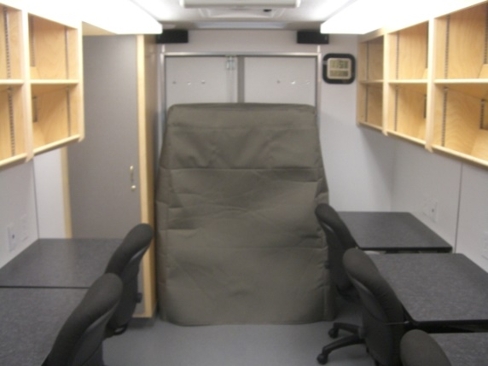
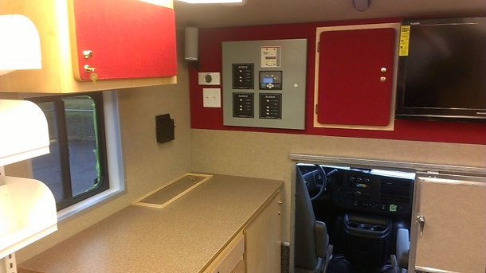
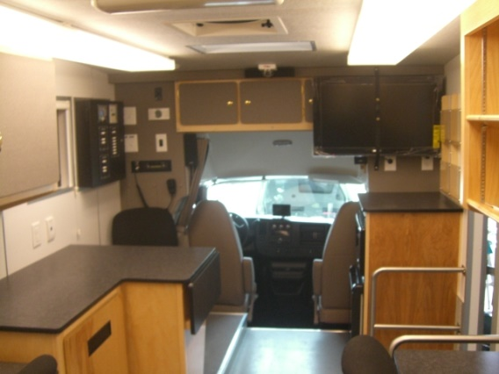
cutaways
Notes:
With or without walk-through (also a “crawl through” option)
Well suited to programming and learning initiatives (lightweight).

Slide 34
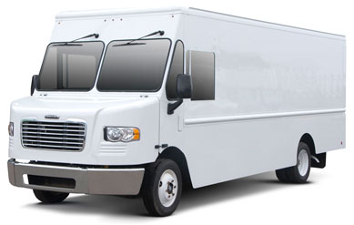
Step Vans
Pros
Cons
Aluminum body
Rectangular shape
Multiple lengths
Medium service duty
Utilitarian cockpit
Higher floor
Notes:
Also known as bread trucks, walk-in vans and UPS trucks
Aluminum body (like truck) lighter weight and doesn’t rust
Rectangular shape is very efficient for shelving (ext. sidewalls great for ext. components… puppet stages, pass-throughs, etc.)
20’ to 40’ on 2’ increments
Not as heavy-duty as truck or bus (designed as delivery vehicle)
Seats uncomfortable and dash is basic.
Relatively high floor (like bus)

Slide 35
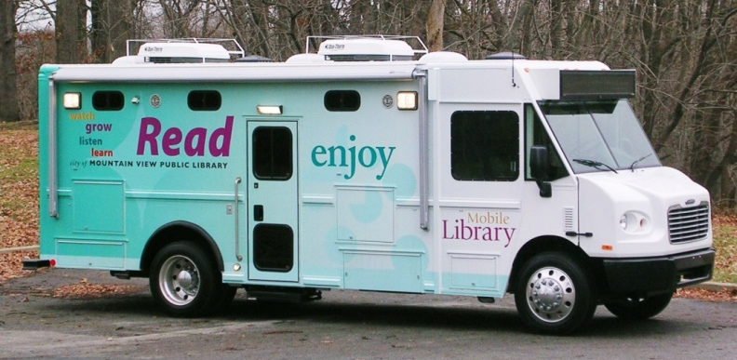
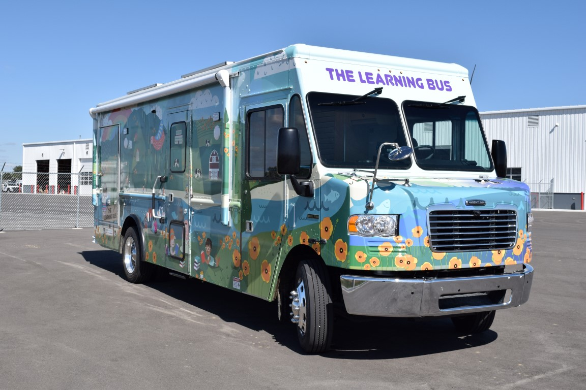
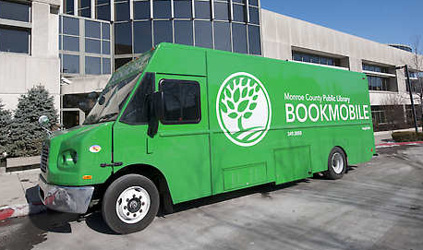
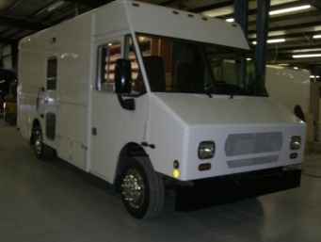
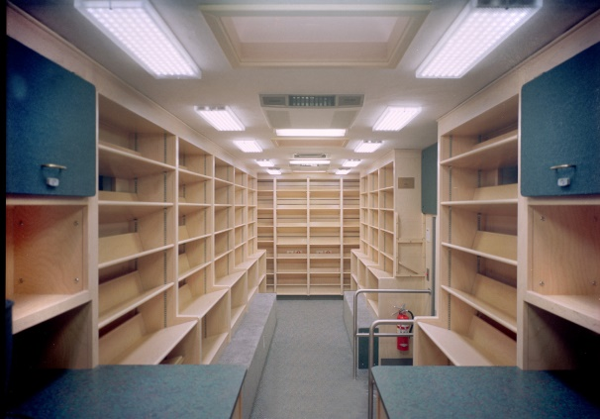
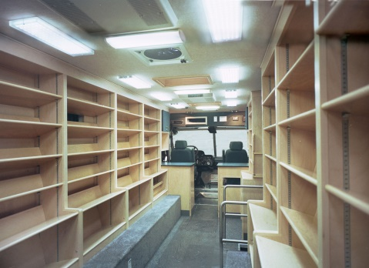
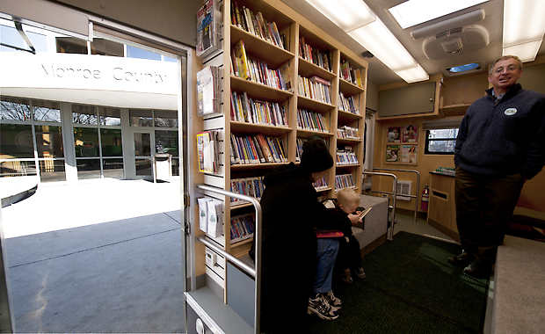
Step Vans

Slide 36
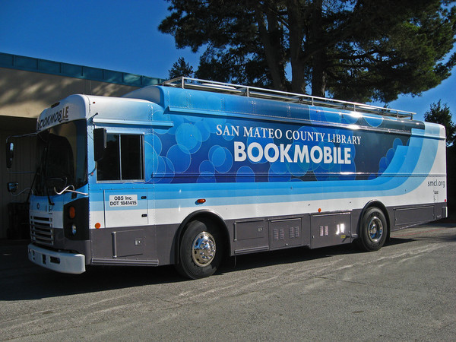
busses
Pros
Cons
Very heavy-duty
Rear FMVSS seating
Very maneuverable
Steel body
Curved sidewalls
Low headroom
Notes:
Heavy-duty, built like a tank to protect our children in a roll-over (high GVWR necessary due to weight)
Can add rear seatbelts
Shorter wheelbase equals tighter turns (sitting in front of steer axle!) 28’ units so maneuverable that they can “porpoise”!
Steel body heavy and prone to rust
Curved sidewalls shrink center aisle and limit shelving height
Only 77” without “roof raise”

Slide 37
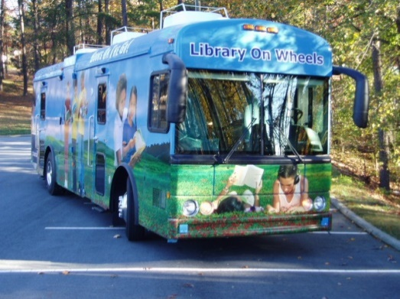
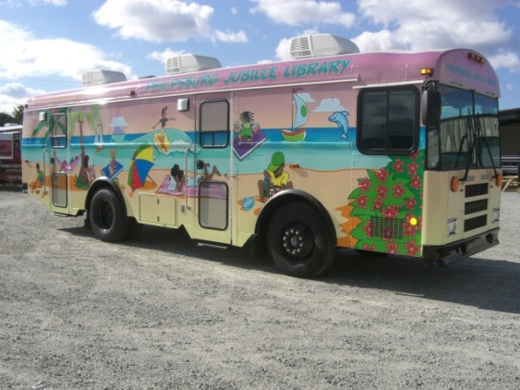
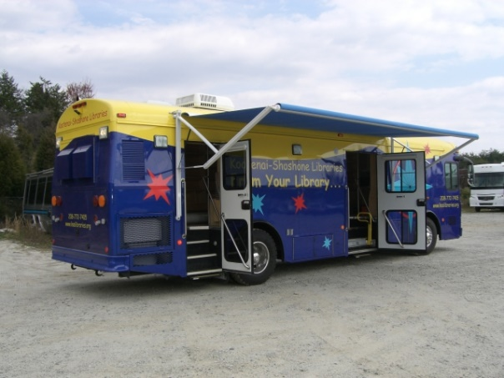
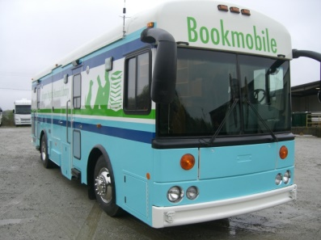
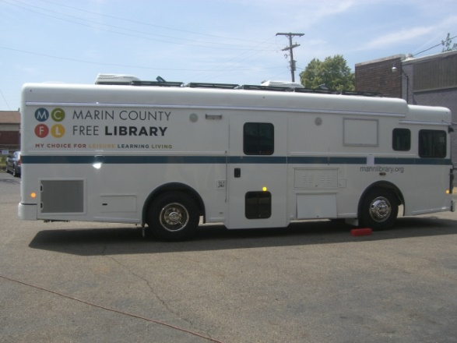
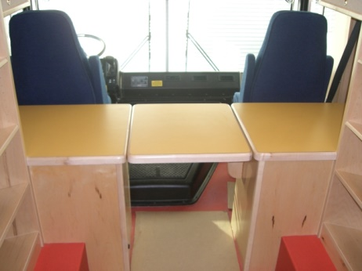
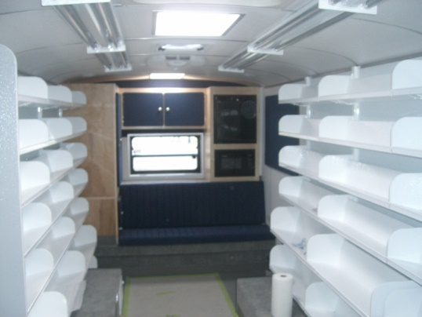
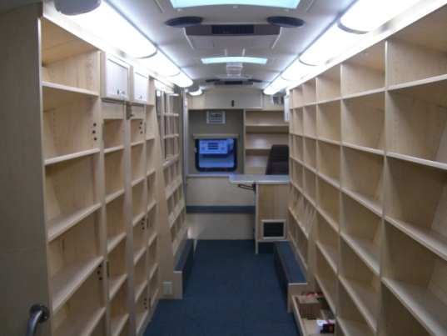
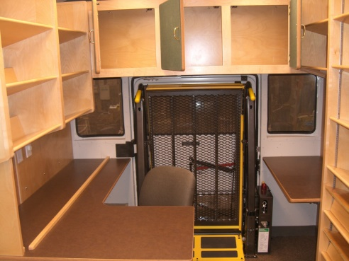
busses
Notes:
Front or rear engine placement
Efficient front end (with front engine)

Slide 38
trucks
Pros
Cons
Multiple configurations
Ease of use & service
Light & efficient body
Cab is single purpose
No rear FMVSS seating
Wider turn radius
Notes:
Multitude of options for length, height, engine, and door placements.
“Car like” driving features and hood for engine service.
Aluminum body with rectangular sidewalls. No wheel wells in some!
Loose efficiency of stacking driver/pass over engine
Can’t install rear seatbelts
Longer wheelbase equals wider turns

Slide 39









trucks
Notes:
With or without walk-through.
Very wide aisle (better with aluminum shelving).
Low profile wheels/tires improve floor height.
Lack of wheel wells greatly improves modularity

Slide 40


Design considerations
Notes:
Barbara went over some general considerations. I would like to speak a bit deeper about some popular choices I see daily. ☺

Slide 41



Aluminum shelving
Pros
Cons
Extremely modular
Light weight
Wider aisle
Higher cost
“Non-traditional” look
Less noise attenuation
Notes:
All connect to the vertical uprights. DVD shelves, divided shelves, desk surfaces, bench seats, etc.
Saves average of 700lbs over wood
Less structure equals wider aisle (42” in Sprinter, 62” in a wood bus, 76” in a 102” wide truck body) 14” more! Show 42”, 62”, 76” string!
Aluminum as a commodity has gotten more expensive
Hard to beat the traditional wood shelving
Doesn’t absorb sound quite as well

Slide 42

Hybrid power systems
Pros
Cons
Minimize generator use
Stable & quiet power
Eco-friendly
Large battery bank
Additional components
User training
Notes:
Use the generator only for necessities, battery charging and backup
Clean and quiet true sine wave power without the need for UPS systems
Less diesel fumes and noise
Large bank because batteries become the primary energy storage
Extra equipment can equal extra headaches down the road
Some additional training is required

Slide 43
Hybrid power systems
Shore
Transfer Switch
120V Panel
Air Conditioners
Generator
Wand
RFID Pad
Printers
Self Check-out
AGS
Inverter
Solar Panels
Computers
LED Lights
USB Receptacles
Diesel Heater
Monitors
Fans
Wheelchair Lift
WiFi
People Counters
Batteries
Engine
Notes:
Basic system powers all loads
Hybrid introduces larger battery bank and inverter… splitting loads into 3 groups (2 powered by batteries). Notice the heater is off the batteries (more in a few)!
Batteries are charged by inverter and engine
Solar can be added to improve run time
Automatic Generator Start (AGS) system can be added to add convenience and reduce user errors

Slide 44

Lithium-ion power systems
Pros
Cons
No generator at all!
Stable & quiet power
Eco-friendly
Cost
User training
Notes:
Next generation in power systems. Automotive grade energy systems designed for vehicle lifetime!
Power large electrical loads with no generator
Designed for solid performance
No noise or fumes
Costs still a bit high
Different way of power thinking

Slide 45

Lithium-ion power systems
Notes:
I thought this 2 minute video may be helpful.
I have visited the Volta plant and feel these products are the future of specialty vehicle power systems!

Slide 46


Solar panels
Pros
Cons
Free power
Very low maintenance
Eco-friendly
Initial cost
Not as useful if garaged
Notes:
Once installed, it’s free (and constant) power
Wipe them off once a year!
Can’t get better than collecting sunshine!
Cost is roughly $1,000 to $1,500 per panel
Fluorescent lighting doesn’t work!

Slide 47

Diesel- fired heaters
Pros
Cons
Minimize generator use
Forced air heat
Pre-heating of interior
Initial cost
Notes:
Is anyone familiar with a diesel fired heater is?
Powered by batteries
Forced air, ducted system (no hot grills to burn ankles)
Can pre-heat interior cabin (thermostatically controlled)
So far… Cost is a bit higher, but elimination of the generator issue must be factored.

Slide 48


Ruggedized modems
Pros
Cons
Built-in w/ ext. antennas
VPN and GPS
Also WiFi hotspot
Initial cost
Future replacements
Configuration required
Notes:
These are built in components (think aircard on steroids!). Bandwidth for 10-20 simultaneous users. Exterior high-gain antennas greatly improve service coverage and bandwidth
Virtual Private Network and GPS tracking available
Cast a WiFi cloud for patron devices.
Cost is about $1200/ea installed
May need replacement as technologies change
There is some configuration necessary from IT dept.

Slide 49


monitors
Pros
Cons
Information display
Valuable content
Patron familiarity
Initial cost
Future replacements
Configuration required
Notes:
Monitors are everywhere we look these days. There is a natural extension in outreach vehicles!
Information display with local or streaming sources
Content can be messaging, entertainment or gaming
Familiar throughout fixed library environments
Always a cost
Technologies age relatively fast
IT folks need to finalize configuration upon delivery

Slide 50


Video surveillance systems
Pros
Cons
Staff security
Accountability
360-degree view
Initial cost
Notes:
Like it or not, we all have to deal with public risk.
Security is paramount, especially with a single staff operation
Avoids the “he said, she said” scenarios
Today’s systems are merged with back-up cameras and stitch all 4 exterior cameras into a 360 degree view.
Telemetric and driver behavior can also be monitored
Real-time monitoring via ruggedized modem!

Slide 51

Specifications
Notes:
Barbara went over some general considerations. Now it’s time to write some specifications. ☺

Slide 52

Specification types
Performance Specifications
  Description of operating requirements (e.g., gross weight, maximum speed, acceleration rate, fuel economy, etc.)
Design Specifications
  Description of physical dimensions (e.g., length, volume carrying capacity, tensile strengths, or other engineering parameters)
Proprietary Specifications
  Description of vehicle’s required equipment (e.g., Caterpillar engine, Allison transmission, Eaton rear axle, etc.)
Bid specs may be primarily of one type or encompass elements of each
Be careful not to restrict specs more than necessary to avoid narrowing choices unintentionally
Be specific, yet flexible!

Slide 53

Specification resources
Other libraries
  Ideally with similar recent projects
Vendors
  Obviously proprietary
Fleet department
  At least with chassis aspect
  Vested in project
Your consultant
  Temporary expertise to supplement your staff
  Efficient and experienced

Slide 54
Working with your vendor
Notes:
So you’ve gone through all the steps and have awarded the project to a vendor. Your work is not done! ☺

Slide 55
Hundreds of details
It’s a team effort
Much like building a custom home
Vendor is expert with materials
You’re the expert on delivery flow
Notes:
Dimensions, features, patron flow, finish selections, graphics, etc.

Slide 56
Doing your part
Make timely decisions
Start graphics development early
Choose materials/colors prior to construction
Request photo updates
Weekly phone call with your representative
On-site inspections
Notes:
Don’t delay in getting information to the vendor
Graphics are a very subjective element. Could go quickly, but sometimes takes longer than the build!
Make your finish selections in a timely manner
Request weekly photo updates to monitor progress and/or check for errors
Have a frequent and open dialog weekly to iron out any issues
Conduct on-site visits. There’s nothing like being there!

Slide 57
Let’s conclude
Build your team
Know your community
Develop your infrastructure
Choose the base vehicle and features
Write your specifications
Work with your vendor

Slide 58
Thank you!!!
Barbara Battles
M: 732.567.5211
E: bbattles@sbpl.info
W: www.sbpl.info
Michael Swendrowski
M: 262.510.1397
E: mswendrowski@vehiclesuccess.com
W: www.vehiclesuccess.com
Notes:
Barbara and I would both like to thank you for your time today, and hope you picked up some great tips and information from our presentation!
Please feel free to use the information on the screen to contact me and/or grab a business card and brochure from the back of the room.
We hope you have/had a great conference and we look forward to any questions you may have.

