Slide 1
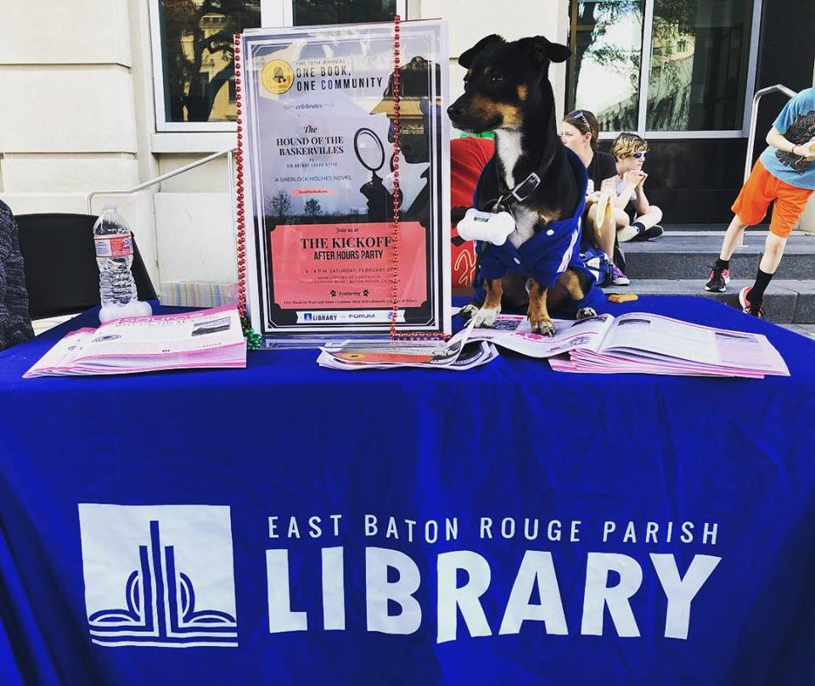
Tools to Market Your
Bookmobile/Outreach Department

Slide 2
To display or exhibit ostentatiously, even shamelessly, especially in order to provoke envy, admiration, or to show defiance.
Some call it marketing…we call it FLAUNTING!!!

Slide 3
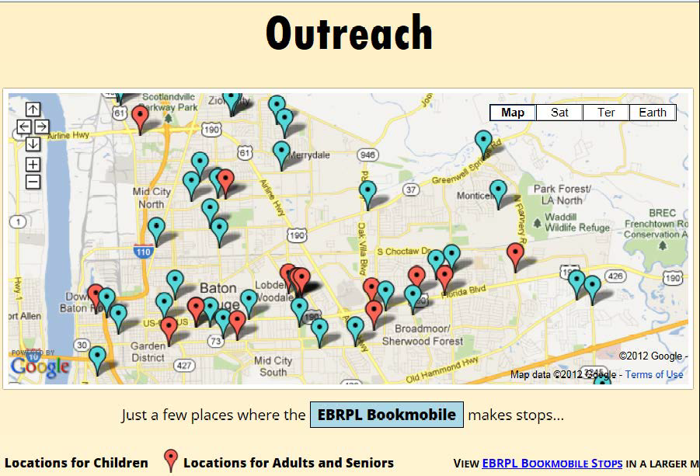
We service over 185 sites for children, teens, millennials, and seniors. We also create, coordinate and execute adult system-wide programming for the East Baton Rouge Parish Library System!
Notes:
We have a in-house staff of 15, plus 3 staff members at the Main Library in Administration
6 Preschool library technician Is,
4 Senior library technician Is,
1 Cataloging technician
1 Vehicle/Preschool supervisor
1 Senior supervisor
1 Clerical Specialist
1 Liaison
We currently have a nine vehicle fleet, 4 bookmobiles and 5 cars. Soon to be 5 bookmobiles—all self contained units.

Slide 4
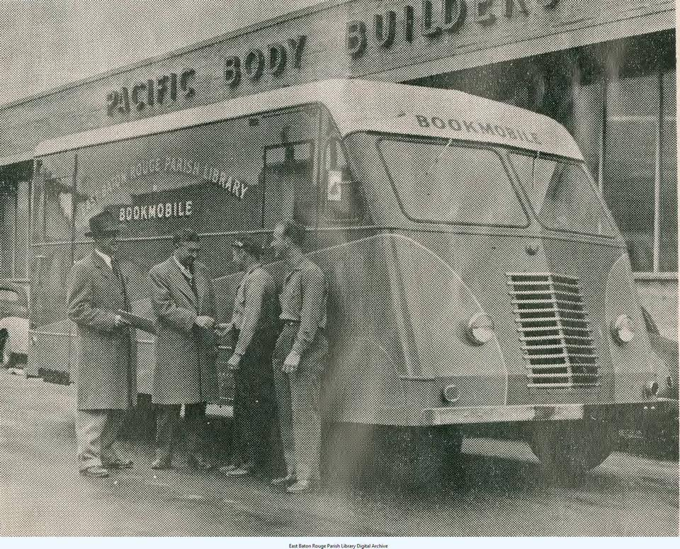
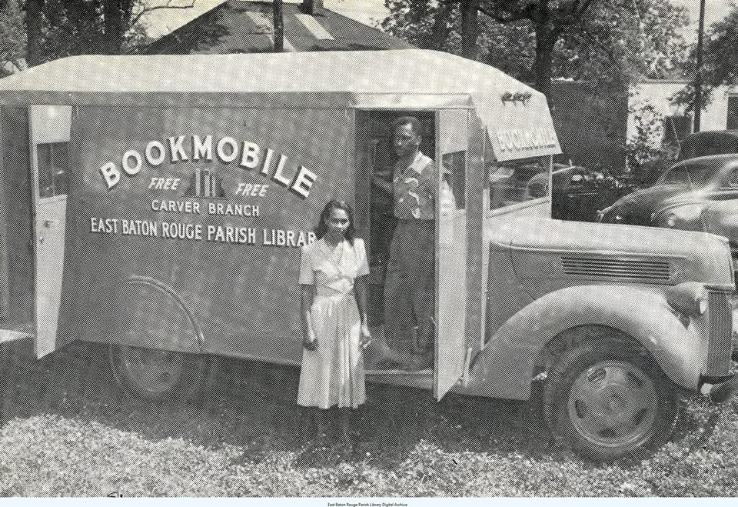
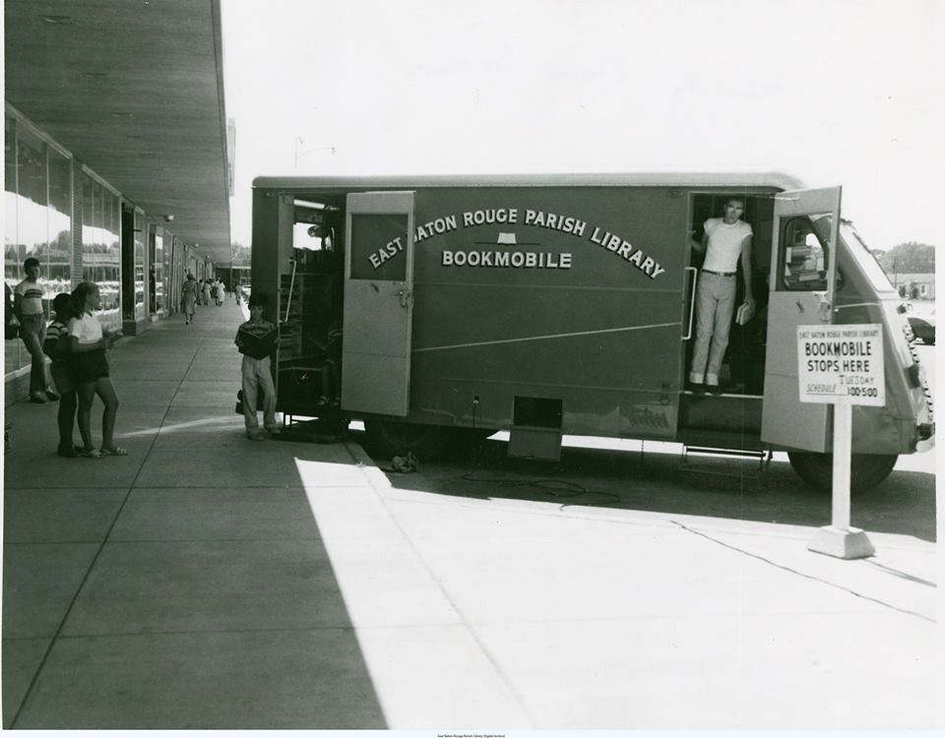
Notes:
Like many of you, the East Baton Rouge Parish Library was established in1939 with a collection of second-hand donated books. During its first three years, the Library established eight additional library branches to service the Baton Rouge area. Pictured above are the two different bookmobiles that serviced the parish. Pictured above is Mary Patricia Love, affectionately called the Bookmobile Lady with the Carver Bookmobile in 1950. Ms. Love was born in Baton Rouge in 1929 and graduated from McKinley High School and Southern University. She worked for the East Baton Rouge Parish Library System for 36 years.

Slide 5
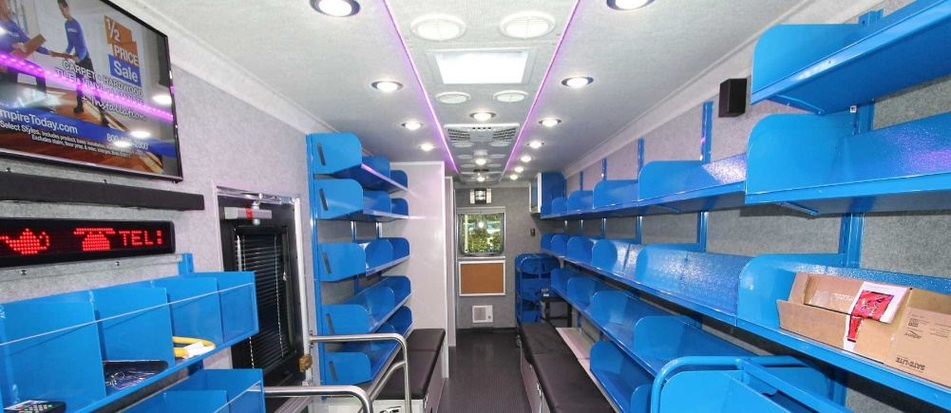
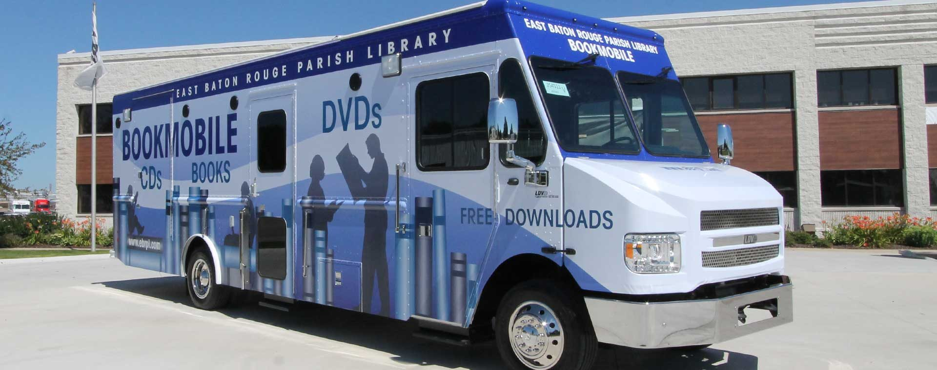
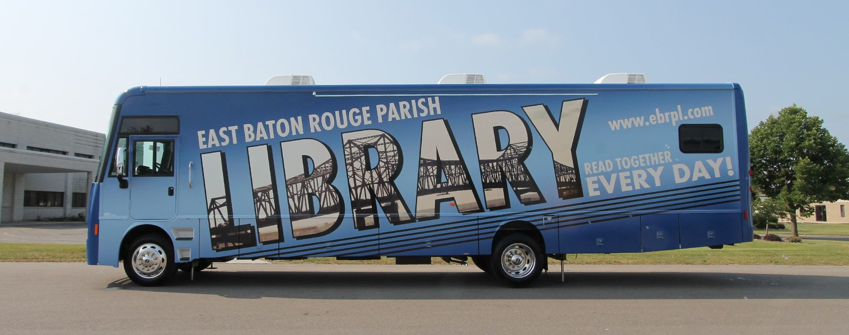
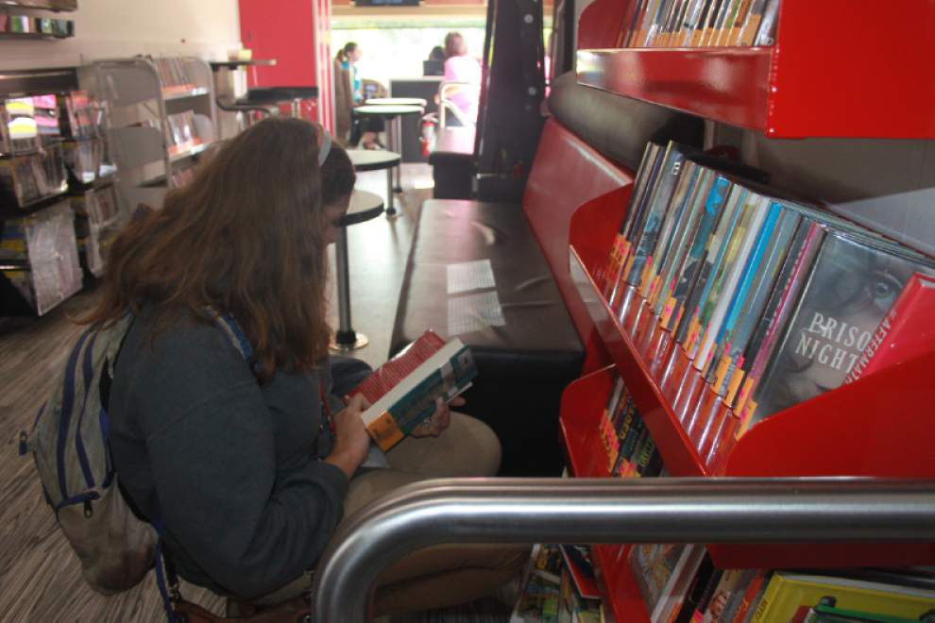
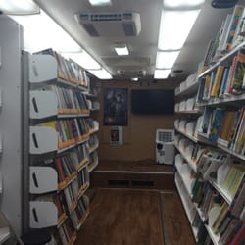
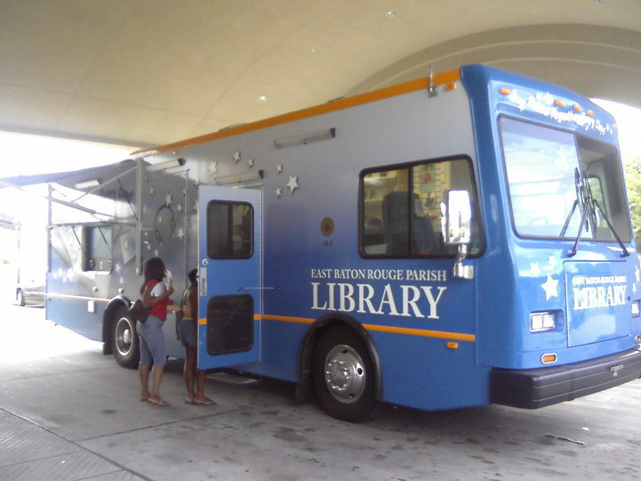
Notes:
We’ve come a mighty long way with our Outreach Division. Some things have worked out brilliantly,--the divisions, the inner workings, the new levels of supervision—while somethings, not so much… We are still working on titles for staff, and the department, itself. Some of us call it community programming and outreach services….for some, we are simply Bookmobile and Outreach Services. Often we are aligned with, and see ourselves as an extension of our Library’s PR Department.

Slide 6
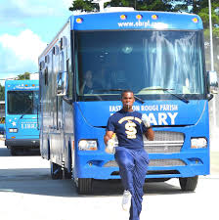
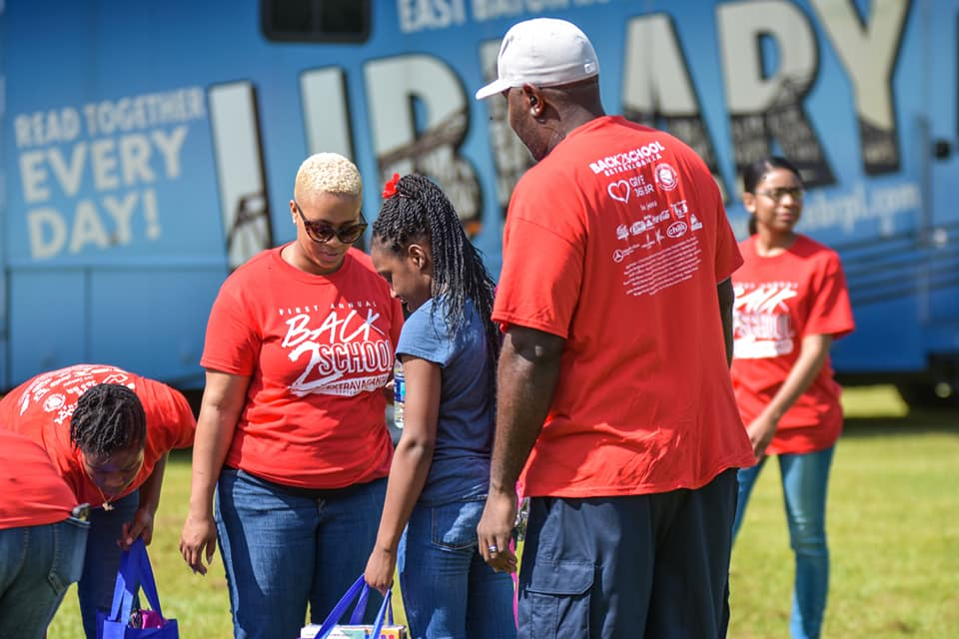
Notes:
People confuse flaunting (or marketing) with selling; when in fact, there is a very distinct difference.
Flaunting: understanding the patron so we provide what’s needed. Flaunting is everything we do to make the phone ring. To get a potential patron to call and inquire
Selling: all about making the sale. Focused on the transaction or the transition of service delivery for money; everything we do once we pick of the phone and answer
No More Selling!!! Stop Preaching to the Choir!!
What do we want????
We want to understand our patrons well, thereby communicating the benefits of our services and resources so well that the Library “sells” itself.
Instead of having to go to the patron and convince them on how important we are….)--They see other people using it, and the come to us of their own free will.
NOVEL IDEA—RIGHT???

Slide 7
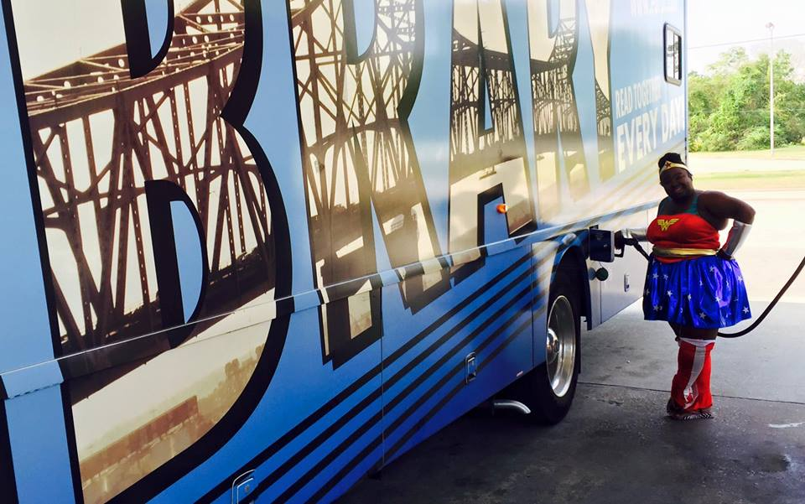
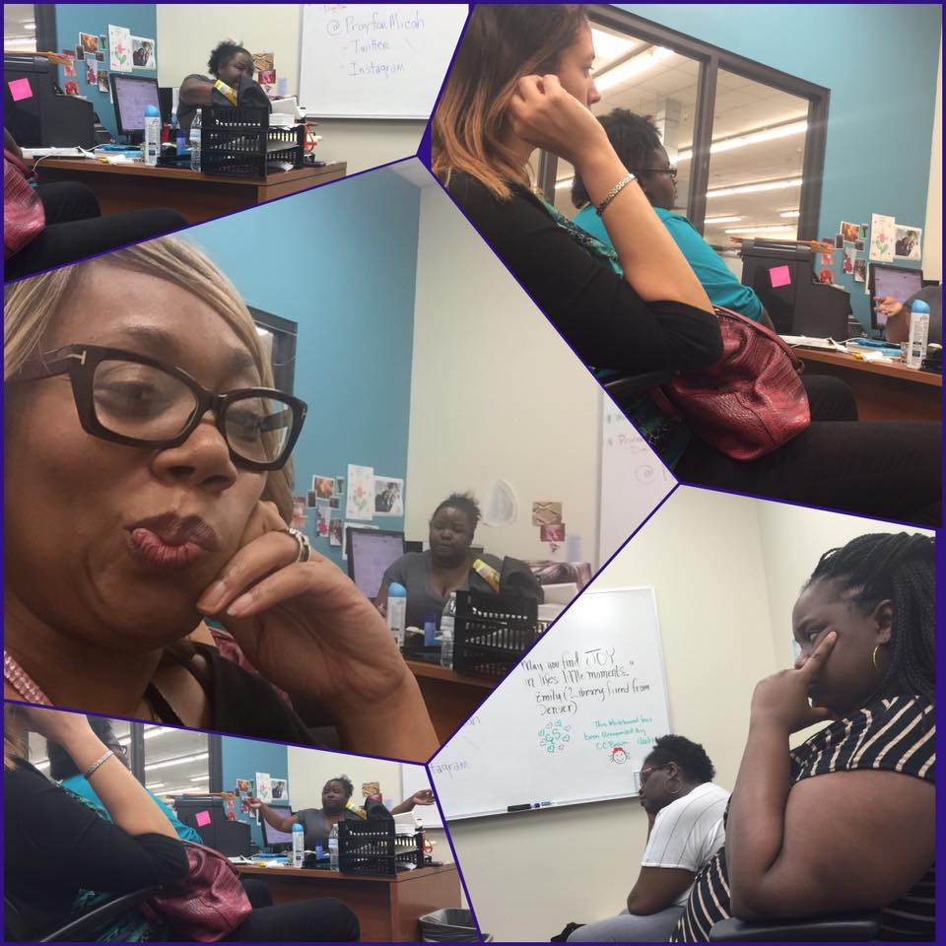
Doing that Outreach Stuff
Notes:
Outreach librarians strive to provide equitable delivery of library services to all people through the development of programs, policies, practices, and behaviors which make the library available to all people.
The following pictures are easily identifiable images of library outreach work, or the pictures that many paint in their head about libraries and library service. This is what they think we do……

Slide 8
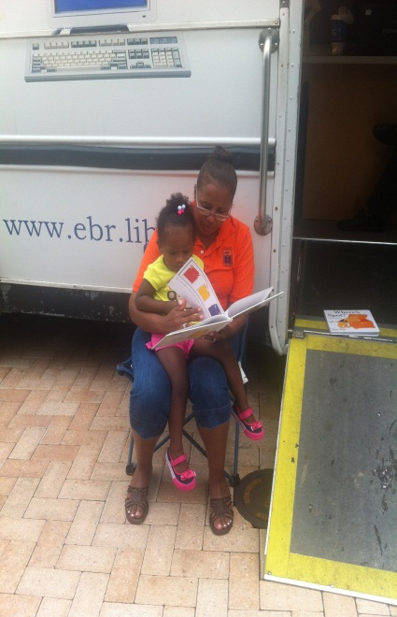
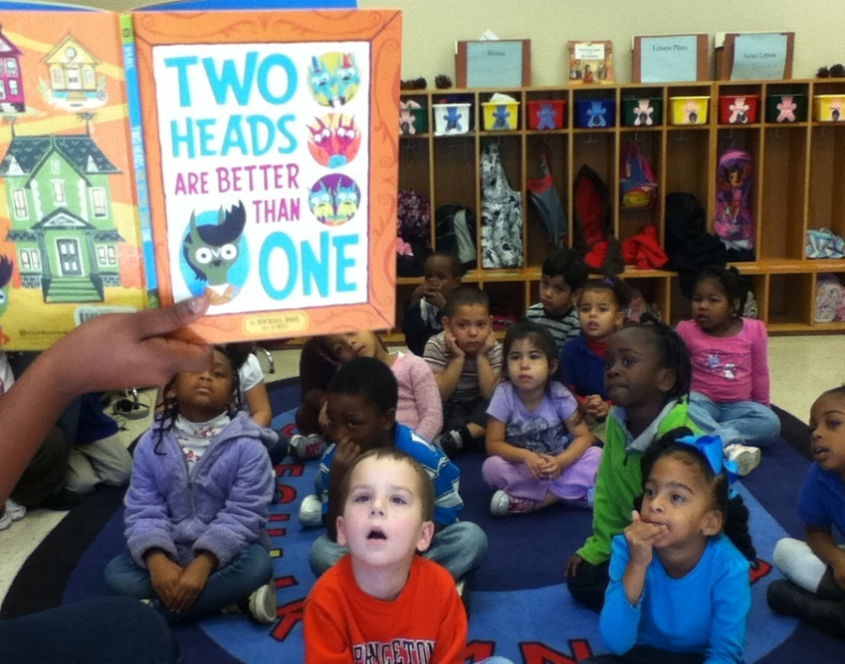
Little Ones
Share Our Love of Reading
Notes:
We want them to think outside of these traditional parameters. We are so much more than repositories for books and little ladies reading books to babies!

Slide 9
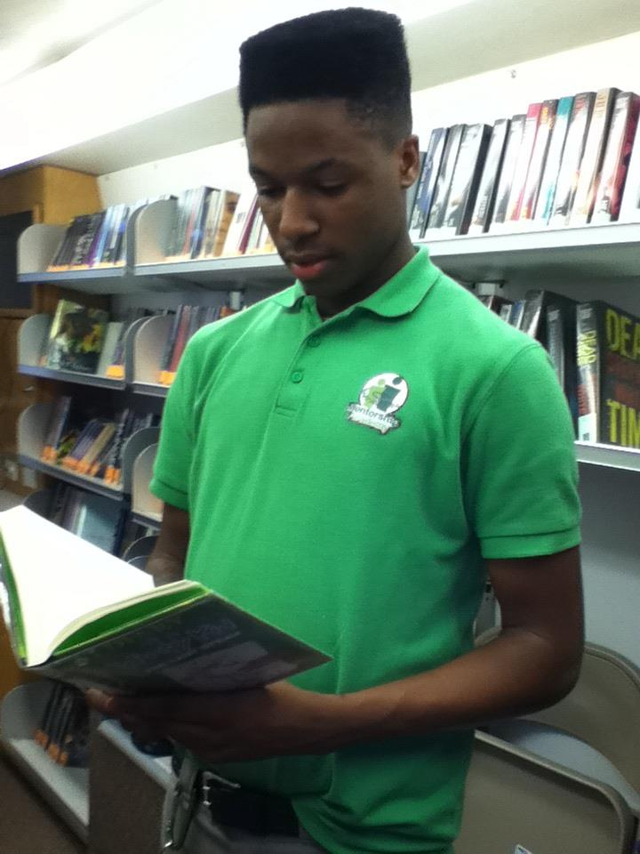
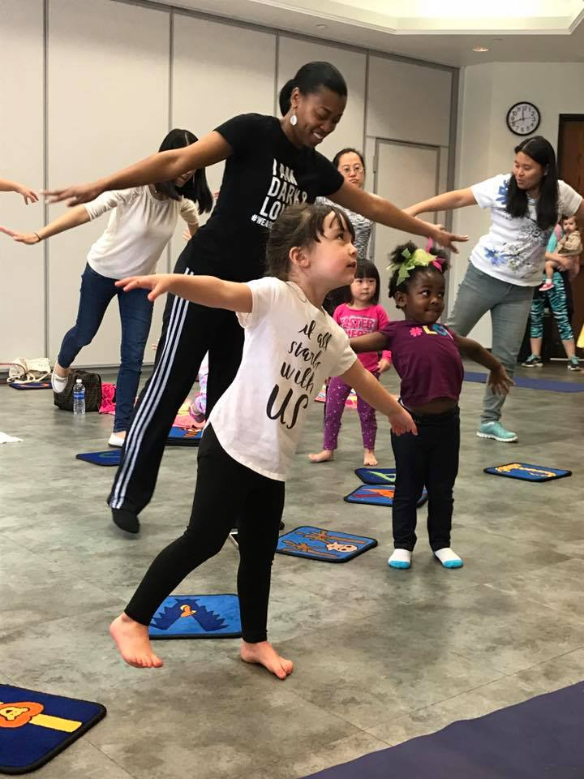
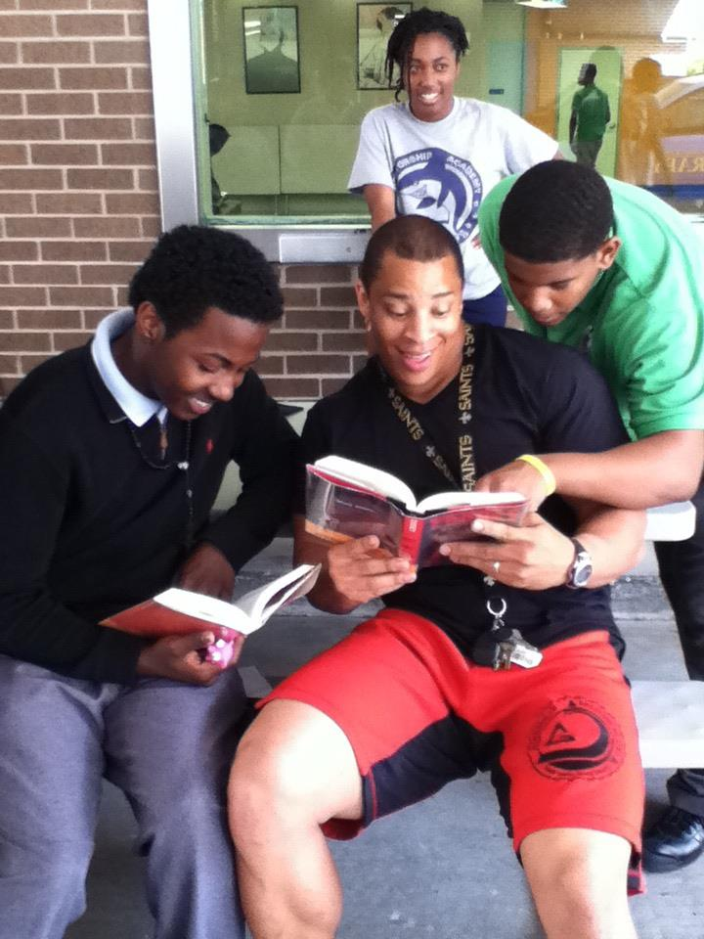
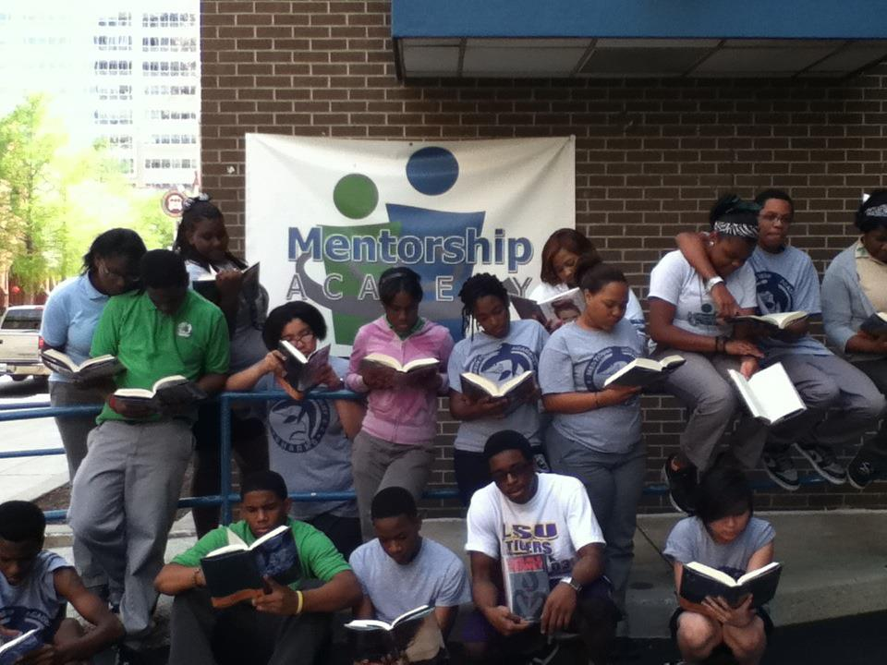
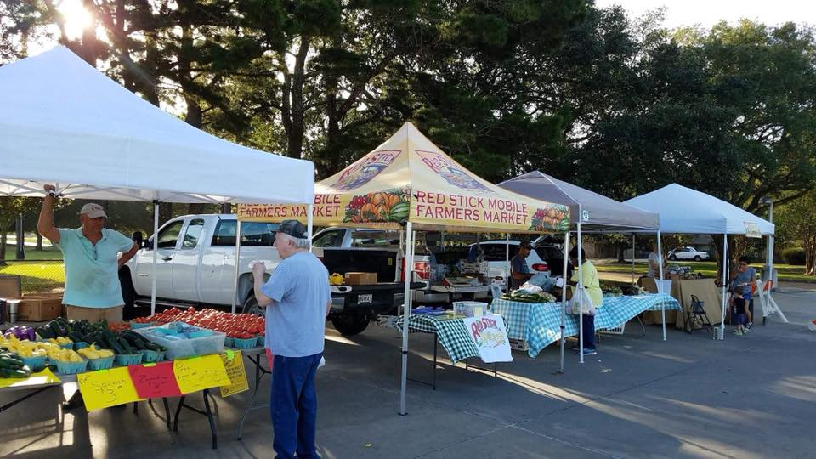
Notes:
We want them to think outside of these traditional parameters. We are so much more than repositories for books.

Slide 10
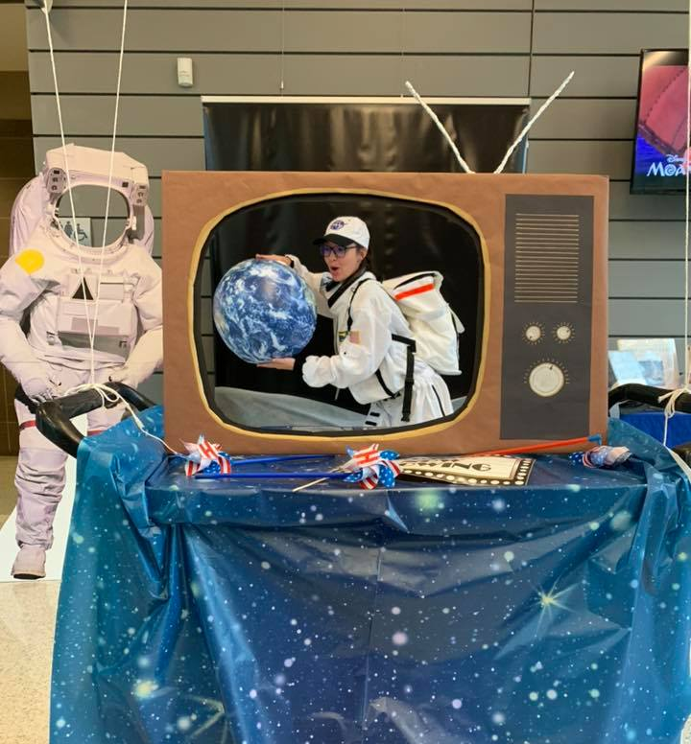
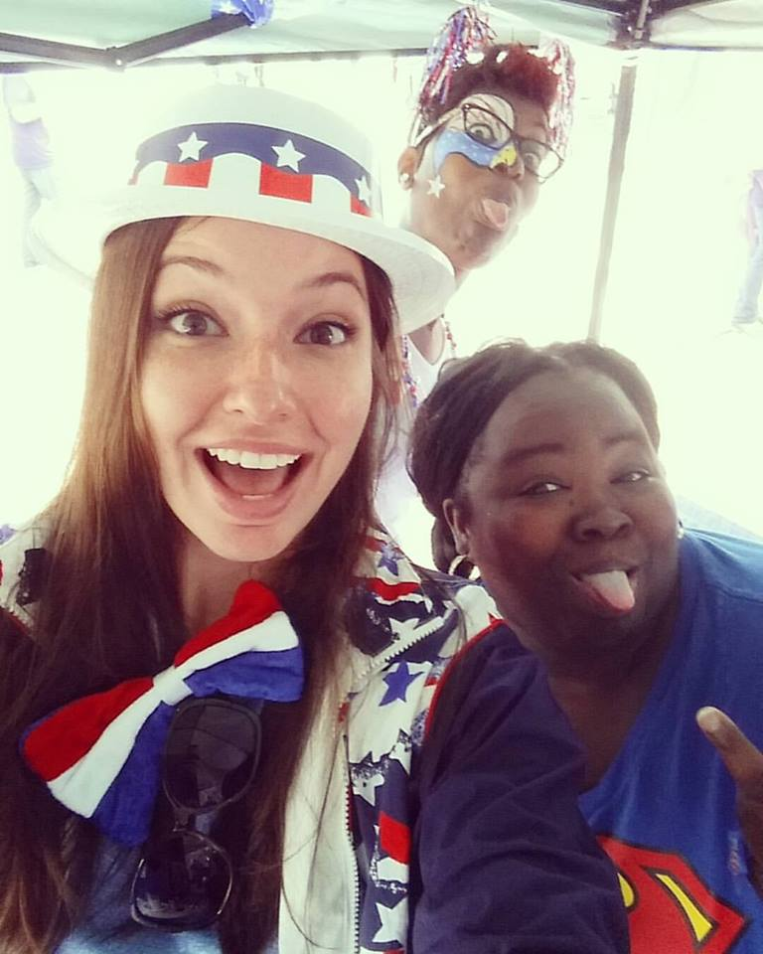
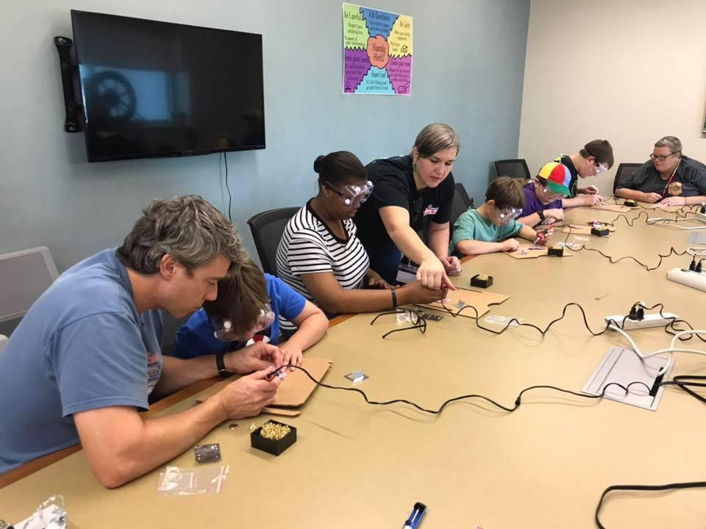
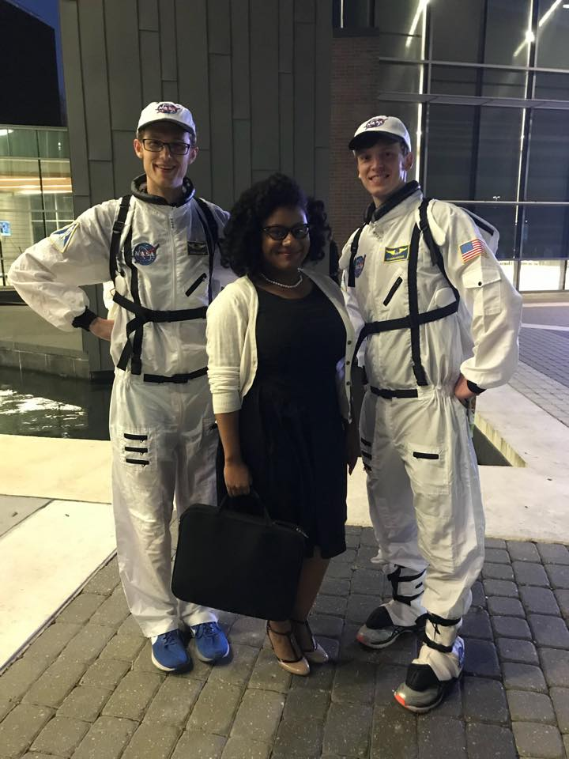
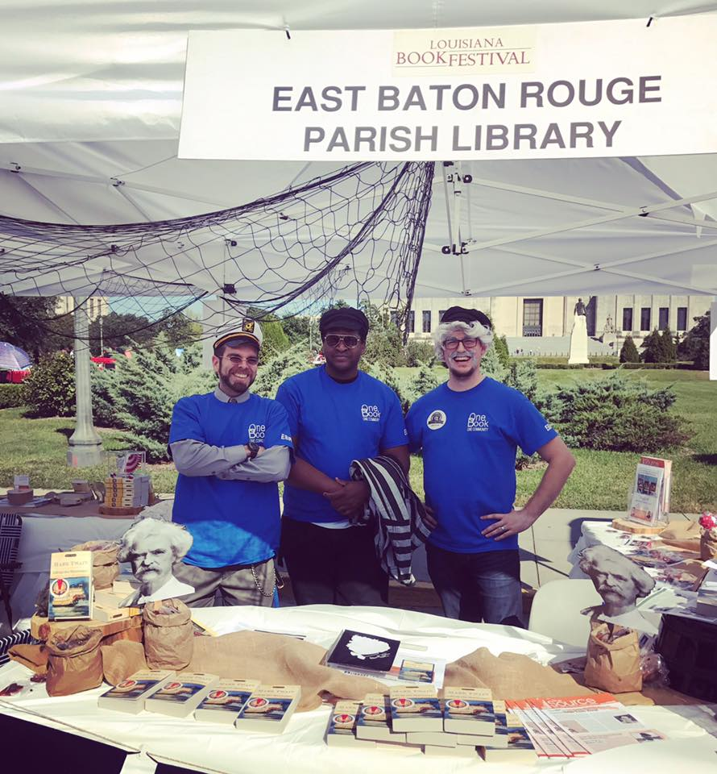
This Is
How We
Roll!

Slide 11
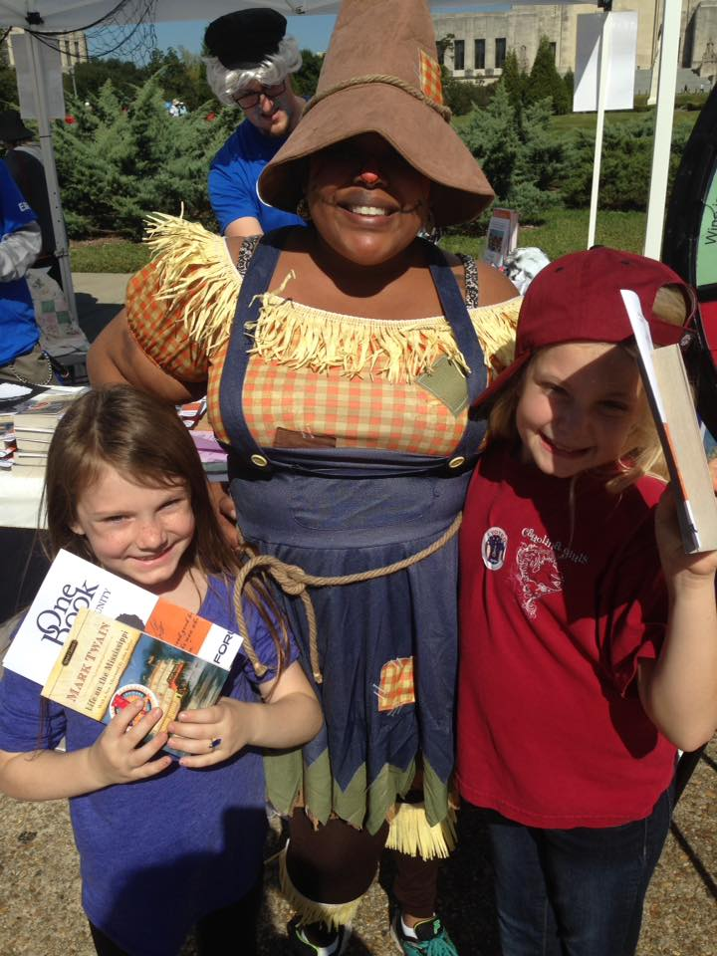
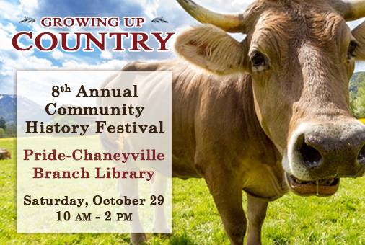
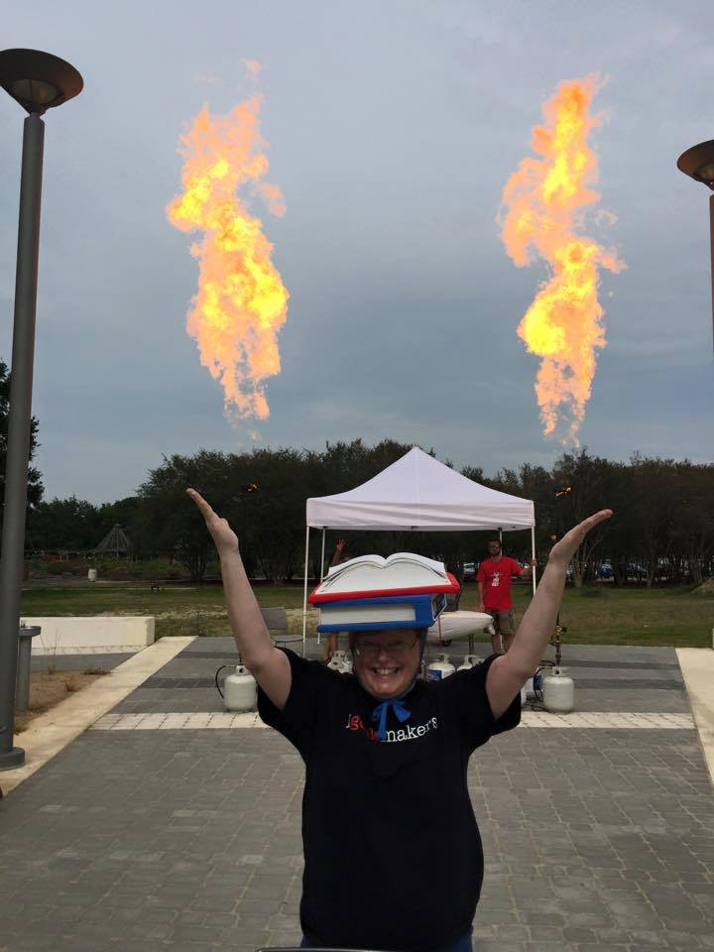

Slide 12
Who & How to Serve?
Are
The
Where
Patrons?
Notes:
The Mission: developing Life-Long Library Love Marketing Boiled Down to its Essence
I am not here to convince librarians that the library services should be an integral part of its community. Consequently, it vital that all members of your OUTREACH staff understand the premise. Community Engagement is the cornerstone of any outreach program…and it requires staff members to branch out and reach out. For many of you, spreading the word about family programs and services that your library offers just might open up an avenue of revenue as grant funding, donations, or attract volunteers.

Slide 13
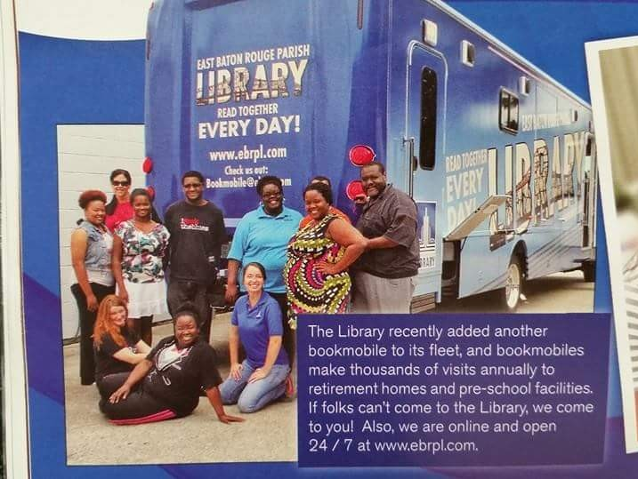
The blueprint
The unit
Guerilla
Networking
Advertising
Engaging the Media
Dolla, DolLa Bills Yall
The four E’s
Notes:
Remember to mention “infiltration” for #3.
We can verbalize “milking the media” but not in print…may work as a room opener, if the ambiance is uncomfortable.

Slide 14
Your Unit/Uniform Speaks
NuNu
Betty/big Bleu
DigiBlu
Community Route/Senior
Preschool focus
Adult/Technology
Notes:
The vehicle is your first line of defense. There are nine vehicles altogether, and they are all in some state of being revamped—either with wraps or paint.
Not pictured: The Elf
Each unit has a specific look, but are all united by color. Our library branding incorporates “library blue” in all our print and non-print advertising. Even if the picture/brand changes, the color has always been Blue. It is a mix of Patriot and Royal Blue, its name is Relux/reflux/reflex Blue.
Staff often work in t-shirts and jeans, we have matching shirts, with either the “bookmobile logo” or “library logo”.
You need to look inviting and comfortable. Think about small changes—the colors of your shelves. Picking a vibrant floor, or using decals.

Slide 15
Popular Guerilla Attacks!
“Geek the Bookmobile”
undercover agents
Counter-Campaigns
Notes:
Guerilla marketing looks to leverage creativity, imagination and originality in place of a big budget. Smart, small departments with a limited budget should utilize guerilla marketing to compete with huge companies.
THE Ice Bucket Challenge for ALS…a peer-to-peer fundraising campaign…that was misunderstood, but did well. Just remember, if you pick a challenge, it needs If you choose a challenge: it needs to be doable, highly social, and flattering.
Lifelock, dared people to steal their CEO’s identity and win 1million dollars.
Tinder’s basic strategy was infiltrate the cool kids, and sucker them in to the app—they went to the best parties and got “attractive, influential” youth on board. Went from 5K to 15K almost overnight.
“Geek the Bookmobile” t-shirts, stickers with acronyms, geek wall!
Employ undercover agents to promote the library directly to potential patrons. Sony hired agents to ask strangers to take photos of them and then raved about their camera.
Patron Participation—make read posters with “popular” or famous community members
Counter-Campaign—Safeguarding American Families, which said it was rooting for the vote to lose so it could throw a book-burning party once the library closed.
Safeguarding American Families printed up signs that said: “Vote to close Troy Library Aug. 2nd, Book burning party Aug 5th.” They planted them on lawns. They started a Facebook page and a Twitter account (“There are 200,000 reasons to close the Troy Library. They’re called books. #BookBurningParty”).

Slide 16
Immediate Guerilla Attack
Craft an elevator pitch
Then
Leverage the Pitch to the community
Notes:
Craft an elevator pitch
You should be marketing all the time — wherever you are. Therefore, you need a compelling elevator pitch.
Research shows the average attention span of an adult is about six to eight seconds. That’s all the time you have to grab someone’s attention.
If you successfully engage them, then you only have a little over a minute to really sell them. Invest the time to craft a killer elevator pitch.
Leverage your pitch to the community
You don’t have to think big when it comes to your marketing efforts. Think locally. What’s going on in your community?
PARTNERSHIPS!!! Get to know your ideal patrons and think about how and where they spend their time.
Then search for opportunities to get in front of your patrons with your library’s mission.

Slide 17
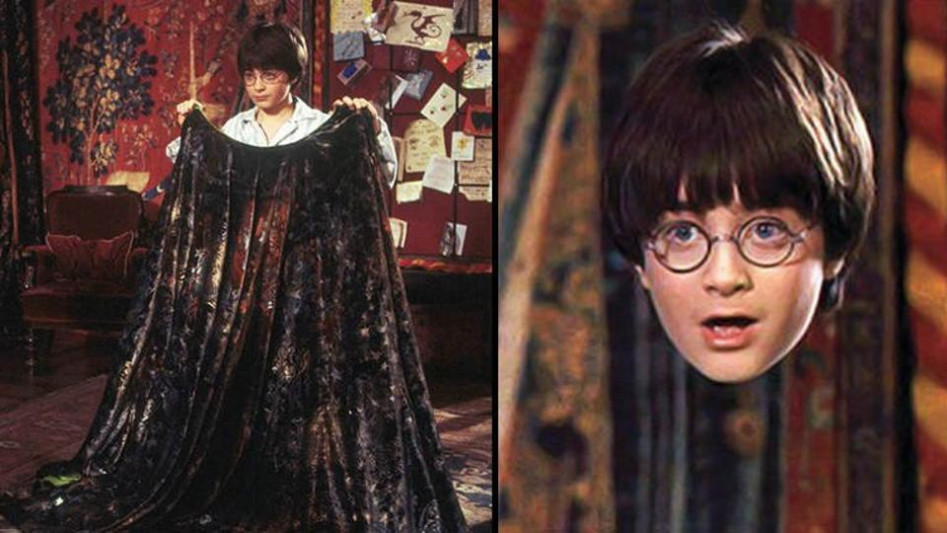
Invisibility: The deathly hallow
STOP BEING INVISIBLE
(and Taking Yourself for Granted)
Notes:
STOP BEING INVISIBLE (and Taking Yourself for Granted)
When you are a library (or department within) with a limited (read non-existent) marketing budget, it makes sense to partner with other complementary businesses and non-profits. These can include the obvious non-profits like Big Buddy, the Boys N Girls Club, Kiwanis, Rotary club, etc….but it should ALSO include non-traditional merchants like Micro-Brewers, SPORTS TEAMS, food trucks, businesses (local and franchises), manufacturers, suppliers and vendors. Not only does your bookmobile win when your patron usage increases, but there is added credibility when businesses recommend you.
Add an email option to each patron record. Mention During the library card application, that they give you permission to receive mailings and it eliminates unnecessary phone calls. If allowed, allow businesses and other non-profits to “sponsor” your email blasts. (Think Sesame Street—brought to you by the letter Z.)
Send and post your bookmobile flyers to public bulleting space—think the public transit system, hospital emergency rooms/waiting areas, social welfare offices (WIC), physical retail space, ask to put your business cards in their customer waiting area.
You can also seek partners within your existing customer base. Create a referral rewards program where you reward your patrons for referring you to, or adding new stops, patrons, or resources. Word of mouth is extremely effective when it comes to marketing.

Slide 18
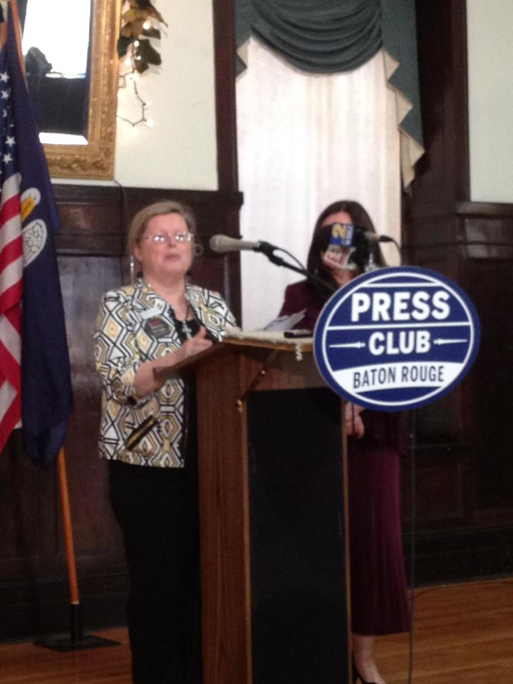
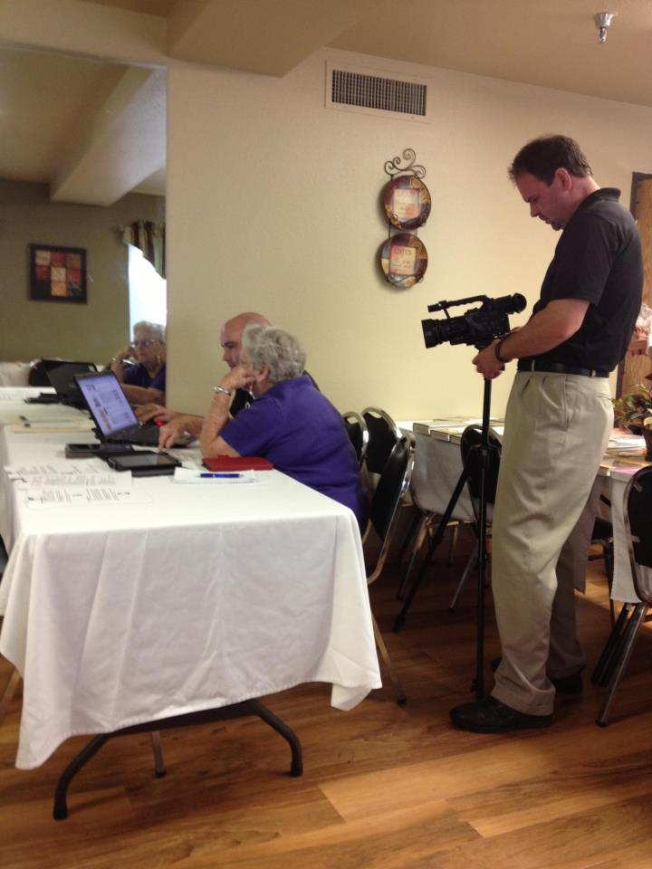
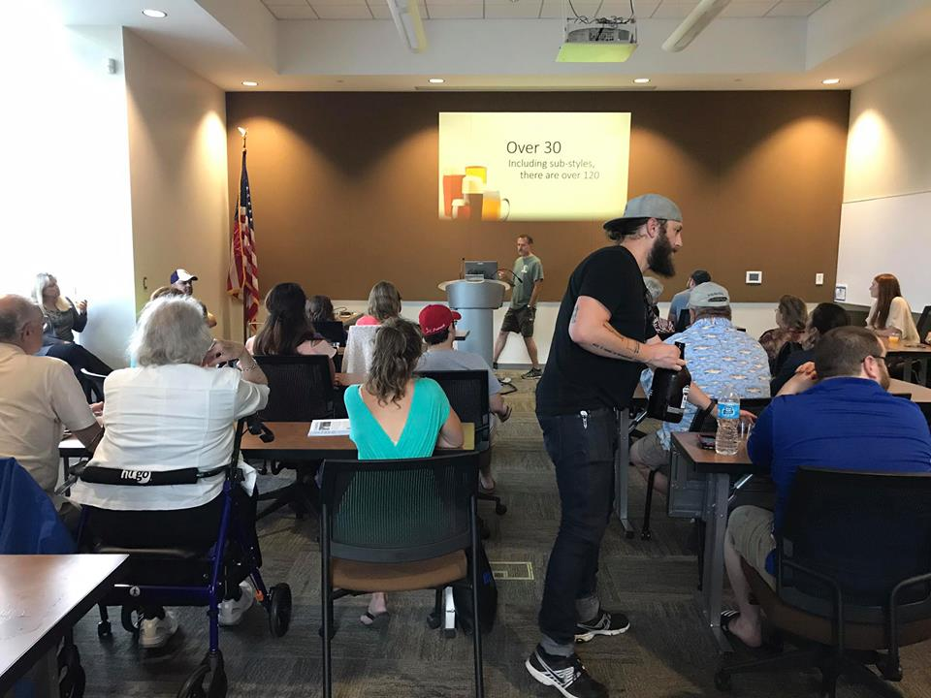
Meet New Friends, Network and the Keep the Old… Collaborate
Notes:
Network
I’m a huge fan of networking. I don’t think there is any better way to build a successful bookmobile program than to get out there, shake some hands, and get to know people. Networking requires a time commitment and it doesn’t provide instant gratification, but a strong network is one of the greatest assets any bookmobile staff member can have.
Collaborate
Put together a group of synergistic, non-competitive businesses and non-profits in your area and agree to cross-promote.
You can use flyers, reciprocal website links, bundled promotions or social media platforms. By collaborating with each other, you can expand your patron base because you’ll be reaching new people. There is nothing wrong with forming alliances with bookstores, other libraries, or literacy alliances in your community. Contrary to popular belief, working with these existing businesses and groups, only helps you!
There are many possibilities for reaching adults who have connections to children. Service groups like Kiwanis Clubs, Lions Clubs, or Altrusa International are often amenable to having guest speakers at their meetings. Spreading the word about family programs and services that your library offers just might open up an avenue of grant funding or attract volunteers.
Afterschool Alliance and United Way’s Success by 6 are two national programs that may have branches in your area. If these groups are meeting in your community, the library should have a seat at the table. These types of meetings are great for networking and figuring out how your library can partner with local organizations. These groups might not think to invite the library, so don’t be afraid to ask to attend—you’ll often find them receptive to including new attendees who care about children.

Slide 19
Partner examples
City Council Members/Office of Community Engagement
Other Libraries, bookstores
YWCA/YMCA
Big Buddy/Boys N Girls Club
BREC (local parks/recreation)
DBA (Downtown Business Association)
SCORE/AARP retirees
Cajun Clickers
Franchises like Raising Cane’s
Community Coffee
WIC offices/DHH
Daiquiri Shops/Bars Lounges
Movie Theaters
Entertainment Centers
Farmer’s Markets
Barnes & Noble
Homeschool Networks
Local Community Colleges
Sports Teams! Think Minors
Reality TV Stars/Shows

Slide 20
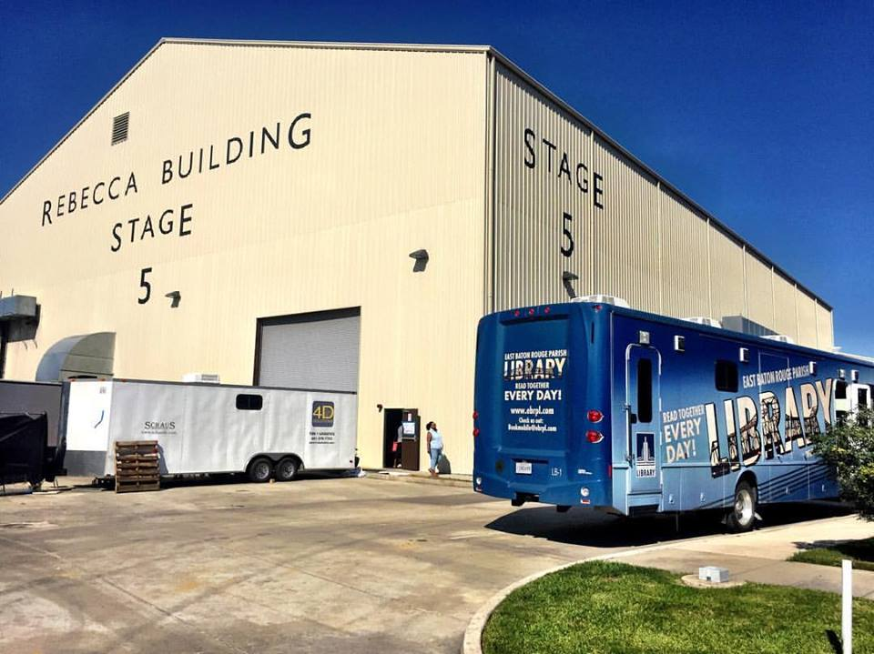
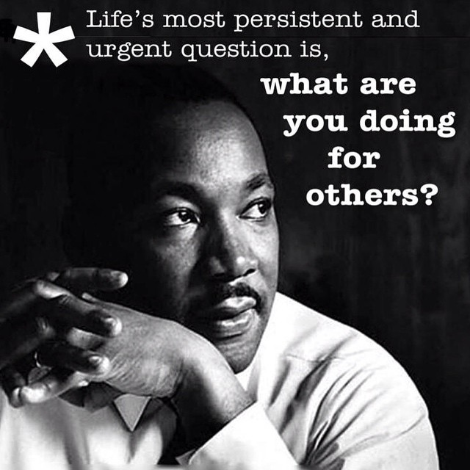
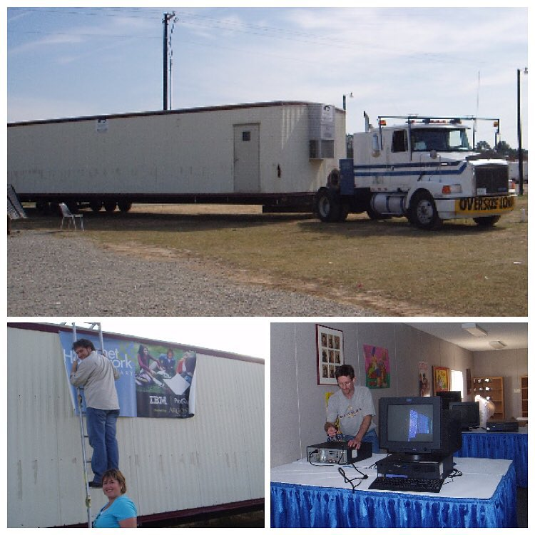
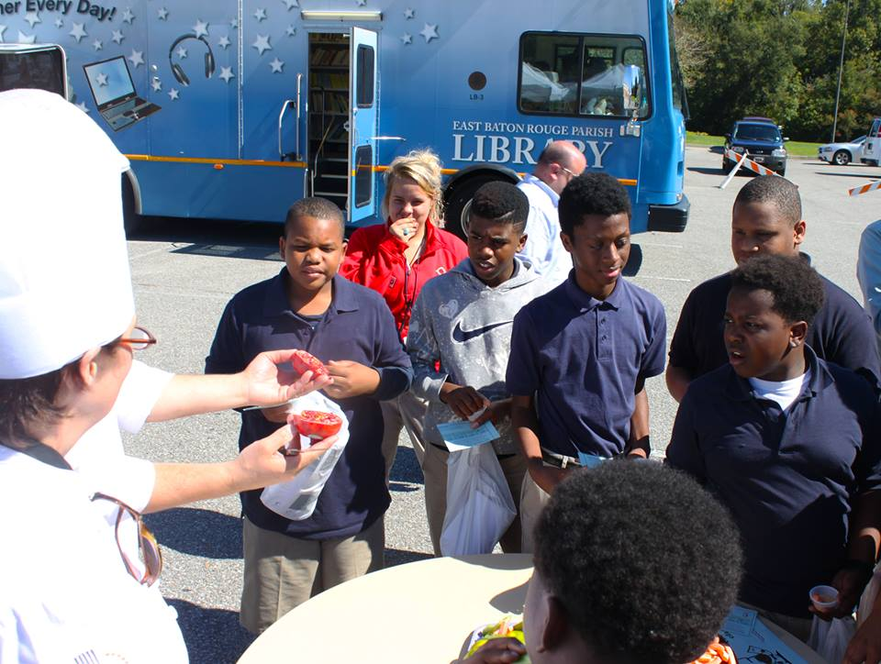
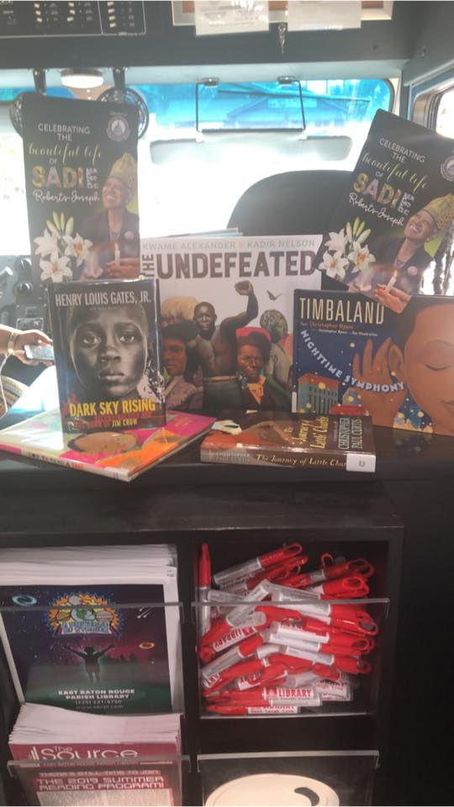
Be More than Your Intentions
Notes:
Bookmobiles are there for people, many times when no one else can be.
In September of 2005 EBRPL partnered with ProQuest to bring a mobile library to those displaced by Hurricane Katrina and Rita. This mobile unit was originally placed by a shelter in downtown Baton Rouge and then moved to Renaissance Village. It was equipped with computers and books that the Katrina evacuees were able to use. It was later used to help Louisianians displaced from Hurricane Gustav (2008), just three years later.
Many of our surrounding “suburbs” are teeming with blight, food deserts, and damage from natural disasters. Our bookmobiles have been used to foster positive social engagement
In August 2016, prolonged rainfall resulted in catastrophic flooding in the state of Louisiana; thousands of houses and businesses were submerged. Our bookmobiles provided shelter from the elements, computer access to people that needed to fill out FEMA forms, and provided a place for volunteers to set up for food dispersal—when libraries weren’t allowed to open. We hosted giveaways, food trucks, clothing drives, and an outpouring of love.
We routinely follow the moveable food markets, and partner with the food bank to provide nourishment for mind, and body.
An avenue to discuss is becoming part of your community’s disaster/COOP plans, and working with the extensions of Homeland Security in your area. Having a seat at this table, allows for the dispersal of TRUE facts and information, directly to the patrons, from people they trust.

Slide 21
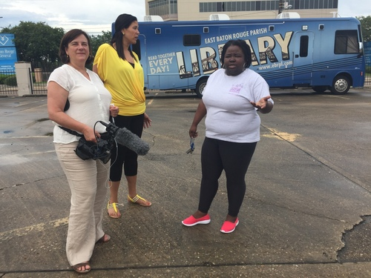
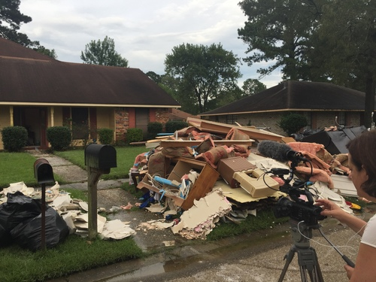
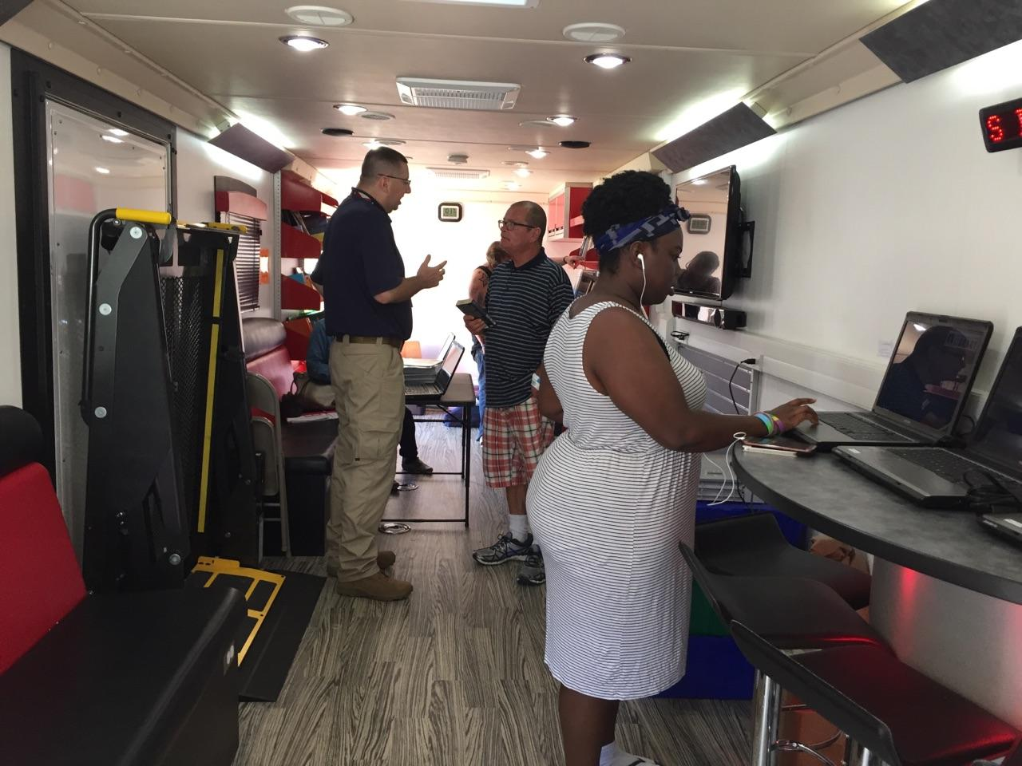
Notes:
Just as the rest of the community was affected, so too was the library’s staff—with I believe 147 staff members flooded. Someone will correct me if I am wrong.
Of our 14 locations, all but the flooded Greenwell Springs Road Regional Branch Library returned to their normal 7 day weekly schedule as soon as enough staff could return to man the desk at each location.
https://www.ebrpl.com/Source/Source201609.pdf
Our library facilities served as:
Place of respite
Place to connect with family and work via email or in person
Place for children and teens to attend impromptu programs to try to put normalcy back into their lives, especially since schools were cancelled for several weeks... and then return to the usual robust schedule of fall programming as soon as possible
Place to attend public meetings on Flood recovery, remediation, construction, town meetings, legal help for homeowners with title problems, etc
Place for “Operation Photo Recovery” wherein flood victims brought treasures to be repaired
Place to attend “Listening Sessions” with trained volunteers by the Interfaith Federation
Place to meet social workers who were “on site” to listen
Place to attend meditative programs, adult coloring programs, crochet and other hand work, etc
Place to see exhibits that might offer a helpful release
Place to train SBA and FEMA and other volunteers
Place for SBA or FEMA staff to hold appointments for flood victims
Place for the LSU Flood Study on Resilience and Recovery to announce progress and to interview or survey participants
Place for the Southeast University pop-up oral history for flood victims
Place for community info distribution such as brochures, booklets, announcements, etc
Our Bookmobile / Outreach Service staff
Went to shelters
Made regular trips to our flooded Greenwell Springs Road Regional Branch Library’s parking lot, first to hand out supplies...
then to provide library materials and free computer/internet use.
Catholic Charities also set up shop there.
FEMA reps were with them and assisted with forms. They even brought printers...
Our staff:
Checked out all facilities and repaired as needed to expedite re-opening
Remediated and renovated the flooded GSR branch to have it open by March 2017
Gathered and shared info related to remediation, shelters, sandbag locations, weather info, flood resources, non-profit and government assistance, etc
Use social media to send out helpful information at all hours of the day and night (even tweeting from the boat!)
Attended meetings to gather useful information
Gathered and shared rebuilding and other consumer info
Assisted patrons with computers and the myriad electronic forms etc.
Shared useful materials to help children deal with disaster stress, fear of rain, etc.
Answered preservation questions
Held scanning sessions
Listened to patrons
Worked with patrons who lacked ID but who needed new cards
Listened to patrons ...
Worked with patrons distraught over lost materials
Listened to patrons ... can’t stress this enough!
Opened their homes to each other
Helped each other as well as the community by washing clothes, cooking meals, lending or donating household goods, giving rides

Slide 22
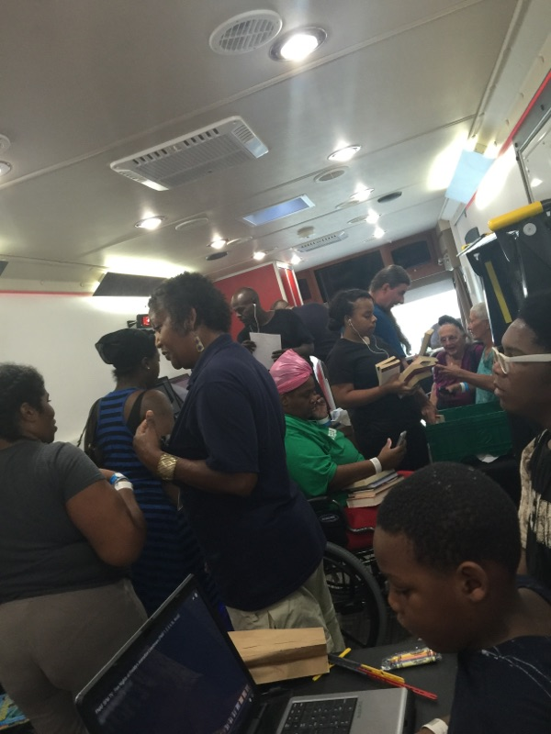
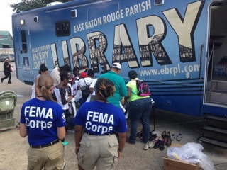
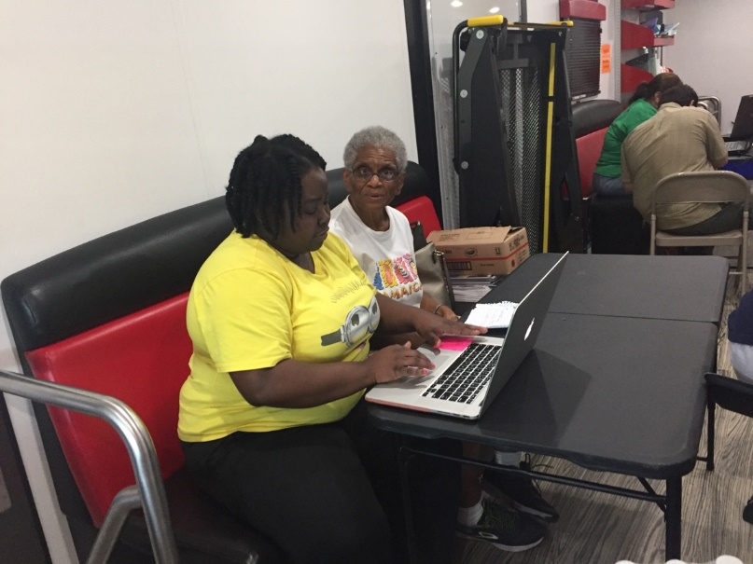

Slide 23
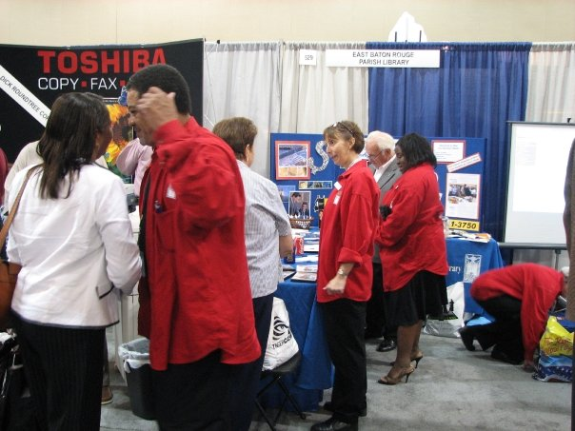
How to Meet new People: Get Uncomfortable
Take a deep breath and volunteer.
Notes:
Give a speech
A lot of people hate public speaking.
However, there are many organizations looking for qualified, subject-matter experts who can present to their groups.
Take a deep breath and volunteer.
You don’t have to be a pro as long as the information you share is helpful to the audience. And the upside — the more you do it the easier it gets.
Plus, it positions you as a credible authority in your field.

Slide 24
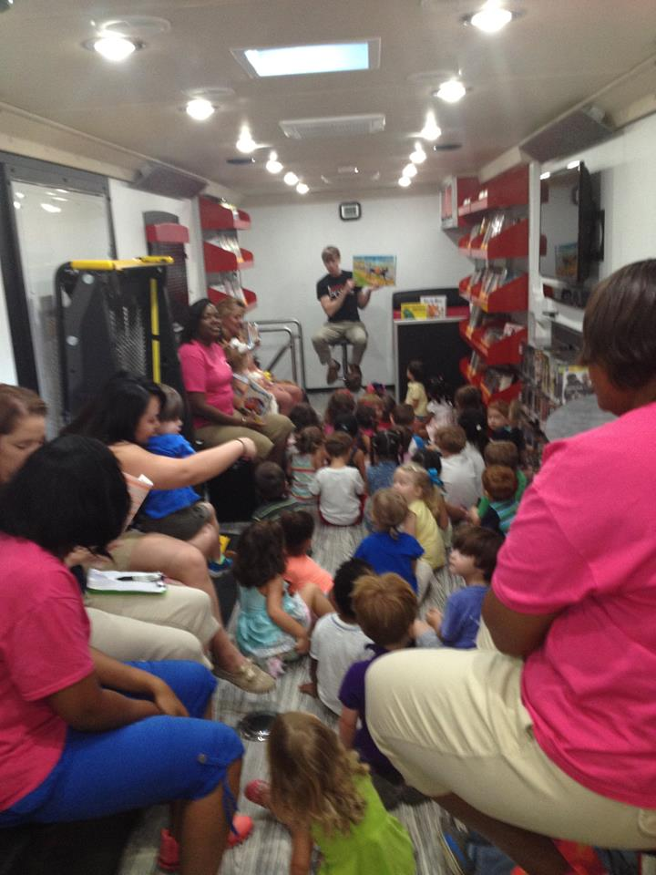
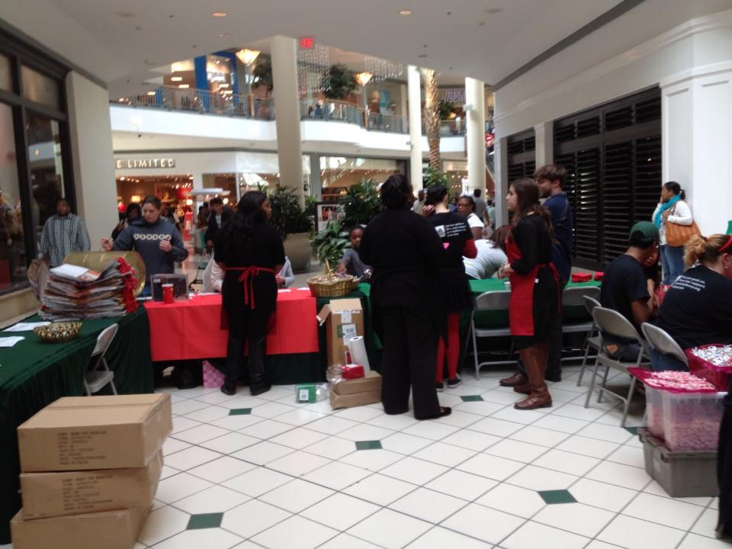
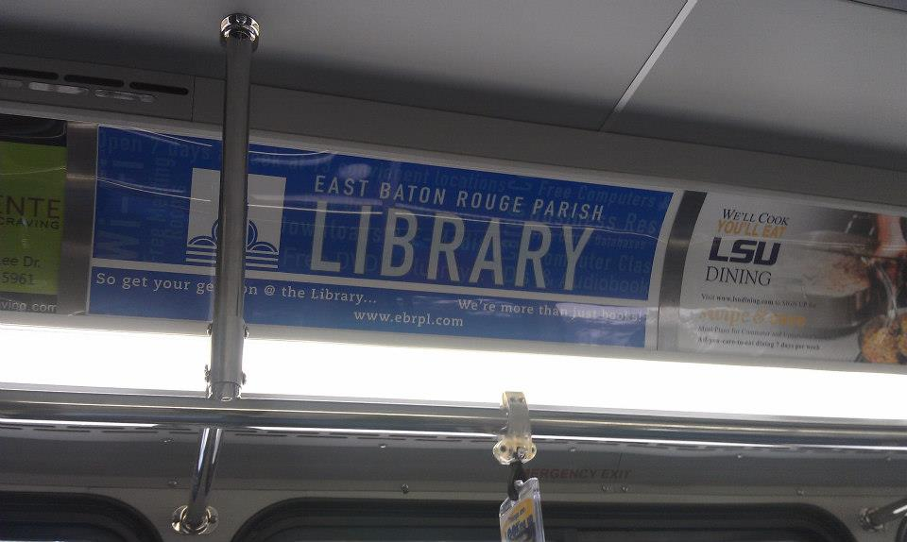
Leverage scalable advertising channels
Notes:
Conventional advertising mediums such as TV, radio and newspaper ads can be extremely costly and hard to measure effectiveness, but online advertising is cheaper and more targeted. Popular options are Google Pay Per Click ads and Facebook ads. Also, don’t forget free online directories like Google Business for Google Maps and Yelp. Libraries can also receive google ads for FREE!!
You also can promote your latest resources, book recommendations, hours of operation and services through these free or cost effective methods:
A telephone message that plays your promotions while patrons are on hold.
Window decals advertising your route or hours of operations.
Car magnets and bumper stickers displaying your logo while you drive around town.
Advertising on email signatures or letterheads.
Sending special holiday messages, and surprise rewards to your mailing list.

Slide 25
Capturing Media Attention!!
Notes:
Milk the Media
Getting your bookmobile featured by the media is free marketing.
To capture the attention of the media, BE BRAVE.
Try some of these ideas--and invite the media to come and cover it.
Create a publicity stunt. We had a flash mob, bronco bull riding event; ALS challenge, etc.
Do something for the community, and actually accept credit by sending out a press release or kit prior to the event. For example, our bookmobile has partnered with cosmetology schools to offer free haircuts to the homeless, and low income students/parents for school.
Sponsor an event by donating your bookmobile, library services, or resources, as giveaways or prizes….and you can even host a contest.
Nominate yourself for a business contest or award. If you win, even better!
You can also seek opportunities to be interviewed for print, radio and TV. To look for opportunities to contribute your expertise, sign up to an email list like Help A Reporter Out.
Related Book: Market Like You Mean It by Al Lautenslager

Slide 26
Social Media—hate the term, love the aps!
YouTube https://www.youtube.com/user/EBRPLibraryTV
Facebook hTtps://www.facebook.com/ebrpl/
Twitter EBRP Library (@ebrpl) · Twitter
Pinterest https://www.pinterest.com/ebrpl/
Instagram EBRP Library (@ebrpl) • Instagram photos and videos
Notes:
According to the Pew Research Center Report of Social Media Usage: 2005-2015, nearly two-thirds of American adults use social media.
Popular social media channels include Facebook, Twitter, Instagram, Pinterest, and Snapchat. Each of these social media platforms are unique in its own right and require unique ways of engagement.
Rather than try to master it all at once, choose a few you like and try to master those first. Your content matters!

Slide 27
THE LIBRARY
ROAD SHOW
The Source
30 minute Magazine style
Infomercial Plus
Library News
Notes:
Our two in-house, most expensive, but most easily identifiable methods for advertising, where WE control the message, everytime.

Slide 29
Sample Flyers
Print & Online

Slide 30
FREE 99
Notes:
THE FREEBIE
Everyone loves free gifts! Give away desirable or fun items to gain goodwill, build brand awareness and connect with potential customers.
They don’t need to be expensive.
Promote your bookmobile through social media—have meet n greets or pop up visits. Where’s Waldo?? Where on earth is Carmen Sandigo, scavenger hunt!
Incentives with your advertising on it such as pencils, balloons, bookmarks, popsockets, key chains, fridge magnets, cups, pens and notepads are always winners!
Audio Visual or viral marketing is where its at—people love dorky videos!

Slide 31
Making your Bookmobile
an Experience
Notes:
The Experience Economy
James Gilmore- customers don’t want
products or services, they want experiences.
The best organizations provide as many of
the 4 e’s as possible
– entertainment
– education
– escapism
– esthetics
Education and Entertainment are built-in offerings of libraries.
• Libraries must work on Esthetics and Escapism, because in many cases library facilities, equipment, and spaces do not offer these benefits.
• We can improve our esthetics:
– Think Trading Spaces- with $1000 you could:
• Clean- upholstered furniture
• Re-arrange furniture, create spaces • Improve look paint, lighting, art.
• Create attractive displays
Escapism
• Create an environment to linger and relax: (ask yourself- why do people go to B&N rather than come on the bookmobile?)
– Offer comfortable nooks
– Offer listening and viewing stations for videos, DVDs and CDs
– Have fun events around patron interests book signings, movie screenings,
– Consider allowing drinks in covered containers.
Entertainment: Disney
Escapism Sandals/Beaches Resorts, Carnival
Esthetics Apple
Education Barnes & Noble

Slide 32
Ostentatious, Obvious & Not So Obvious
Outreach Ideas
Notes:
EBR Outreach staff engages our community not only by promoting library resources and programs through local media outlets, but also by goodwill! If we only focused on media outlets, we would miss valuable opportunities.
Remember, there is no one right way to expand your outreach efforts. Therefore, what is right for you will probably be a mixture of ideas you gather over time and from various sources. Do what works for your library and community, and think outside of the box.
.
Obvious: Use your library Facebook and Twitter accounts on a regular basis to share information about library programs, classes, and resources. It is helpful to pay staff….
Not so Obvious: use interns and college students—but you will need to set criteria for posting—or see about small services that post for you.
Obvious: leave flyers in your meeting rooms when groups use them
Not so obvious: Require a staff member to attend. Attend one local civic group meeting each month to talk about the library and its programs (less or more frequently depending on the number of groups). These include, but are not limited to, Kiwanis, Lions, Jaycees, Chamber of Commerce, Business and Professional Women's (BPW), Rotary, garden clubs, historical society meetings, hobby clubs, churches, etc. Ostentatious: Think if you library Library Director, board members or staff were members of the some of the civic groups mentioned above to ensure the library is represented in those groups' planning efforts.—they could be your brand ambassadors.
Obvious: have computer classes
Not so obvious: offer to do onsite demos in lobbies that people are held captive in: SSI Office, DMV, WIC centers, Hospitals
Communicate regularly with school district employees and teachers to keep them abreast of library programs and to keep yourself informed about projects or assignments for which students will turn to you and your staff members.
Obvious: Create a virtual tour of your library on your website.Prepare a PowerPoint presentation that highlights your library's hours, programs, and services. Having it running on your units or in public spaces.
Not so Obvious: Make it available on the library website, and distributed on jump drives or CDS
Ostentations: Included in birth packets at your local hospitals, run it on Public Access TV, or included in packets prepared for prospective new businesses, or by realtors when they work with home buyers new to the community.
Ostentatious: Write a regular column in the local newspaper (monthly would be ideal, but less frequently also works if that is all the space the newspaper can provide). Ours was called “off the shelf” contained stats about the library; popular book titles, fun facts
Ostentatious: Work with your local cable access channel to produce a regular program on the library and library/information issues. This is a great opportunity to highlight programs or events (with video clips of past programs), recognize the contributions of staff and volunteers, interview local elected officials or library trustees about library-related issues, or highlight local experts about issues or topics that the library can help research (like genealogy, technology purchases, travel/vacations, auto repairs/purchases, gardening, music, home improvement, etc.). It could be something as simple as a book talk.
Ostentatious: Work with the local cable access or television/radio stations to produce regular Public Service Announcements (PSAs). These might be for specific observances (like Library Card Sign-Up Month) or library programs, or they might just be generic "support your library" messages.
Ostentatious: Prepare a "Welcome to the Library" packet for all new residents. This could be distributed by realtors, lending institutions, businesses/industries, churches, Chamber of Commerce, or Welcome Wagon. Prepare a packet that can be distributed to new parents. You can turn to "Books for Babies" from the Friends of Libraries USA (FOLUSA) -- http://www.ala.org/united/products_services/booksforbabies -- or create your own packet with local contributions.
Ostentatious: Use floats, booths, book cart drill teams, etc., to tie in with local "festivals" or other community observances (including county fairs). These are excellent opportunities to keep the library and its mission before the community.
Make sure the websites for local organizations, businesses, and government include a link to your library's website. Encourage them to highlight specific databases or services that may be of interest to users of their websites. This is a great way to make your library a direct resource to others with specific information needs.
Consider an electronic newsletter for your library. This can be either email or web based.

Slide 33
Budget Creatively!!!
Know when to splurge!
Less is More!
Notes:
Limited budget? Stop reinventing the Wheel, and get to Networking
– Local businesses and organizations donate or barter prizes and printing for newsletters, flyers, etc.
– Recruit interns for college credit-
Are you part of your school system….if its owned by the district, it may be avaialbe to you
– Have potluck brunches, etc.
-Scour the city auction sites, and prepare to put in a lot of work.
EBR’s bulk of the funding is provided by a 10 year, dedicated property tax.
Other ways to generate funds:
-grants
-gifts
-donations
-naming rights
--a special note about Fines may be a source of library revenue, but the policy of charging fines is the subject of debate concerning their effectiveness in encouraging the return of materials, and concerning their public relations effects. In establishing a fine policy, consider not only the possible revenue but also the potential negative public relations effects.

Slide 34
CHELSEA’S CAFÉ
Wednesday Night
6 p.m. – 8 p.m.
Free
Family Friendly
Fun
Notes:
One of the Library’s connections with CATS our public transit system, has garnered us pull with area lounges, hipster hangouts, and some hole in the walls. It is a unique experience to have a library bookmobile out at a daiquiri shop, but we registered well over 50 new library users, and were able to waive fines and bring people back to the library.
Yes, it does sometime impact us negatively.
Yes, it does cause staff to often work strange hours.
Yes, you do have to allow people to possibly bring alcohol on your unit—but Louisiana is a fun place, with interesting ideas for fun.

Slide 35
Score Big With Books!

Slide 36
ATTIC TREASURES

Slide 37
LOUISIANA
BOOK
FESTIVAL
Annual Partner

Slide 38
Mid-City Mini Micro-Con

Slide 39
CHRISTMAS AND PARADES
Season’s Readings

Slide 40
Celebrities, Authors, & Friends

Slide 41
Author Illustrator

Slide 42
One Book/One Community

Slide 43
Baton Rouge Blues Festival, Live After Five
Southern University & LSU Football Tailgate!!!

Slide 44
Flaunting cycle
Prepare
Test
Try-out
Report and Review
Crazy Idea

Slide 45
Flaunt, Flaunt, Flaunt take aways!
For the most bang for your buck:
Run 2-3 Large Scale events each year and make them yours!
Patrons recognize and look forward to them.
Live @ Chelsea’s & Live After Five
Mid-City MicroCon
Mini Maker Faire
Author Illustrator
One Book/One community
Attic Treasures
Book Festival (formerly Author Row)

